Slide 1
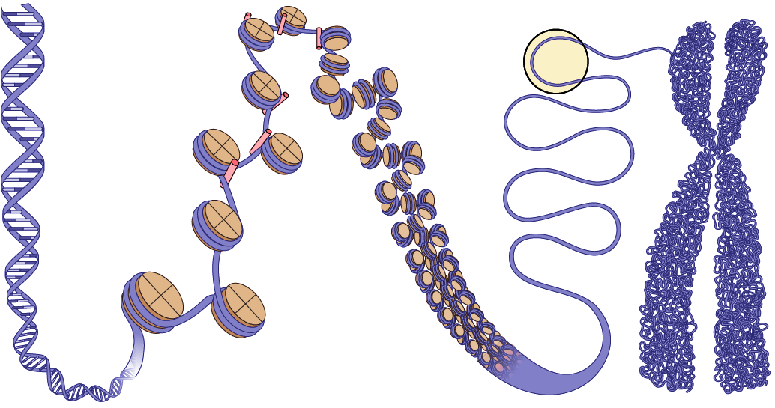
Agenda
12:00 – 1:00 pm | Joseph Costello, PhD Professor, Department of Neurological Surgery, University of California, San Francisco A master key to tumor cell immortality
1:00 – 1:20 pm | Jun Wang, PhD (Greg Wang, PhD) EZH2 non-canonically binds cMyc and p300 through a cryptic transactivation domain to mediate gene activation and promote oncogenesis
1:20 – 1:40 pm | Dhirendra Kumar, PhD (Systems Biology Group, Raja Jothi, PhD) Decoding the function of bivalent chromatin in development and cancer
1:40 – 2:00 pm | Break
2:00 – 2:20 pm | Jackson Peterson (Edward P. Browne, PhD and David M. Margolis, PhD) A histone deacetylase network regulates epigenetic reprogramming and viral silencing in HIV infected T cells
2:20 – 2:40 pm | Matt Regner (Hector Franco, PhD) Identification of cancer-specific enhancer elements at single-cell resolution
2:40 – 3:00 pm | Aleksandra Skrajna, PhD (Rob McGinty, PhD) Proteome-wide footprinting of nucleosome acidic patch binding at amino acid resolution
3:00 – 3:20 pm | Xijuan Liu, PhD (Albert Baldwin, PhD) A Role for Histone H3 Proline 16 Hydroxylation in Regulation of Mammalian Gene Expression
3:20 – 3:40 pm | Alexis Stutzman (Jill Dowen, PhD, and McKay, PhD) H3K9-mediated HP1 binding is required for heterochromatic genome architecture
3:40 – 4:00 pm | Caroline Fraser (Ian Davis, MD) Investigating the connection between EWS-FLI1 and PAX7 in chromatin state and oncogenesis in Ewing sarcoma
4:00 – 6:00 pm | Poster session and reception
5th Annual
Chromatin and Epigenetics Symposium
March 3rd, 2022
Invited Speakers
Joseph Costello, PhD, Professor, Department of Neurological Surgery, University of California, San Francisco
Joseph Costello is currently a Professor in the Department of Neurological Surgery and a Karen Osney Brownstein Endowed Chair in Molecular Neuro-Oncology at the University of California at San Francisco. He received his Ph.D. degree from Loyola University. He performed postdoctoral research at the Ludwig Institute for Cancer research in San Diego. His group is interested in the role of genetic and epigenetic alterations in the formation of sporadic cancers, including brain tumors.
Jointly sponsored by the Carolina Chromatin Consortium, Cancer Epigenetics Training Program, IBGS, and Lineberger Comprehensive Cancer Center.

