Slide 1
A Career in
Scientific Publishing
Ana Batista
Editor, Trends in Cancer
CellPress, Cambridge, MA
ITCMS Director's Career Symposium, May 2017

Slide 2
Is this the right way for me?
Career Path
Daily Routine
What does it take

Slide 3
Cell Press & Elsevier
Cell, Benjamin Lewin, 1974, MIT Press
Benjamin Lewin buys Cell – CellPress, 1986
Neuron, 1988; Immunity, 1994; Molecular Cell, 1997
Elsevier acquires CellPress, 1998
CellPress acquires Trends & Society Journals, 2007
1880, Netherlands. Over 130yrs in Publishing
Technology Information Company
> 7,000 employees in 20 countries

Slide 4
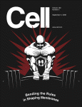
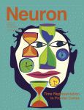
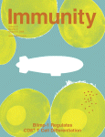
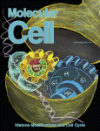
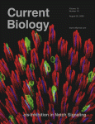
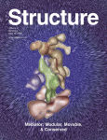
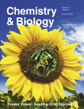
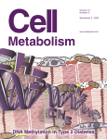
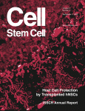
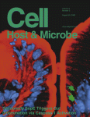
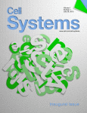
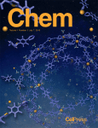
Cell Press Research Journals
Cell Press Research Journals
2012, OA
2015
2016
2017

Slide 5
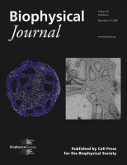
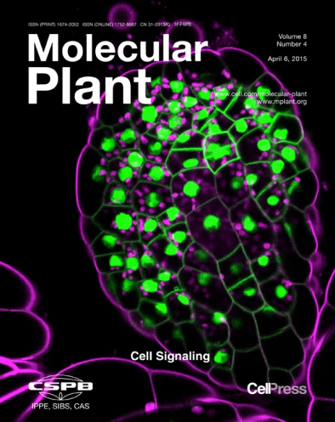
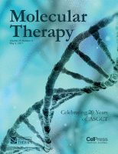
Society & Partner Journals

Slide 6
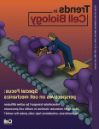
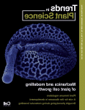
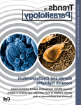
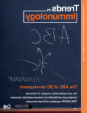
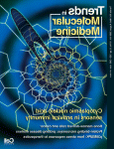
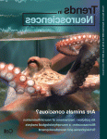
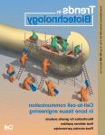
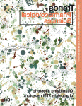
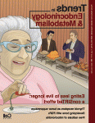
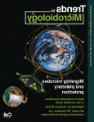
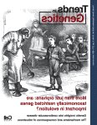
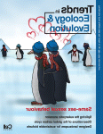
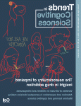
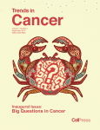
Trends Journals
Trends Journals
Fall 2015

Slide 7
Who does this?
>90 Scientific Editors
Editorial Support
Production Staff
Sales & Marketing
Who are these people?

Slide 8
My Background
BSc Biochemistry, Coimbra, Portugal
MSc Cellular Biology, Coimbra & UTSW
PhD Molecular Biology, Coimbra, DFCI & IUPUI
Post-doc, MGH
Since Aug 2015, Editor of Trends in Cancer

Slide 9
My Experience
10 yrs Translational Cancer Research
Clinical Trials & Industry Collaboration
Program Grants
Accelerator Business Training
I became an Editor because..
I have always been interested in science broadly
I love to read, think, write, and discuss about science

Slide 10
A Day in the Life of a Trends Editor
Editorial Strategy & Commission Articles (30%)
Select Reviewers & Handle Peer-Review (10%)
Developmental Editing (30%)
Email Correspondence (10%)
Other Editorial Duties (20%)

Slide 11
Other Editorial Duties
Attend Conferences, Local Seminar, Lab Visits
Manage Website, PR & Social Media
Journal Graphics (Covers)
Analyze Journal/Competitor Content & Performance
Organize Scientific Conferences
Work with Sales & Marketing
Managing other Editors
In-Company Projects

Slide 12
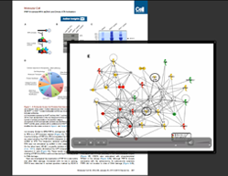
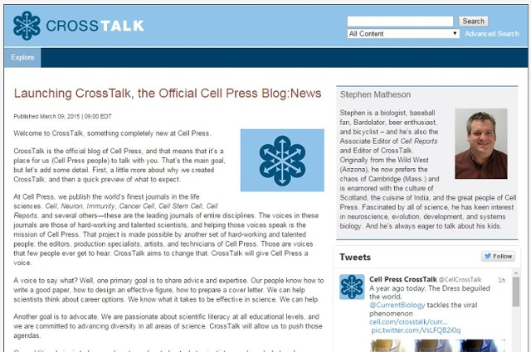
Publishing in a Digital 21st Century
Videos & Figure360

Slide 13
A Typical Day- Research Journal
Read new papers and related papers
Select reviewers
Evaluate revised papers, rebuttals/appeals
Make decisions on papers at different stages
Discuss papers & various issues with other editors
Discussions with authors, reviewers
Read other journals
Daily editorial meeting
Develop ideas for review articles
Conferences, lab-visits, local seminars

Slide 14
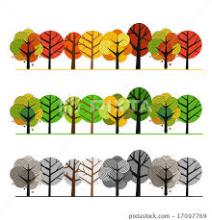
Research Journal vs Reviews
Sieving
Filtering the noise
Composing
Searching the interesting

Slide 15
Other Editorial Jobs
Editor for news material
Managing editor working with academic editors
Book commissioning & editing
Medical & technical writing
Freelance writing & journalism

Slide 16
What I like about my job
Exposure to a broad range of interesting science
Learning to see the “big picture”
Job is intellectually stimulating & challenging
Close interaction with scientific community
Travel opportunities
Flexible hours & location
Producing a tangible Journal that I am proud about

Slide 17
The not-so-good things
Exciting pace can be stressful
Workload is often high
High pressure (single editor team - it’s all on you!)
Having to say no

Slide 18
Editorial Career & Beyond
Move-up the Editorial Ladder
Move to Publishing/Business Role
Scientific Advisor/ Directing Research Programs
(academia, companies, science foundations)
Grant Administration
Science Communication Officer
(universities, companies)

Slide 19
With this Qualifications & Qualities
Strong training in life-sciences (PhD or Post-doc)
Broad interest in science
Think critically
Decisiveness, but able to revise your opinion
Express opinions clearly in writing
Diplomacy & people skills
Organization & ability to prioritize
Work to tight deadlines & multitasking
No editorial experience required
editing could be for you!

Slide 20
If you are interested in editing
Go to seminars, journal clubs, conferences
Read outside your field
Get involved in reviewing papers & write/review grants
Writing: try freelancing
Set up an informational interview
Consider an internship

Slide 21
Where to look for editorial jobs
Journal homepages
Cell, Nature, Science, PLoS, JEM, NJM, EMBO Press
Elsevier Careers, Nature & Science Jobs Page
Scientific Magazines (ex. News Scientist)
Job Sites (Indeed.com) & LinkedIn
Jobs advertised are real opportunities!
We do look at external CVs!

Slide 22
An advanced science degree & experience is a valuable asset
to a great fulfilling
non-academic career !
Questions?

