Slide 1
Careers in Pharmaceutical Regulatory Affairs
Kevin D. Healy, PHd, rac
Senior Director, global regulatory affairs
Roivant Sciences, Inc.
May 15, 2017

Slide 2
Overview
Career Path
Regulatory Affairs
Career Highlights

Slide 3
Careeer path

Slide 4
Strong scientific background laid foundation for success
Chenango Forks High School
Cornell University
B.S. Biological Sciences
University of Wisconsin-Madison
PhD Biochemistry
UNC - Chapel Hill
Postdoctoral Fellowship, LCCC

Slide 5
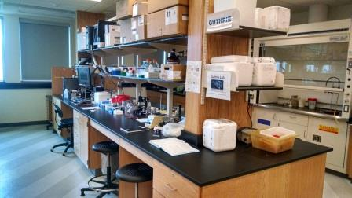
Transitioning to Industry
Academia to Industry
Bench to Desk

Slide 6
First Job in Industry
Clinical Scientist / Medical Writer
Regulatory Affairs and Strategic Drug Development Services (RA/SDDS)
~18 Months:
Lineberry Research Associates
Constella Group
SRA International

Slide 7
Contract Research Organizations
Support Pharmaceutical Companies
Discovery or Assay Development
Nonclinical studies
Clinical studies
Manufacturing
Regulatory & Medical Writing
Strategic consulting
Smaller clients
Outsourced labor force
Big pharma
Excellent entry to pharma & exposure to drug development
MAY 10, 2017 12:25 PM INC Research buys larger rival, boosts Triangle’s status
BY DAVID RANII
dranii@newsobserver.com

Slide 8
Next Opportunity: Gilead Sciences
Senior Associate, Regulatory Affairs
HCV Development Programs
HBV Development & Marketed Product Support

Slide 9
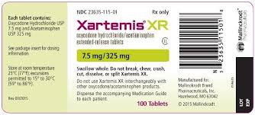
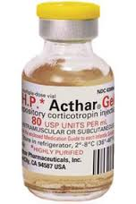
Mallinckrodt Pharmaceuticals
Senior Manager, RA
Associate Director, RA
Director, RA
Senior Director, RA
Pain Therapeutic Area
Autoimmune and Rare Diseases

Slide 10
Roivant Sciences
Senior Director, Global Regulatory Affairs
“Roivant Sciences is a global healthcare company focused on realizing the full value of promising biomedical research to improve the lives of patients and their families”
Successful Executive Team
Novel Approach
Growing Company

Slide 11
Regulatory affairs

Slide 13
Developing Regulatory strategy
Overall Objective:
Development: Rapid approval enabling access to broad patient popn
Post-Approval (Life-cycle mgmt): Compliance; Expand indication(s)
Developing Global Regulatory Strategy:
Knowledge of Regulations and Guidances
Requirements
Opportunities
Therapeutic area & Patient needs
Drug: Mechanism of action; Risks & benefits
Corporate objectives
Leverage Regulations and Current Environment

Slide 14
Executing Regulatory strategy
Build and maintain connections with global health authorities
FDA
EMA and European National Health Authorities
Health Canada
PMDA (Japan)
Other markets – Asia, Central / South America, Middle East…
Execution: Submissions to health authorities
Original INDs & CTAs
IND /CTA Amendments
Health Authority Meetings (eg, FDA, EMA, PMDA)
Registration applications: NDA, BLA, MAA
Annual Reports
Post-marketing: Life-cycle management and compliance

Slide 15
Typical Activities
Researching project, therapeutic area, and relevant precedent
Write summaries and create presentations
Planning health authority interactions (eg, meetings & submissions)
What / Why
Where / When
Who
Internal meetings: Lead, attend, plan & schedule
Communicating with co-workers and stakeholders
Team & Management
Health Authorities
Consultants
Submission work: Authoring, review, and operational

Slide 16
Skillset
Scientific Background
Interpretation and judgement
Communication skills
Listening
Talking
Presenting
Writing
Organizational skills
Enthusiasm

Slide 17
Career Highlights

Slide 18
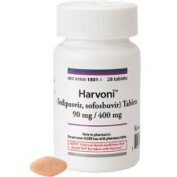
Gilead Sciences
Leading revolution in HCV Treatment
Direct-acting antivirals
48 to 12 week treatment
Dramatically improved efficacy and tolerability
Regulatory lead for GS-5885 (Ledipasvir)
Original IND (2010)
Harvoni (Ledipasvir/sofosbuvir) approved 2014
Gilead HCV franchise: $19B 2015; $14B 2016

Slide 19
Mallinckrodt Pharmaceuticals
Transitioning from generic / API company to Branded Pharmaceuticals
Regulatory lead: Pain Therapeutic Area
Top products in development
Submission and approval of 1st NDA
Meetings w/ European HAs
Due diligence and acquisitions
Regulatory Lead: Autoimmune & Rare Diseases

Slide 20
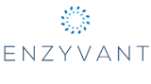
Roivant Sciences
Building world-class company & GRA Team
Regulatory lead: RVT-801 (Enzyvant)
Recombinant human acid ceramidase for Farber Disease
Rare Disease Day; Upcoming IND submission
Regulatory lead: RVT-802 (Enzyvant)
Cultured thymic tissue for transplantation into patients with Complete DiGeorge Anomaly
Collaboration with Duke; Upcoming BLA submission

Slide 21
Questions?

Slide 22
Director’s Career Symposium Breakout Sessions
Sessions begin at 3:30 pm
Ana Batista: LCCC 32-001
Kevin Healy: LCCC 22-001
Lesley Griner: Pagano Conf. Room

