Slide 1
From postdoc to first academic position
Dr. Jill Dowen
Dr. Erin Shanle
May 16, 2016
Steps
Finding positions
Application materials
The interview
Making a decision

Slide 2
Finding academic research positions
Career page of Cell, Science and Nature websites
Letter solicitations
Reasonable fit with job description
Medical School, Undergraduate
Be organized
Spreadsheet of schools, deadlines, materials, letters sent

Slide 3
Application materials
Cover Letter (specific)
Curriculum vitae
Research Statement (2 page or 4 page)
Teaching Statement (1 page)
References (3 or 4)
Start early (leave enough time to completely redo)
I applied to 28 positions

Slide 4
The interview
One-on-one meetings
Notes about each person so that you can ask questions.
Be enthusiastic (every 30 minutes of the day)
Science, trainees, events, requirements for tenure
50 min seminar
Several practice talks (leave enough time to completely redo)
Big picture, impact

Slide 5
The interview
Lunches, Dinners
Enjoy yourself, be personable
Discuss living in the town
Speak up about special needs
Have a 30 second and 5 minute version answer to “what do you do?”
Handshake, appropriate attire
I had 8 interviews

Slide 6
How to make a decision
Do a 2nd visit (lab space, meetings, housing, partner/family). I had two 2nd visits.
Negotiation
Calculate your start up needs
Is there big equipment you need (over $50K)?
Understand expectations, tenure requirements
Environment, support, fit, colleagues, success

Slide 7
Considerations for the job search
What do you want to do? (Teaching/Research/Service)
Timing
Cover letter
CV
Research statement
Teaching statement/philosophy
Diversity statement

Slide 8
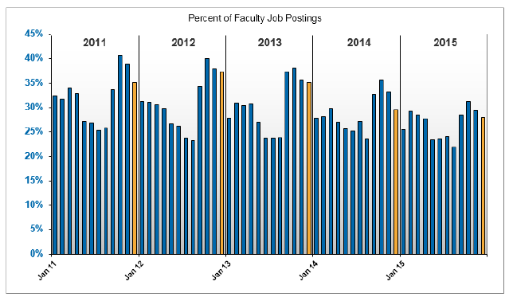
Timing for applying for faculty positions
Postings peak in September for the following academic year
Have materials ready by the end of July
Top schools post early and for shorter periods of time (sometimes just 30 days)
Job postings:
Word of mouth
Higheredjobs.com
Indeed.com
Chronicle of higher education
Source: Higher Ed Jobs 2015 Q15 higher education employment report
Hint: Sign up for email alerts or take a look at job postings now to see what is required to get the jobs you like

Slide 9
Considerations for applying to PUIs
Emphasize experience working with students in the lab/classroom
Do your research on the institution
Make sure research statement clearly outlines feasibility, fundability, and impact
Teaching statements are almost always required
Diversity statements are becoming common

Slide 10
The interview process
Phone interviews (sometimes questions are provided)
Why did you apply to this institution?
What unique approaches have you used in the classroom?
What classes would you like to teach and/or develop at our institution?
How would you teach a difficult concept to a large classroom?
How will you contribute to the missions of the department, college and university?
How will you integrate undergraduates in your research?
What challenges do you expect to face in this position?
What equipment will you need to start your research?

Slide 11
The campus interview
Research talk
Use this as an opportunity to show how you can communicate complicated ideas clearly to a broad audience
Discuss what you will do and how you will do it
Teaching demonstration
May be part of current course or not
Topic is decided ahead of time (25 min, “Control of gene expression”, for sophomore/junior level with understanding of central dogma)
Meetings with faculty, chair, provost, dean
You interview them and they interview you

Slide 12
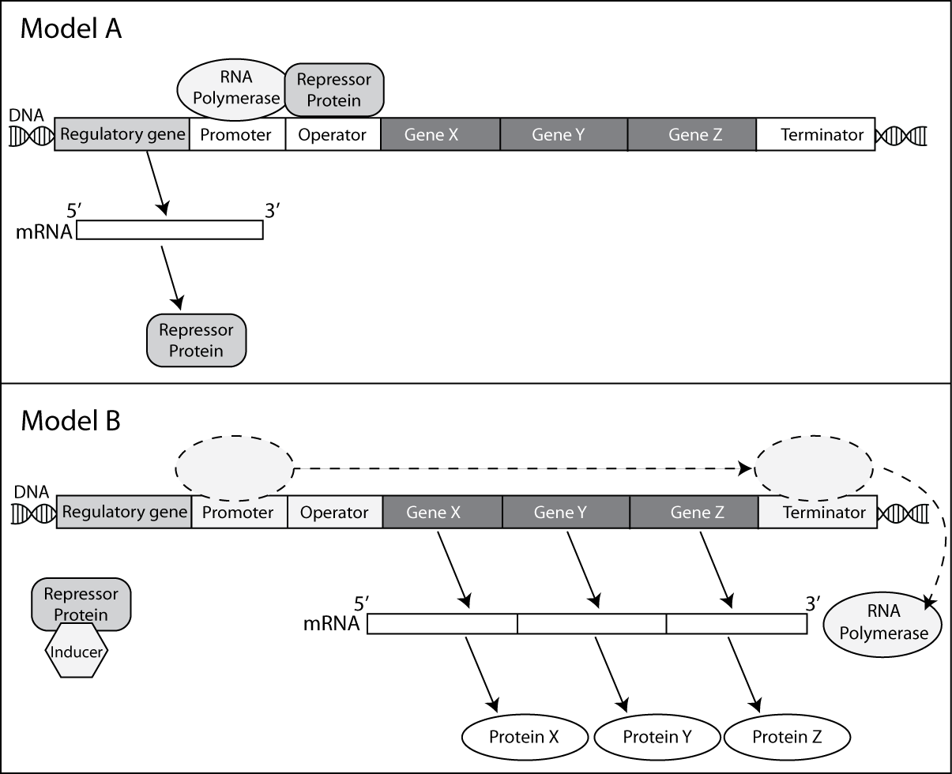
Example: Dissecting the components of a prokaryotic operon

Slide 13
Questions?
Email: shanle@live.unc.edu
Resources:
http://www.sciencemag.org/careers/2013/11/career-college-science-teacher
http://www.ascb.org/wp-content/uploads/2015/12/How-to-get-a-teaching-job.pdf

