Slide 1
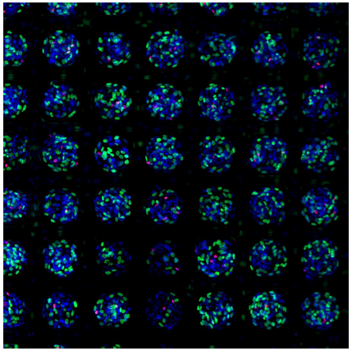
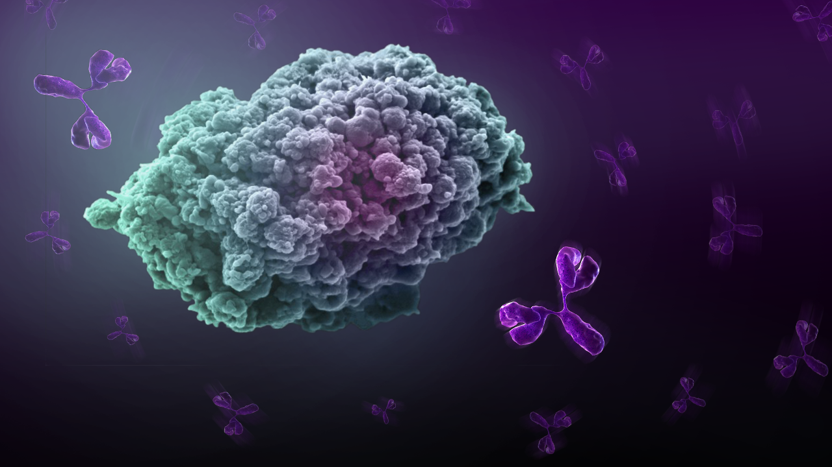
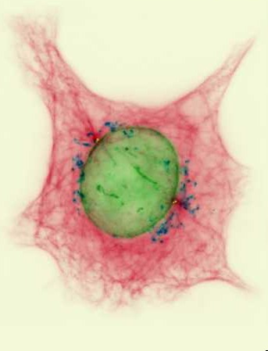
Medicine hunting for new cancer drugs
UNC Visit
UNC Integrated Cancer Program
Postdoc Career Day
Lesley Griner, Ph.D.
May 15, 2017
Notes:
Good morning and thank you for the invitation to speak today. I would like to thank AAAS for organizing this awesome event and your school and teachers for hosting it. I am going to share a bit of my story with you as to how I became a scientist and then how we hunt for new medicine to treat the disease of cancer at my company called Novartis.

Slide 2
Agenda
Introduction to myself and Novartis
Background on profiling/screening in high throughput plate based systems
Establishing a drug combination screening platform at NCATS
Examples of 3D models in Oncology Drug Discovery
Final thoughts on working in industry

Slide 3
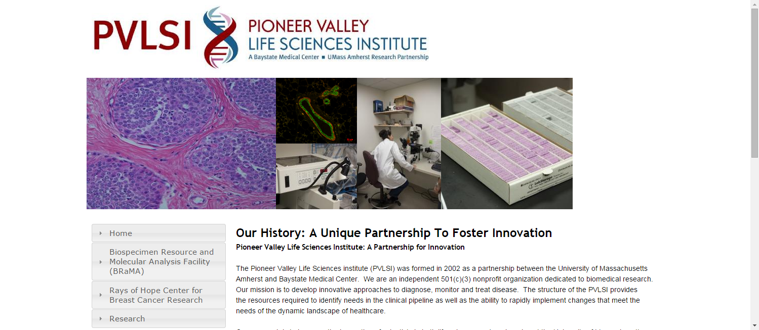
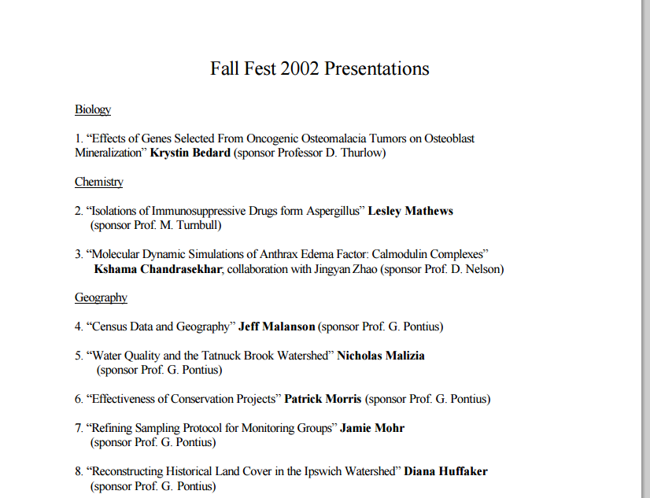
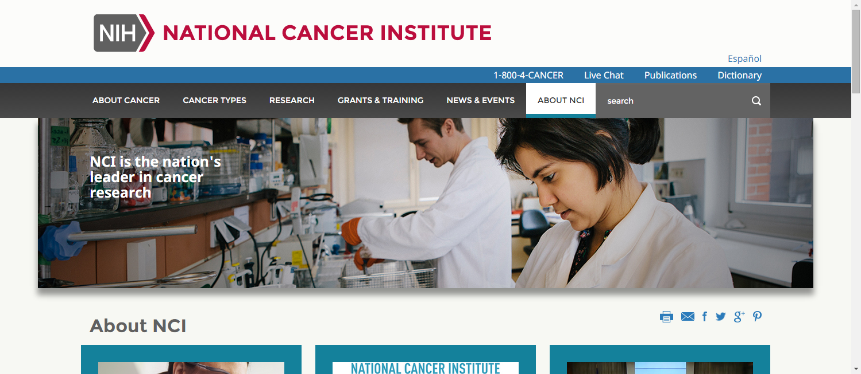

How did I get here?
My path...the journey continues
Notes:
So when I was little I was always reading books about leaves and asking questions like why are leaves green in the summer and then orange and brown in the fall? My mom would say because that is how it is, but that was never good enough for me! So throughout middle and high school I took an interest in science classes, from taking apart my hair dryer for a how it works class to understanding genetics in a plant AP biology lab. I naturally entered college at Clark as premed then but found that after doing internships at hospitals and labs research was more suited for me. You can see by my first research poster here at a Clark science day. I then went on to pursue my PhD in Molecular Biology at Umass Amherst studying breast cancer and continued that in my postdoctoral research into my career studying how to target cancer genes by designing small molecules to disrupt them.

Slide 4
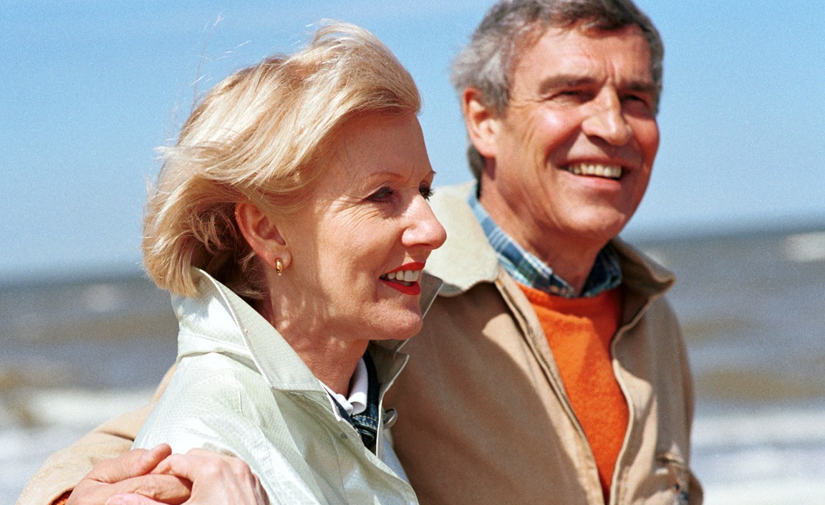


Our mission is to discover new ways to improve and extend peoples lives
We use science-based innovation to address some of society's most challenging healthcare issues
We discover and develop breakthrough treatments and find new ways to deliver them to as many people as possible
We provide a shareholder return that reflects outstanding performance and adequately rewards those who invest ideas and work in our company
Notes:
WHY WE DO WHAT WE DO:
Novartis success is founded on a vision of caring and curing for patients through breakthrough innovation, sound financial performance and a strong commitment to ethics.
Through our vision and commitment to patients, Novartis is well positioned to lead the industry over the next 10 years and more by answering unmet health needs of patients around the globe.
Slide Transition:
Focus on first part of mission – about helping patients
Ask before revealing the second part what they think it might be. Emphasize that profit is necessary in order to meet the first part of our mission – about patients. Also, that we are a performance based company.

Slide 5
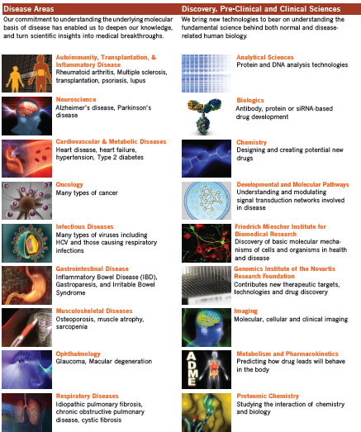
Diverse research programs across many disease areas
Autoimmunity, Transplantation, & Inflammatory Disease (ATI)
Infectious Diseases (ID)
Neuroscience (NS)
Musculoskeletal Diseases (MSD)
Cardiovascular & Metabolic Diseases (CVM)
Ophthalmology (OPH)
Oncology (ONC)
Exploratory Immuno-Oncology (IO)
Respiratory Diseases (RD)
Notes:
Autoimmunity, Transplantation, & Inflammatory Disease (ATI)
Rheumatoid arthritis, Multiple sclerosis, transplantation, psoriasis, lupus
Neuroscience (NS)
Alzheimer’s disease, Parkinson’s disease
Cardiovascular & Metabolic Diseases (CVM)
Heart disease, heart failure, hypertension, Type 2 diabetes
Oncology (ONC)
Many types of cancer
Infectious Diseases (ID)
Many types of viruses including HCV and those causing respiratory infections
Gastrointestinal Disease (GI)
Inflammatory Bowel Disease (IBD), Gastroparesis, and Irritable Bowel Syndrome
Musculoskeletal Diseases (MSD)
Osteoporosis, muscle atrophy, sacropenia
Ophthalmology (OPH)
Glaucoma, Macular degeneration
Respiratory Diseases (RD)
Idiopathic pulmonary fibrosis, chronic obstructive pulmonary disease, cystic fibrosis

Slide 6
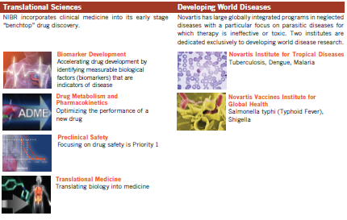

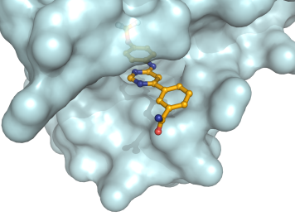
Diverse scientific disciplines are essential to our research at NIBR
CBT
Biologics
Translational Medicine
Global
Discovery Chemistry
Supporting Sciences
Preclinical Safety
Proteomic Chemistry
Analytical Sciences & Imaging
Drug Metabolism & Pharmacokinetics

Slide 7


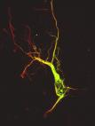
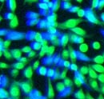

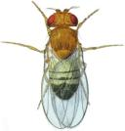

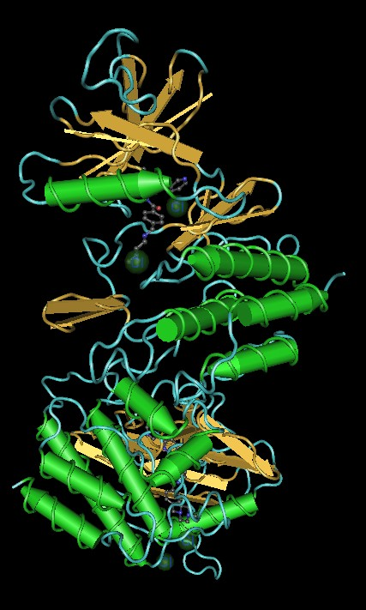
What can be assayed?
10/day
1000/day
10,000/day
100,000/day
Speed of screening
Complexity
Volume
500,000+ samples/day
Notes:
At Novartis and in many other companies we do this large volume and with assays we called screens where we can do almost 100,000 experiments in one day.

Slide 8
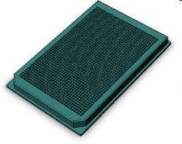
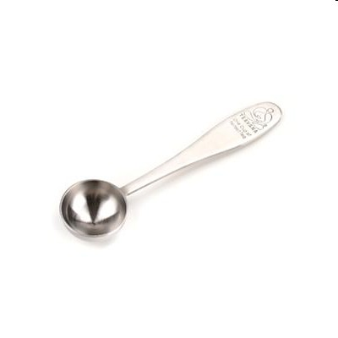
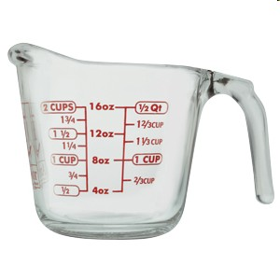
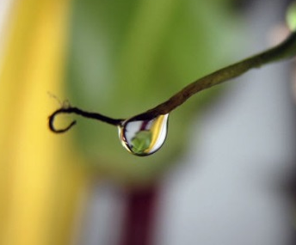
To test many samples, very small volumes are used
1 well in a
1536 well plate
5 uL
1/10 raindrop
=
1 cup
1 teaspoon
~1/50 cup
1 raindrop
1/100 teaspoon
50 uL
5 mL
225 mL
Notes:
This allows us to test things in very small volumes in small micowell plates. We can test things in multi-well dishing ranging from 6-wells all the way to up to 384 or 1536 samples at a time.

Slide 9
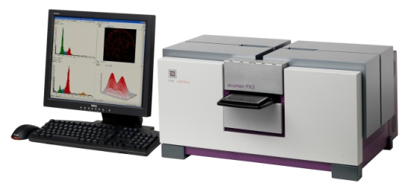
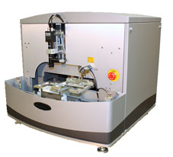
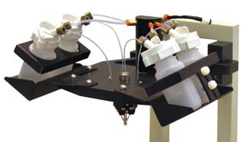
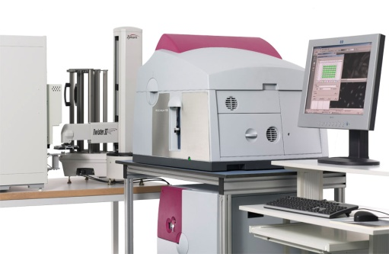
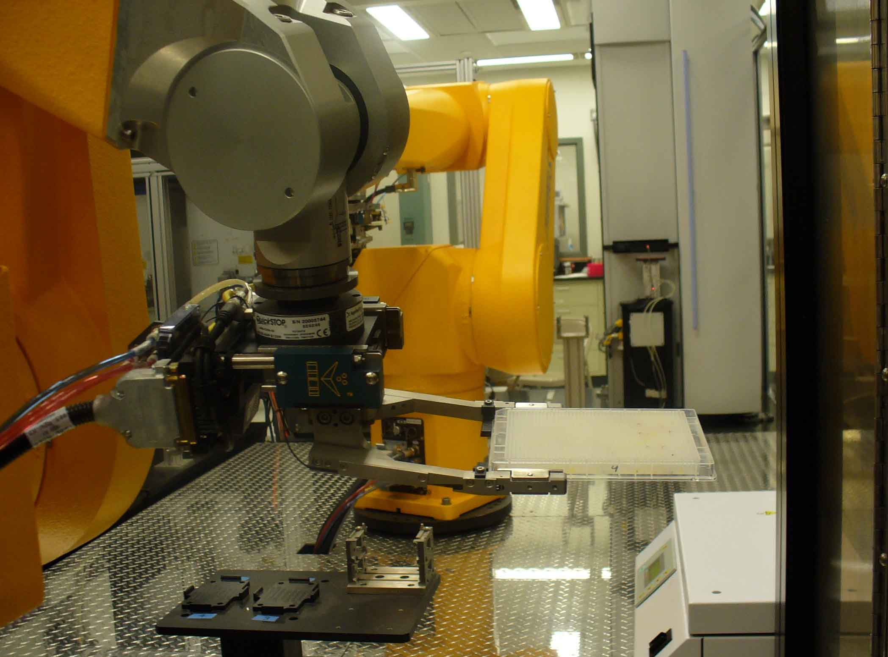
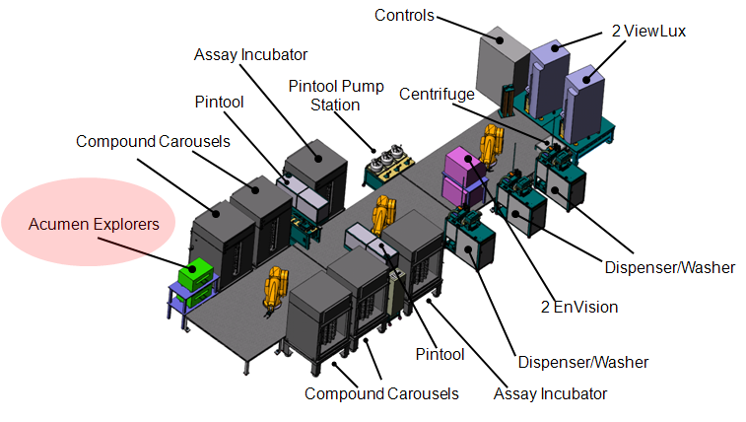
Specialized equipment to do well based SAR
Acoustic dispensers to
transfer compounds
Reagent dispensers
Detectors to read plates
Automation to handle large screens

Slide 10
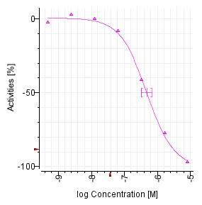
Implementation of High Throuhgput Dose Response Curves for Cancer Research
Compounds are assayed at multiple concentrations to generate titration-response curves.
Source library plated at 10 or more concentrations.
Assay volumes 2-8 uL in 1536-well plate format, 20-50 uL in 384.
Automated dispensing.
Informatics pipeline for data processing, curve fitting & classification, and extraction of SAR.
Compound concentration
Proc. Natl. Acad. Sci. USA 103, 11473-8 (2006).
JALA, 2008 Apr;13(2):79-89.

Slide 11
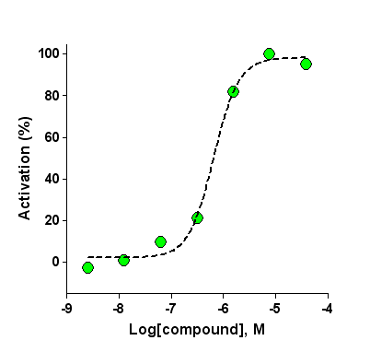
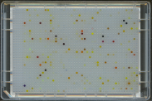
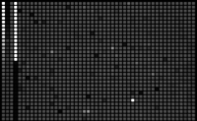


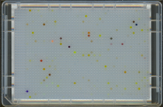
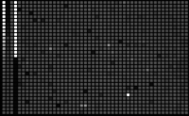

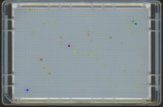
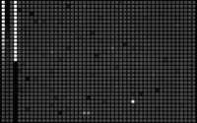

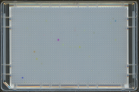
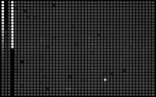

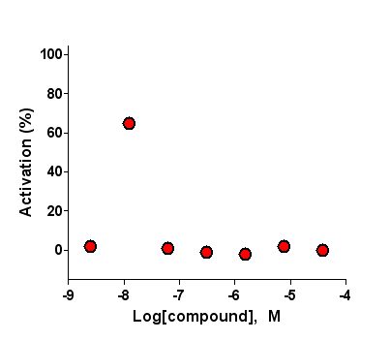
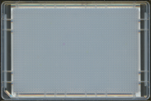
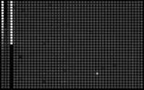

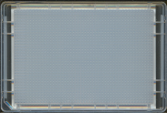



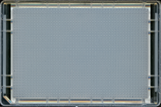


What does this look like in high throughput?
Compound library plates, concentration series (photograph)
Assay plates, concentration series (CCD image)
JALA, 2008 Apr;13(2):79-89.

Slide 12
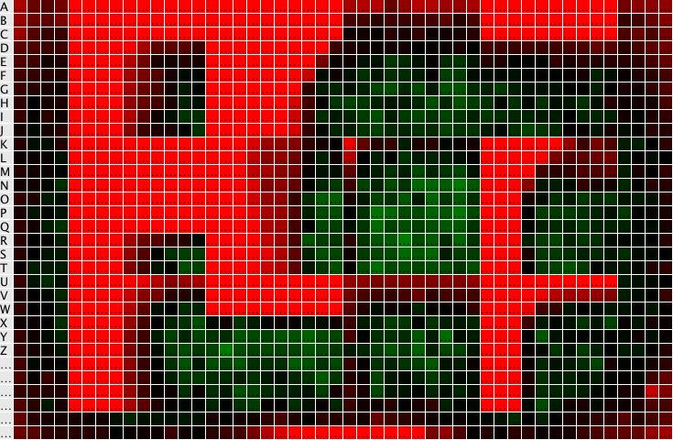
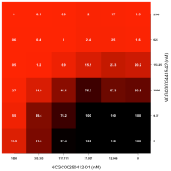
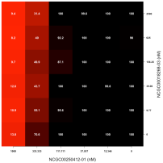
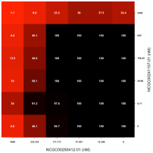
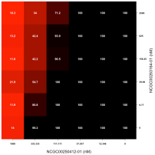
Creating a technology platform for the discovery of novel drug combinations
Putting the Platform together…
● Needed: 1) a high-value library of small molecules.
2) an effective plating process.
3) an automated data analysis method.
Step 3: Expand good combinations to 10X10 blocks to confirm synergistic combinations and perform self-crosses to provide context for activities.
Step 2: Generate 6X6 matrix data to uncover potential synergies.
Step 1: Generate single agent results.

Slide 13
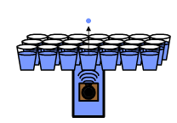
● Needed: 1) a high-value library of small molecules.
2) an effective plating process.
3) an automated data analysis method.
Dose Matrix
12
6.0
Cmpd B (uM)
3.0
0
32
16
8.0
0
Cmpd A (uM)
The EDC acoustic dispenser is ideal for an application like this

Slide 14
Analysis of Multiple Dose Response Compound Matrices

Slide 15
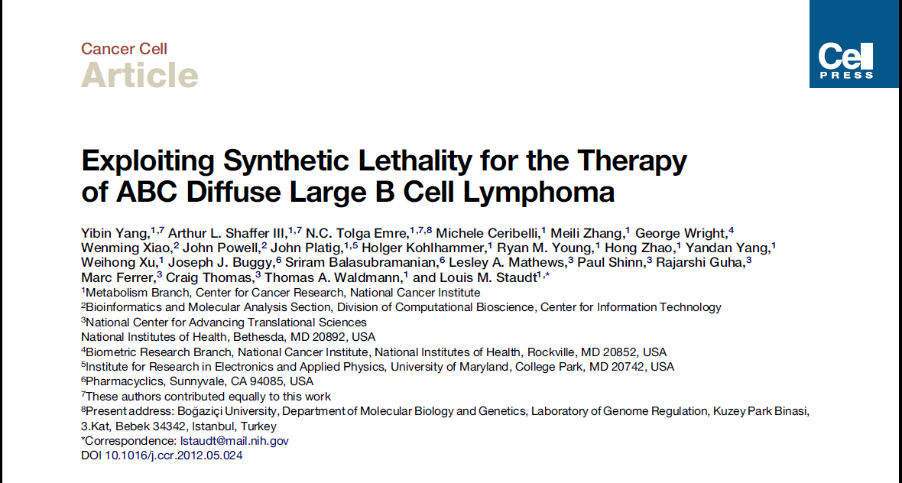
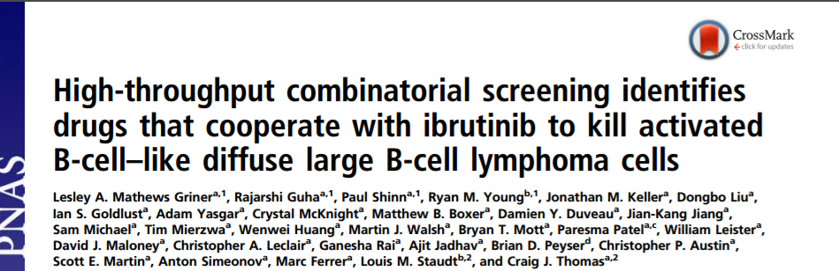
New combinations for DLBCL unveiled

Slide 16
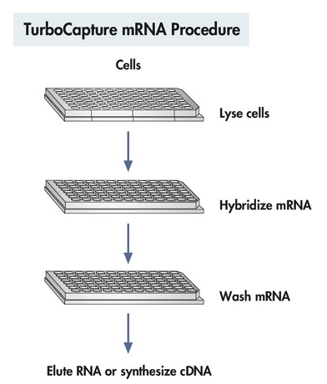
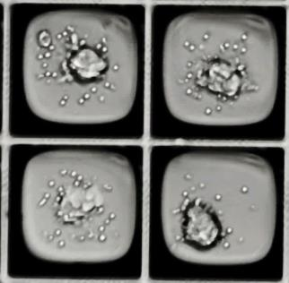
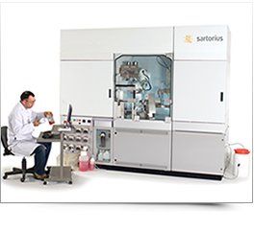


Target centric phenotypic assays: in vitro assays to address complex pharmacology questions
Selection of both assays and models are critical to success of novel targets
HT qRT-PCR
3D models/Co-cultures
Automated Cell Culture
High content imaging
Targeted combinations

Slide 17
Object level information much more informative than whole well reads but with more complexity
  Compared to plate reader based endpoint options
Cell Titer Glo or ATP-Lite
Cytotoxic
vs Cytostatic
Cell
count
Nuclear
Stain
Click-IT
EdU/pH3
Cell Intensity
and area
Histogram for
Pseudo Cell Cycle
Apoptosis
Mitochondrial damage
True Cell Cycle Arrest (FACS)
NucView
Cell Event
iQue kits
Mechanisms of
cell death
Specific PD Markers
Intensity Based IF

Slide 18
Targeting the MAPK Pathway in Cancer
Effective treatment for RAS^{mut} tumors remains a challenge
MAPK pathway is frequently altered
in human cancers
RTK(s)
RAS mutations
90% pancreatic
40% colorectal
25% lung
25% melanoma
BRAF mutations
50% melanoma
15% colorectal
RAS^{mut}
CRAF
BRAF
RAS^{mut} cancers remain a high unmet medical need: BRAF inhibitors induce paradoxical activation and promote tumor growth in RAS^{mut} context; clinical efficacy of MEK inhibitors is limited by on-target toxicities
Better therapeutic agents targeting RAS^{mut} tumors are needed
MEK1/2
ERK1/2
Proliferation & Survival

Slide 19

The paradox of drugging RAF in KRASmut cells
Many RAF inhibitors induce paradoxical activation
ATP competitive inhibitors of BRAF such as vemurafenib (PLX4032) have shown significant antitumor activity in the clinic for treatment of metastatic melanomas harboring the BRAF^{V600E} mutation
However, in BRAF^{WT} cells, most ATP-competitive BRAF inhibitors paradoxically activate the MAPK pathway by inducing dimerization of BRAF with CRAF in a RAS-GTP-dependent manner.
Hatzivassiliou et al., 2010

Slide 20


Can anchorage independent cell culture offer advantages vs 2D?
3D assay is more sensitive in detection of paradoxical activation
3D assay detects induction of proliferation in KRAS^{mut} cells by compounds that induce paradoxical activation
Type 1.5 RAFi in cells
pMEK & proliferation in 2D assay
2D Proliferation
2D pMEK
Paradoxical
Activation
Relative to DMSO
Conc [μM]
Cell proliferation in 3D assay (SCIVAX)
3D Proliferation
Paradoxical
Activation
Relative to DMSO
Conc [μM]

Slide 21






Many commercial options for 3D/anchorage independent cell culture
Selection may depend on endpoint assay and cell type
Hanging Droplets
In Sphero
Nanoculture plates
Scivax
Magnetic
Bioprinting
n3D Bio
Round bottom
ULA plates-Corning/Greiner
Micro-well plates
Elplasia
Embedded
Matrigel

Slide 22

Anchorage independent cells show improved sensitivity to MAPK pathway inhibitors with a larger dynamic range
3D proliferation IC₅₀ [μM]
2D proliferation IC₅₀ [μM]
Improved range allows for more robust hit selection

Slide 23

Growth inhibition in 3D also correlates better to on target inhibition of the pathway
2-D plastic
3-D Scivax
Improved correlation between
pMEK and 3D Cell Proliferation
Does this trend hold true for other RAS mutant cell lines?

Slide 24
Workflow for a 3D 1536-CP assay
8-point DRC using a chemically defined serum-free and growth media
Addition of compounds
A)
2-D Monolayer culture
5 days
Cell Seeding into assay plates
24 hours
Growth media + FBS
CTG
Addition of compounds
B)
3-D spheres
Seeding into assay plates
3 days
5 days
CTG
SCM+KO+ITS
SCM+KO+ITS
J Biomol Screen. 2012 Oct;17(9):1231-42. Epub 2012 Aug 27.
A 1536-well quantitative high-throughput screen to identify compounds targeting cancer stem cells.
Mathews LA¹, Keller JM, Goodwin BL, Guha R, Shinn P, Mull R, Thomas CJ, de Kluyver RL, Sayers TJ, Ferrer M.
What cell lines should we profile?

Slide 25

Spheroid Method of Culturing Cells
J Biomol Screen. 2012 Oct;17(9):1231-42. Epub 2012 Aug 27.
Mathews LA¹ et al.

Slide 26



Snapshot of varying spheroid morphologies
Morphologies and responses are highly dependent on cell line
Loose Aggregates
Tight Spheres
Spheres with
spindle phenotype
Large Scale Pharmacological Profiling of 3D Tumor Models of Cancer Cells
Mathews Griner, Cell Death and Disease, September 20, 2016
Notes:
Now these experiments were conducted with one line in Calu6. For the ONC7CRK program we wanted to know is 3D really needed for sensitivity and correlation with PD? Would be able to conduct our work just fine in 2D? We began to investigate this by testing a number of different RAS mutant lines in 3D whether it be K-N or even HRAS as well as BRAF mutant cells. We tested their morphology and growth characteristics in normal media and in defined media and in different types of 3D plates/vendors. What we found was surprising...

Slide 27



























2-D 3-D
2-D 3-D
2-D 3-D
2-D 3-D
2-D 3-D
2-D 3-D
2-D 3-D
2-D 3-D
2-D 3-D
2-D 3-D
2-D 3-D
2-D 3-D
2-D 3-D
2-D 3-D
2-D 3-D
Various Morphologies

Slide 28

Focused inhibitor screen in 1536
Subset of cell lines demonstrate a distinct sensitivity to
compounds when grown in 3D
3-D_Qualified Absolute IC50
2-D_Qualified Absolute IC50

Slide 29

Paradoxical Activation observed in 1536- well plates
Subset of cell lines demonstrate a distinct sensitivity to compounds when grown in 3D
2D: Red
3D: Blue

Slide 30

Gene expression changes in 2D and 3D will help us understand substantial changes in these models
Decreasing in 3D
Increasing in 3D
p-value
2D vs 3D DMSO control

Slide 31






Teamwork is central
Biologists
Engineers
Chemists
Human Resources Staff
Operations Staff
Informatics
Scientists

Slide 32
What is the path to a career in industry ?
Excel in science
  Publish: Not always about quantity-Quality and impact!
  Present: Whenever possible take the opportunity to share your science.
  Write: Even in industry we write! Communicate data to large teams or to the agencies like the FDA
Cultivate a passion for science and learning
  Be curious: ask ‘How’ and ‘Why’ questions
Learn to play well with others as everything we do is in a matrix environment

Slide 33



My own journey with personalized medicine
In 2007 I had back injury while lifting in the lab
Single Nucleotide Polymorphism (SNP)
C677T mutation

Slide 34
Acknowledgements
NCATS/NIH Novartis
Marc Ferrer Serena Silver
Craig Thomas Kalyani Gampa
Xiaohu Zhang Fei Feng
Combination MAPK Teams
Screening Team

