Slide 1
Writing and Holding an IND- IIT Development Week 3- Proposing and Conducting a Clinical Trial
J. Kaitlin Morrison, PhD
Director of UNC Lineberger Sponsored Clinical Research
Assistant Professor of Medicine- Hematology
Kaitlin_Morrison@med.unc.edu

Slide 2
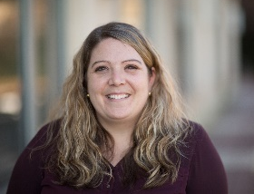
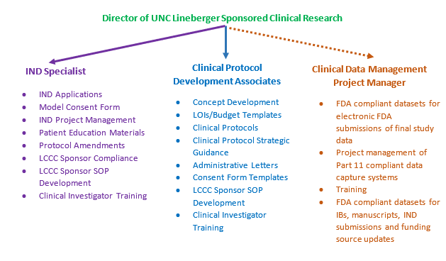
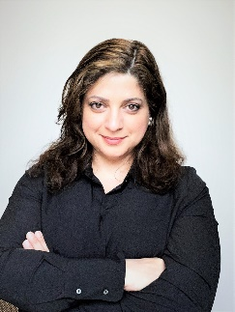
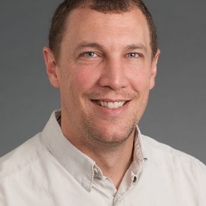
Who is There to Help me? The Office of UNC Lineberger Sponsored Clinical Research
We can help you:
Figure out what regulations apply to your study
Submit to the FDA on your behalf (IND & IDE templates)
Submit an IND/IDE exemption determination to the PRC (SOP and WI-31)
Make sure that your study team has the right information
Draft appropriate protocol, ICF & patient education materials
Lead protocol and correlative review meetings (SOP and WI-31)
Facilitate the transition of your study from the bench to the clinic
Help you find LCCC sources to enable clinical development
Interact with the Institutional COI Board
Train you on your responsibilities

Slide 3
Pre-Clinical Data OR Previous Human Experience
Secured Investigational Product OR Manufacturing Validation
Develop Protocol
Funding Source Review
(If externally funded)
Final Draft Protocol Approved!
Protocol Review Meeting
ICF Development
PRC Review
FDA Review
(if applicable)
Hard Stop Until Secure Funding*
Opening the UNC Site
(IRB, IBC (if applicable), Beacon Build, Contract (if applicable), Budget, OnCore Build, etc.)
Opening Multicenter Sites
(if applicable)
*Previous steps may only occur if trying to secure funding from a grant

Slide 4
Clinical Protocol Development
Templates
Advice from FDA
Teleconferences
Guidances
Regulatory Strategy from Other Similar Products
Operational Successes and Failures on Other Trials
LCCC Resources

Slide 5
Pre-Clinical Data OR Previous Human Experience
Secured Investigational Product OR Manufacturing Validation
Develop Protocol
Funding Source Review
(If externally funded)
Final Draft Protocol Approved!
Protocol Review Meeting
ICF Development
PRC Review
FDA Review
(if applicable)
Hard Stop Until Secure Funding*
Opening the UNC Site
(IRB, IBC (if applicable), Beacon Build, Contract (if applicable), Budget, OnCore Build, etc.)
Opening Multicenter Sites
(if applicable)
*Previous steps may only occur if trying to secure funding from a grant

Slide 6
Informed Consent Form Development
Essential Elements of a consent Form | Description
Research Description | A statement that is the therapy uses id NOT FDA approved and is Investigational. The statement must include that participation in the trial is voluntary
Summary of the Research | Purpose | Duration | List of Procedures | Accrual Goal
 | Why is this research done? | What is the expected duration of participation How long will treatment last How long will Follow up be | What procedure/tests are to be done. What is done for research only What is done as part of routine care | How many subjects will be enrolled and locations (if applicable)
Foreseeable risks/discomforts | Not limited to known side effects of the investigational product, but also should mention that other unpredictable risks are possible. Must also include risks of procedures, tests as well as risks to embryo, fetus, lactating babies, and partners (pregnancy)
Foreseeable benefits | Will depend on the therapy. But it should be limited to disease management (at best) but not guaranteed. The overall benefit is to expand R &D for therapeutics
Information/confidentiality Protection | A consent is like a business contract, so must describe the extent of confidentiality of identifiable records, HIPPA
Alternative Treatments | If there are known alternatives that might be advantageous to a subject, MUST be listed in the consent. Remember, participation is voluntary.
Compensation | Costs |  | Incentives
 | Out of pocket cost for participation, and what will be free |  | It is legal to pay a subject (parking, travel, food, hotel), but there are rules and limits
Contact | Whom to contact within the study team |  | Whom to contact for subject rights
 | Principal Investigator |  | IRB contact information
Protection of Subject Rights | A statement about protecting subject’s right in case of an injury
Sharing of Information | New Finding |  | Future Finding
 | Sharing any new finding that may impact willingness to continue participation |  | Sharing of future results is not necessary (it takes time)
Biospeciment use/storage | collection for research |  | Storage for future research
 | Describe what is being collected and for what type of research |  | Describe what is being stored, length of storage
Attestation | Individual | LAR | Parent/Legal Guardian
 | Depending on the risk level of the trial, signature requirements will vary per regulations.
Readable
Understandable
8th Grade Reading Level
Not overselling OR coercing

Slide 7
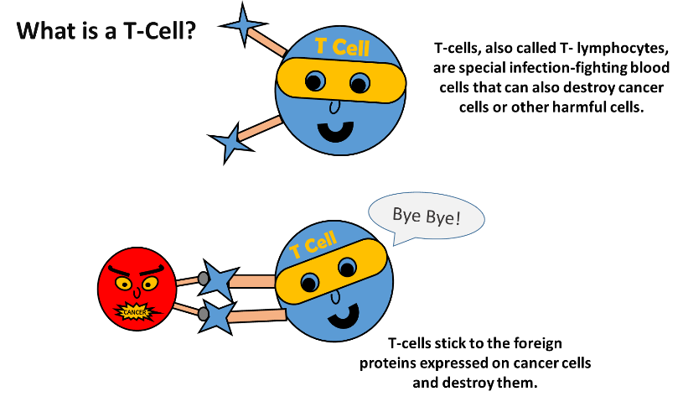
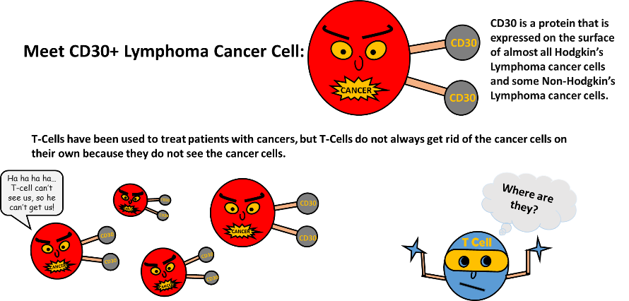
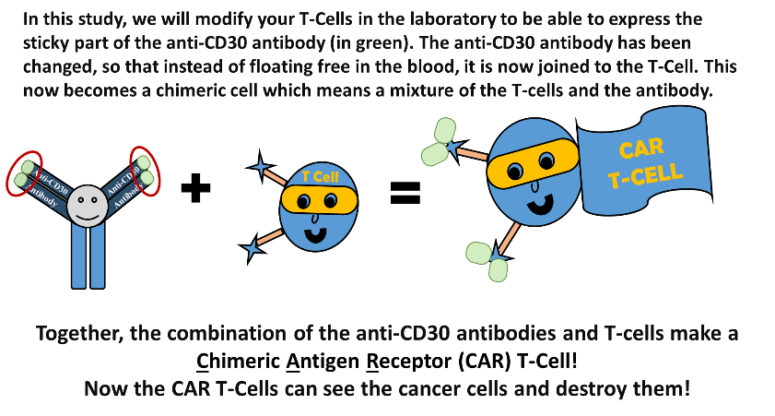
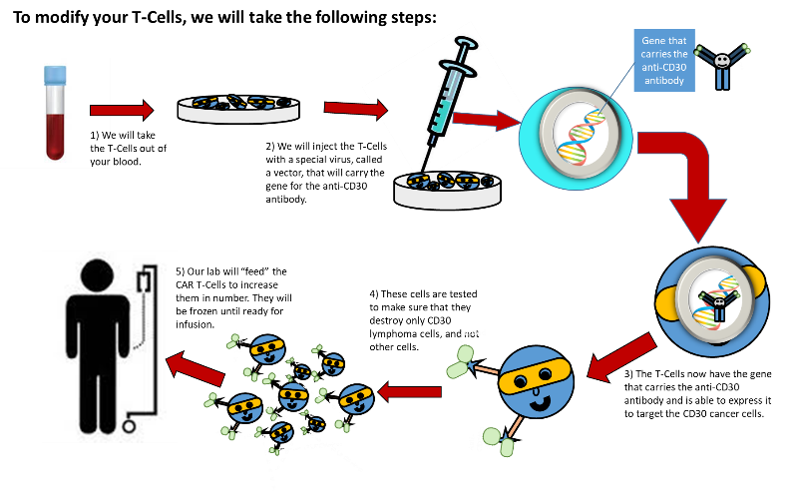
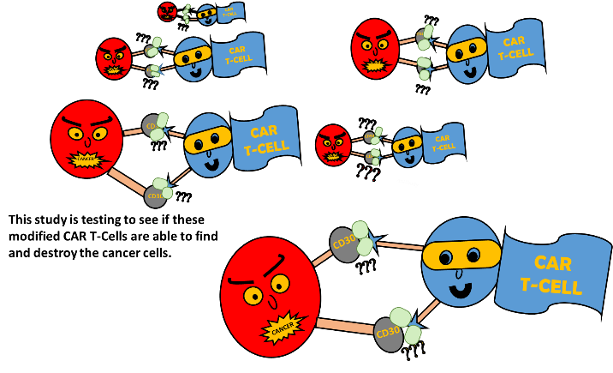
Informed Consent Form Development
Additional patient education required
Complicated concepts that must be simplified for patient understanding

Slide 8
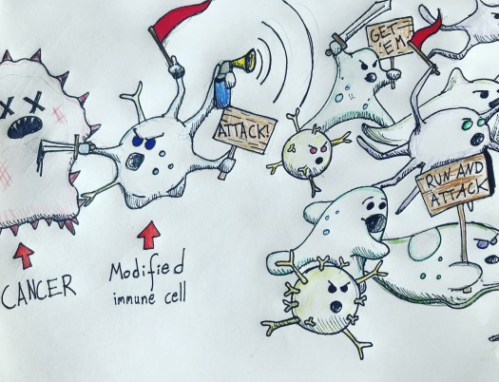
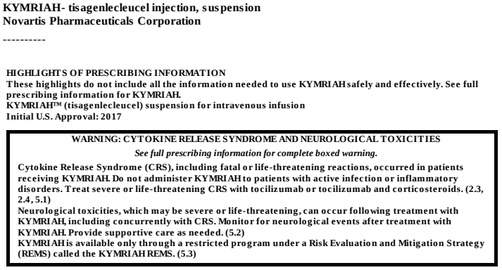
Informed Consent Form Development
Additional patient education required
Patients must understand unique side effects
Source: When an Effective Cancer Treatment Makes Your Cells Riot: Cytokine Release Syndrome, TylerJFord.com, November 29, 2018
Source: KYMRIAHTM (tisagenlecleucel) [package insert]. Novartis, East Hanover, NJ; 2017

Slide 9
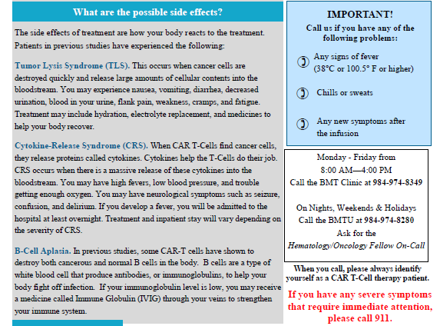
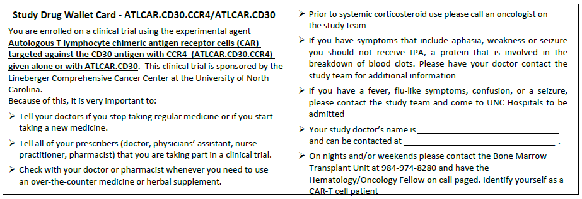
Informed Consent Form Development
Additional patient education required
Patients must understand unique side effects
Handouts:
Wallet Cards:

Slide 10
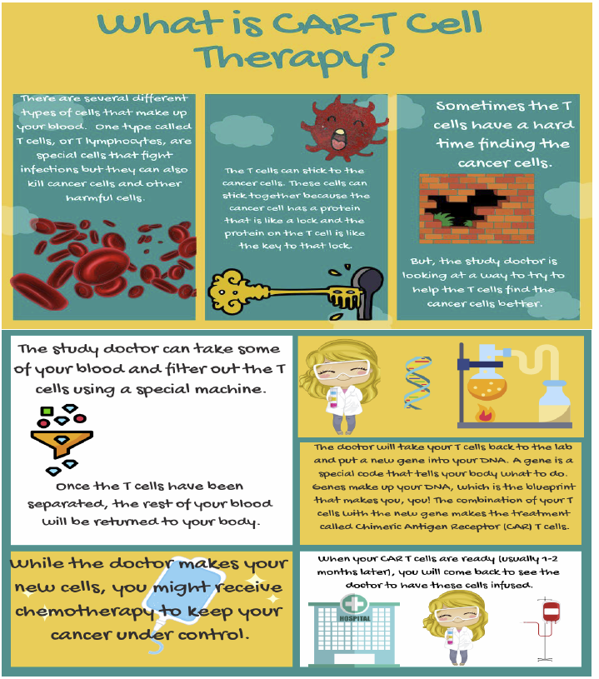
Informed Consent Form Development
Additional patient education required
Pediatric Patients

Slide 11
Pre-Clinical Data OR Previous Human Experience
Secured Investigational Product OR Manufacturing Validation
Develop Protocol
Funding Source Review
(If externally funded)
Final Draft Protocol Approved!
Protocol Review Meeting
ICF Development
PRC Review
FDA Review
(if applicable)
Hard Stop Until Secure Funding*
Opening the UNC Site
(IRB, IBC (if applicable), Beacon Build, Contract (if applicable), Budget, OnCore Build, etc.)
Opening Multicenter Sites
(if applicable)
*Previous steps may only occur if trying to secure funding from a grant

Slide 12
What is an Investigational New Drug Application (IND)?
A request for authorization from the FDA to administer an investigational drug or biological product to humans
Gives permission for interstate shipment of an IP
Initial IND Application
New Drug Application (NDA) or Biological License Application (BLA)
IND
FDA Approved
Discovery/Development
Preclinical (Animal) Studies
Phase 1
Phase 2
Phase 3
Phase 4

Slide 13
Initial IND Applications PRIOR TO THE IND SUBMISSION: WHAT YOU NEED TO DO
Determine early if your study may need an IND
Consider having a Pre-IND Meeting with FDA
If UNC is the manufacturer
Finish pre-clinical studies
Complete validation of the manufacturing process
If pharma company is the manufacturer then collect:
Letter of Authorization
Investigator Brochure
Template Risk Language for the ICF (if available)
Initial IND Application
Discovery/Development
Preclinical (Animal) Studies
Preparation → Drafting IND → FDA Review → Safe to Proceed

Slide 14
Initial IND Applications
IND EXEMPTIONS
Your study must meet all of the following conditions to be exempt:
Not intended to support FDA approval of:
New indication
Significant change in the labeling
Not intended to support a significant change in advertising
Conducted in compliance with IRB and informed consent regulations
Conducted in compliance with promotion and charging for investigational drugs regulations
Does NOT involve a route of administration or dosage level or using a patient population or other factor that significantly increases the risks (or decreases the acceptability of the risks associated with the use of the drug product)
Be careful! Make sure you refer to the rest of the guidance because FDA provides examples of studies that are NOT exempt:
Studies with adjuvant chemotherapy
One reason why: studied population may have low risk of cancer recurring after surgery so treatment with any toxic therapy may significantly increase risk
Studies involving substitution of a new agent of unproven activity when standard therapy provides a cure or increase in survival
New drug combinations UNLESS adequately described in the literature
Due to the possible occurrence of synergistic toxicity
Preparation → Drafting IND → FDA Review → Safe to Proceed

Slide 15
Initial IND Applications
LCCC EXAMPLE
Study LCCC XXXX does not intend to support FDA approval of a new indication, significant change in labeling or a significant change in advertising for the investigational product. The study will be submitted to the IRB and an appropriate ICF has been drafted. The investigational product is being given in the same way with the same frequency as many other clinical trials. However, when the Investigator submitted the protocol to the PRC the following stipulation was received:
Why did this study require an IND?
Investigational product = Not FDA Approved
For a study to be IND exempt the study drug used MUST be a commercial product*
*Even if the drug is FDA approved you MUST be using the commercial lot of the product for the study to be IND exempt.

Slide 16
Initial IND Applications PRIOR TO THE IND SUBMISSION: WHAT YOU NEED TO DO
Determine early if your study may need an IND
Consider having a Pre-IND Meeting with FDA
If UNC is the manufacturer
Finish pre-clinical studies
Complete validation of the manufacturing process
If pharma company is the manufacturer then collect:
Investigator Brochure
Template Risk Language for the ICF (if available)
Letter of Authorization
Initial IND Application
Discovery/Development
Preclinical (Animal) Studies
Preparation → Drafting IND → FDA Review → Safe to Proceed

Slide 17
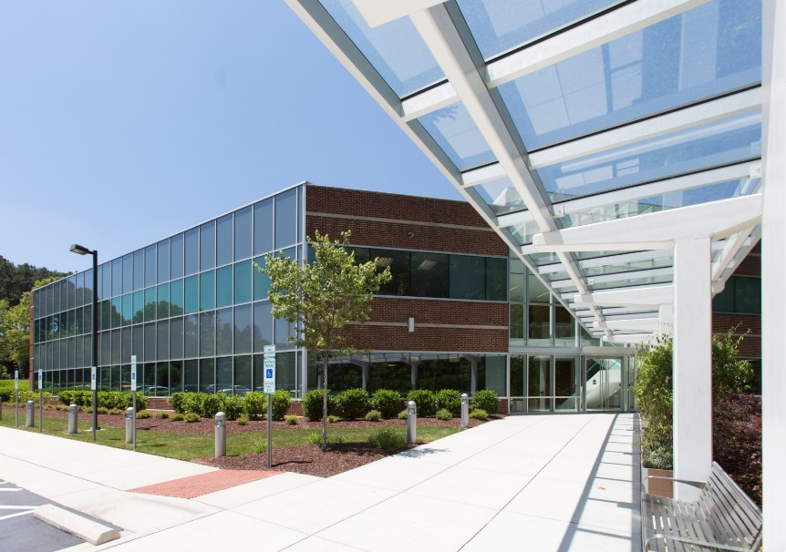
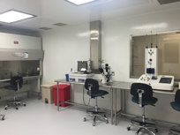
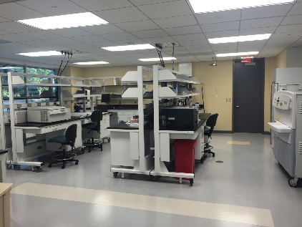
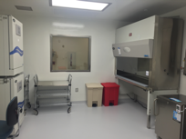
UNC as a Manufacturer- Good Manufacturing Practices (GMP)
Ensure IP is manufactured in accordance with GMP.
The IP must be coded and labelled in a manner that complies with the applicable regulatory requirements
GMP Facilities:
UNC Lineberger Advanced Cellular Therapy Facility
UNC Biomedical Research Imaging Center (BRIC)
UNC Food Allergy Initiative
As a sponsor we have to ensure subject safety and data quality by ensure potency, purity and identity of our IP.

Slide 18
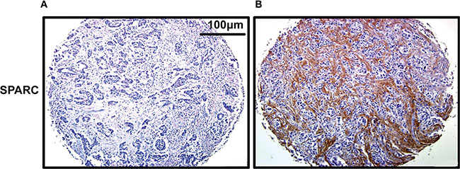
UNC as a Manufacturer- in vitro Companion Diagnostics
May require a test to determine eligibility for a study
These diagnostics are FDA-regulated devices…
< 5% of cancer in vitro diagnostics require an IDE, but…
Your Device
Example: Using IHC to see how is eligible for your protocol, only those with expression have the chance to benefit or there are other viable treatment options
This Photo by Unknown Author is licensed under CC BY
IRB approvals for device development for preclinical work
Preparation of nonclinical data for device-related additions to IND submission OR IDE submission

Slide 19
Initial IND Applications PRIOR TO THE IND SUBMISSION: WHAT YOU NEED TO DO
Determine early if your study may need an IND
Consider having a Pre-IND Meeting with FDA
If UNC is the manufacturer
Finish pre-clinical studies
Complete validation of the manufacturing process
If pharma company is the manufacturer then collect:
Investigator Brochure
Template Risk Language for the ICF (if available)
Letter of Authorization
Initial IND Application
Discovery/Development
Preclinical (Animal) Studies
Preparation → Drafting IND → FDA Review → Safe to Proceed

Slide 20
Initial IND Applications SUBMISSION PREPARATION What goes into an initial IND Application?
Form FDA 1571
Table of Contents
Introductory Statement
Name of Drug and active ingredients
Pharmacological Class
Structural formula
Formulation
Route of administration
Objectives and Duration
Status of drug in other countries
General Investigational Plan
Rationale
Indication
Approach to evaluate treatment
Drug Related Risks
Investigator’s Brochure
Protocol
Study Protocol
Informed Consent Form
Investigator and Facility Data (Form FDA 1572)
Chemistry, Manufacturing and Controls
Pharmacology and Toxicology
Previous Human Experience
Additional Information
Drug Dependence and Abuse Potential
Radioactive Drugs
Pediatric Studies
Biosimiliar User Fee Cover Sheet
Clinical Trials Certification of Compliance
Preparation → Drafting IND → FDA Review → Safe to Proceed

Slide 21
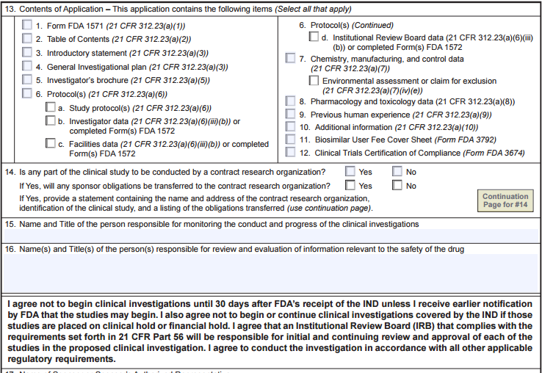
Initial IND Applications KNOWLEDGE TEST
What is this form? Have any of you seen it before?
Form FDA 1571
FDA’s cover letter for all serial submission
Typically, the PI’s name goes here for our LCCC studies
What does this mean?
Agreeing to monitor conduct and progress of clinical investigations
Agreeing to review and evaluate information relevant to the safety of the drug
Preparation → Drafting IND → FDA Review → Safe to Proceed

Slide 22
Initial IND Applications FORM FDA 1571
What are you agreeing to when you sign it?
Not to begin until 30 day initial review is complete
Not to begin research if placed on clinical or financial hold
Agrees that an IRB that complies with the regulations will be responsible for initial and continuing review and approval of all studies under the IND
Agrees to conduct investigation in accordance with the regulatory requirements
Preparation → Drafting IND → FDA Review → Safe to Proceed

Slide 23
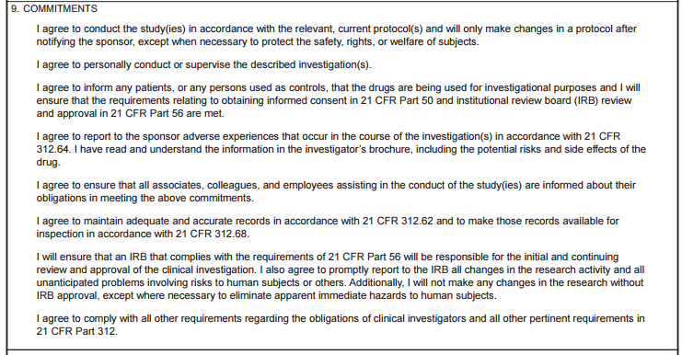
Initial IND Applications KNOWLEDGE TEST
KNOWLEDGE TEST
What is this form? Have any of you seen it before?
Form FDA 1572
Statement of Investigator
Preparation → Drafting IND → FDA Review → Safe to Proceed

Slide 24
Initial IND Applications FORM FDA 1572
Conduct study according to protocol
Personally conduct or supervise
Tell subjects using an IP
Obtain informed consent
Obtain IRB review and approval
Read and Understood the IB
Including risks and side effects
Ensure all associate, colleagues and employees are informed about the obligations
Maintain adequate and accurate records
Make records available for inspections
Report all UPRISOs to the IRB
Not to make changes to research without IRB approval
Except to eliminate apparent immediate hazards to human subjects
Follow all IND regulations
Preparation → Drafting IND → FDA Review → Safe to Proceed

Slide 25
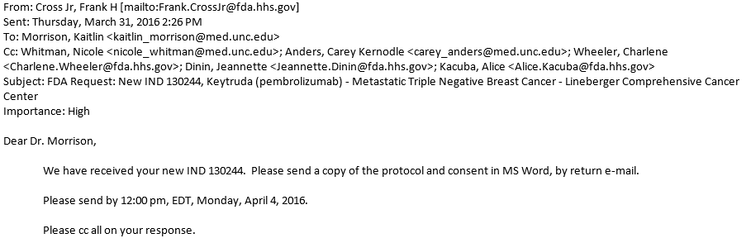
Initial IND Applications SUBMITTED TO FDA What happens next?
Start your 30 Day FDA Review- FDA confirms receipt of IND
FDA may request additional information
Better Dose Rationale
Copy of the Informed Consent Form
Preparation → Drafting IND → FDA Review → Safe to Proceed

Slide 26
Initial IND Applications SUBMITTED TO FDA What happens next?
Start your 30 Day FDA Review
FDA may request additional information
30 day clock ends
Safe to Proceed Letter
Clinical Hold
Preparation → Drafting IND → FDA Review → Safe to Proceed

Slide 27
Pre-Clinical Data OR Previous Human Experience
Secured Investigational Product OR Manufacturing Validation
Develop Protocol
Funding Source Review
(If externally funded)
Final Draft Protocol Approved!
Protocol Review Meeting
ICF Development
PRC Review
FDA Review
(if applicable)
Hard Stop Until Secure Funding*
Opening the UNC Site
(IRB, IBC (if applicable), Beacon Build, Contract (if applicable), Budget, OnCore Build, etc.)
Opening Multicenter Sites
(if applicable)
*Previous steps may only occur if trying to secure funding from a grant

Slide 28
Sponsor Responsibilities
Now you have your IIT up and running, what additional responsibilities do you have?

Slide 29
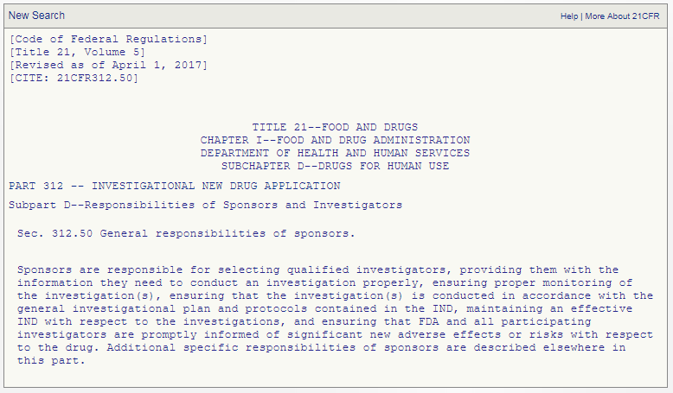
Definition of a Sponsor
Sponsor: An individual or entity who takes responsibility for and initiates a clinical investigation.
an individual
a pharmaceutical company
a government agency
an academic institution
another organization
Clinical Investigator: An individual who conducts a clinical investigation under whose immediate supervision the investigational drug/device is administered.

Slide 30
Initial IND Applications
FORM FDA 1571
What are you agreeing to when you sign it?
Not to begin until 30 day initial review is complete
Not to begin research if placed on clinical or financial hold
Agrees that an IRB that complies with the regulations will be responsible for initial and continuing review and approval of all studies under the IND
Agrees to conduct investigation in accordance with the regulatory requirements
Agreeing to overseeing the trial as the clinical trial sponsor!!

Slide 31
LCCC Org Structure to Manage LCCC Sponsored Treatment Trials
Multicenter Operations:
Monitoring & Multicenter Site Management
Assistant Director, Multicenter Clinical Trial Operations
Clinical Regulatory Manager
In-House Monitors
Multicenter Project Managers
Multicenter Regulatory Associates
Compliance:
Auditing, Data & Safety Monitoring, Compliance, Training
Compliance Manager (also coordinators routine audits)
DSMC Coordinator
PRC Coordinator
Training Coordinator (for both LCCC site and sponsor staff)
Compliance Committee
DSMC
PRC
Clinical Development:
IND Management, Protocol Development, Patient Education & ICF Development, Clinical Development
Director of UNC Lineberger Sponsored Clinical Research
Clinical Protocol Development Associates
IND Specialist
Clinical Data Management Project Manager*
Seat on ACT Oversight Committee
Data Operations:
Clinical Data Operations, Clinical Trial Systems, CT.gov, eCTD data sets
Assistant Director, Data Operations & Clinical Trials Systems
Lead Clinical Data Management Associate
Clinical Data Management Associates
Clinical Data Management Project Manager*
OnCore Analysts & Administrator
Temp SDTM programmer
Clinical Trials Analyst (CT.gov & CTRP)
Also, finance support from the pre-award finance team.
Notes:
5 monitors, 3 PMs, 5 CDMAs

Slide 32
Clinical Trial Life Cycle- Sponsor Obligations
Data Management Plans
Evaluation and Decimation of New Risk Info
IND Maintenance
Secure Data System
Essential Docs
Initial IND Application
IND Maintenance/ Withdrawal
Monitoring Plans
Secure Data System
GLP
Essential Docs
GMP
Record Retention
Preclinical/Protocol Development
Clinical Trial
Data Analysis
Providing Proper Info to Investigators
Providing Proper Info to Investigators
CT.gov
Monitoring
Auditing
QC with SOPs
QC with SOPs
QC with SOPs
CT.gov
CT.gov
CRFs
IP Accountability
Selecting Qualified Investigators
Assuring Investigation Conducted in Accordance with Plan
Monitor Progress of Clinical Investigation

Slide 33
Maintaining an effective IND
What needs to be done to maintain an IND?
Initial IND Application
New Drug Application (NDA) or Biological License Application (BLA)
IND
FDA Approved
Discovery/Development
Preclinical (Animal) Studies
Protocol Amendments
Change in Protocol
New Protocol
New Investigator (New Site)
IND Safety Reports
UPIRSO
Aggregate Report
Pre-clinical
Annual Reports
Continued Communication with FDA
Withdrawal
Change in Sponsors/PIs
Phase 1
Phase 2
Phase 3
Phase 4
Preparation → Drafting IND → FDA Review → Safe to Proceed

Slide 34
IND Application Maintenance Protocol Amendment- Change in Protocol
QUIZ
The Following Types of Protocol Amendment MUST be Submitted to FDA:
A: Any Increase in Drug Dosage
B: Significant Increase in # of Subjects
C: Addition of a Control Group
D: Any Significant Change to Study Design
E: Any Increase in Duration of Drug Exposure
F: Removal of a Control Group
G: Addition of a Test or Procedure to Improve Monitoring For and Reduce Risk of a Side Effect or AE
H: Removal of a Test Intended to Monitor Safety
I: All Protocol Amendments
Amendment #1
Amendment #3
Amendment #2
Amendment #4
Amendment #1
Amendment #2
Amendment #3
Amendment #1
Amendment #3
Phase 1
Amendment #2
Phase 2
Phase 3

Slide 35
IND Application Maintenance Protocol Amendment- Change in Protocol
ANSWER
The Following Types of Protocol Amendment MUST be Submitted to FDA: Answers A-H
Although you are not required to submit all protocol amendments to FDA it is highly encouraged and standard practice in the CPO.
Amendment #3
Amendment #1
Amendment #3
Amendment #2
Amendment #2
Amendment #4
Amendment #4
Amendment #1
Amendment #1
Amendment #2
Amendment #2
Amendment #3
Amendment #3
Amendment #1
Amendment #1
Amendment #2
Amendment #3
Amendment #2
Phase 1
Amendment #3
Phase 2
Phase 3

Slide 36
IND Application Maintenance Protocol Amendment- Change in Protocol
KNOWLEDGE TEST
Protocol Amendment: “The frequency of ophthalmic exams was reduced and are now only required at screening and as clinically-indicated due to the presence of ocular symptoms”
Does this protocol amendment require FDA submission?
YES!
This is the Removal of a Test Intended to Monitor Safety

Slide 37
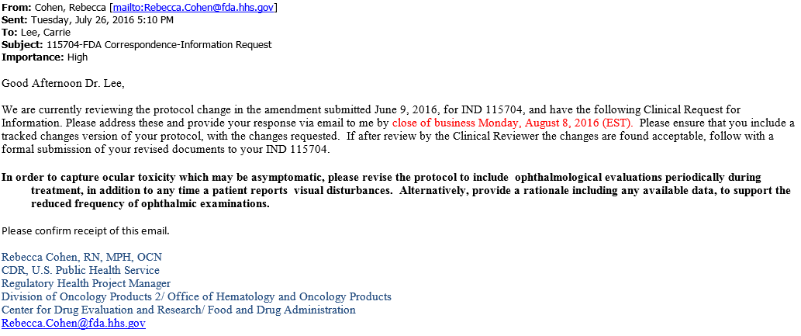
IND Application Maintenance Protocol Amendment- Change in Protocol
WHAT ACTUALLY HAPPENED
PI didn’t submit to FDA
In retrospect the PI wouldn’t have submitted because for SOC the PI would not have performed the additional eye exams that were removed
HOWEVER, 6 months later when the protocol amendment was submitted:

Slide 38
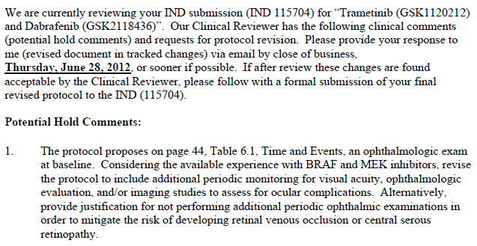
IND Application Maintenance Protocol Amendment- Change in Protocol
WHAT ACTUALLY HAPPENED
PI didn’t submit to FDA
In retrospect the PI wouldn’t have submitted because for SOC the PI would not have performed the additional eye exams that were removed
Helpful Hint: Before amending the protocol, make sure that you are not eliminating anything FDA specifically asked for:

Slide 39
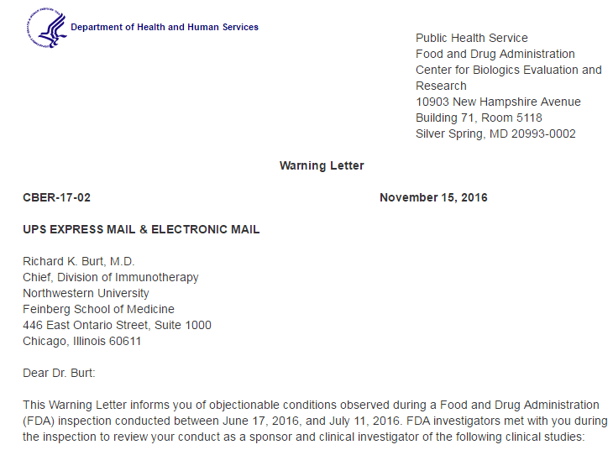
IND Application Maintenance Protocol Amendment- Change in Protocol
WHAT COULD HAVE HAPPENED

Slide 40
Providing investigators with the information needed to conduct an investigation properly
How do we do this?
MULTICENTER SITES
Multicenter Site Initiation Meetings
Team Calls
IND Safety Report Distribution
Ensure responsibilities of coordinating investigators and other participating investigators are documented prior to the start of the trial.
Ensure facilitated communication
Ultimate responsibility: Keeping participating investigators informed of new info, particularly with respect to AEs and safe use of the IP.
May be distributed by means of:
periodically revised IB
reprints of published studies or reports
letters to CIs
LCCC Multicenter Project Managers
Multicenter Regulatory Associates

Slide 41
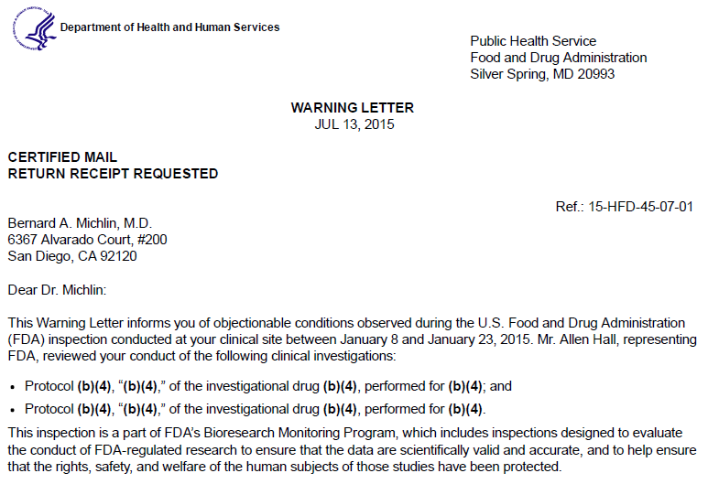
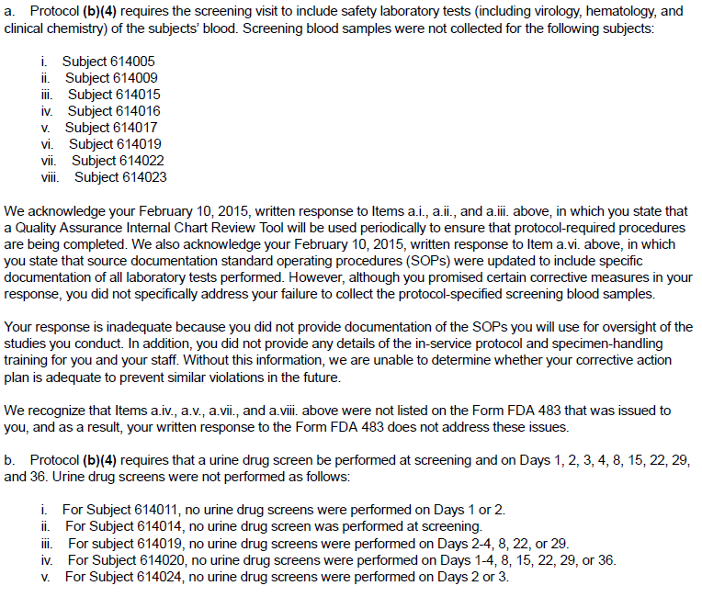
Ensuring that the investigation is conducted in accordance with the general investigational plan/protocol
One of the most common reasons for a clinical investigator to get a warning letter is not following the investigational plan.
Ultimately, the sponsor is responsible for ensuring an investigator is following the plan and bringing the investigator into compliance if they are not.

Slide 42
Ensuring proper monitoring of investigation(s)
What is monitoring?
The act of overseeing the progress of a clinical trial, and of ensuring that it is conducted, recorded and reported in accordance with the protocol, SOPs, GCP and applicable regulatory requirements.
Continuous
Risk-Based
Includes:
Precise tracking of patient accrual
Ongoing assessment of patient eligibility and evaluability
Adequate measures to ensure timely submission of study data
Adequate measures to ensure timely medical review and assessment of individual patient data
Timely reporting of adverse events
“Monitoring is not optional. Required by 21 CFR 312.50.
Responsibilities of sponsors
Selecting monitors qualified by training and experience (21 CFR 312.53(d))
Monitor the ongoing investigations (21 CFR 312.56)
Ensure proper monitoring (21 CFR 812.40)”
Notes:
One place of major improvement.

Slide 43
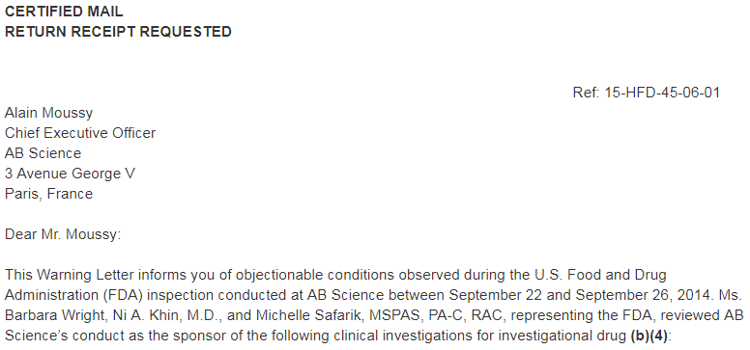
Ensuring proper monitoring of investigation(s)
Why do you need to monitor?
How can you tell if you are guaranteeing subject safety if you don’t double check?
How can you tell if the data are reliable if you don’t double check that it is accurate?
If data coming out of the study are not reliable is it worth the risk to give the IP to additional subject?
Are their trends across multiple sites?
How can you improve the process?
Re-education?
Protocol Amendment?
Administrative Letter?
To FDA data not collected (no matter what the reason) are missing data.
Monitoring Plans help identify critical values upfront.

Slide 44
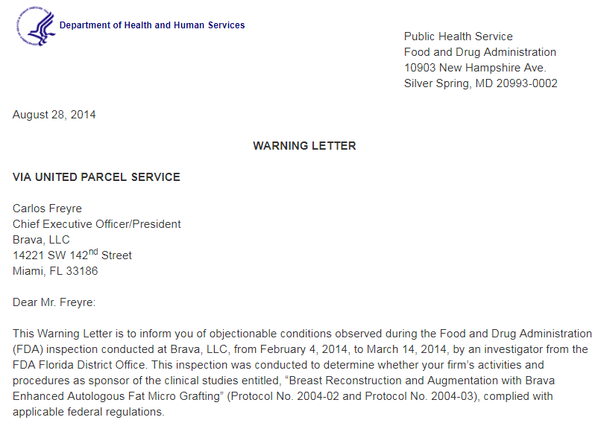
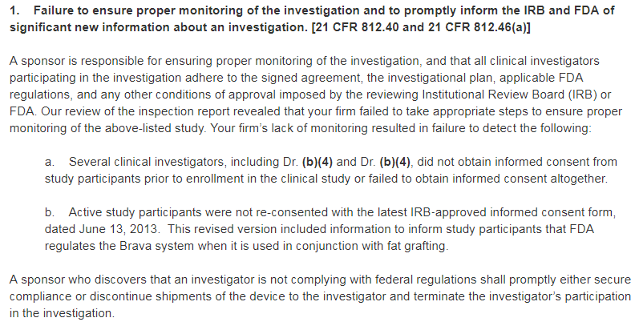
Discontinue shipment of IP to Noncompliant Sites
Deviation at any site is a deviation on the clinical trial
Deviations are cumulative
Sponsor responsible for oversight of all sites
Need to monitor their compliance and whether the sponsor need to re-educate the site
If a site can not be brought into compliance it is the sponsor’s responsibility to stop the site’s participation—Otherwise the site’s continued noncompliance is also the sponsor’s
“A sponsor who discovers that an investigator is not complying with the signed agreement (Form FDA-1572), the general investigational plan, or the requirements of this part or other applicable parts shall promptly either secure compliance or discontinue shipments of the investigational new drug to the investigator and end the investigator's participation in the investigation. If the investigator's participation in the investigation is ended, the sponsor shall require that the investigator dispose of or return the investigational drug in accordance with the requirements of 312.59 and shall notify FDA.”

Slide 45
Monitor the progress of all clinical investigations being conducted under its IND
NC TraCS Data Safety Monitoring Board (DSMB)
Medical Monitor
Data Safety Monitoring Committee (DSMC)
Pod Meetings/ Team Calls
Interim Analysis
Literature
Deviations and SAEs
SSEs
DSMC is the primary agent for assuring data and safety monitoring. Responsible for review of these trials.
Has the authority to suspend research activities or to refer trials to the PRC or IRB for such actions.
DSMC meets monthly, with ad hoc review and additional meetings called when necessary.
Duties defined in the LCCC DSMC Charter

Slide 46
Monitor the progress of all clinical investigations being conducted under its IND
Compliance Committee
Audit IIT trials to:
Authenticate compliance
Capture accurate data
Conducted by OCT under the UNC Clinical Trials Quality Assurance Program (CTQA)
Reviewed by the Committee:
CAPA Responses
Audit Trends
Charter for the Compliance Committee UNC Lineberger Comprehensive Cancer Center
Compliance Committee
Audit Reports
Office of Clinical Trials (OCT) Auditors

Slide 47
Monitor the progress of all clinical investigations being conducted under its IND
PRC: classifies studies by levels of complexity and risk to direct DSMC, Compliance Committee and monitoring
Determines acceptability of continued research based on subject accrual, risk/benefit ratio and institutional interest
Determines necessary actions following audits of internal trials.
Protocol Review Committee (PRC)
Data Safety Monitoring Committee (DSMC)
Compliance Committee
Judge acceptability of protocol amendments
New drug
Change in primary objective
Change in stats
Recommend study closure
PRC Charter
Audit Reports
Protocol Amendments/ ICFs
Monitoring Letters
Office of Clinical Trials (OCT) Auditors
Protocol Development or Reg
LCCC CPO Monitors

Slide 48
Monitor the progress of all clinical investigations being conducted under its IND
Pod Meetings
Current status of trial/patients
Enrollment
Monitoring and audit reports
Deviations
SAEs
Regulatory actions
Data quality
Pod Meetings/ Team Calls
Audit Reports
Protocol Amendments/ ICFs
Monitoring Letters
Deviations and SAEs
Office of Clinical Trials (OCT) Auditors
Protocol Development or Reg
LCCC CPO Monitors

Slide 49
Monitor the progress of all clinical investigations being conducted under its IND
On the FDA Form 1571 the Medical Monitor is listed as:
The person responsible for monitoring the conduct and progress of the clinical investigations
The person responsible for review and evaluation of information relevant to the safety of the drug
Medical Monitor
Data Safety Monitoring Committee (DSMC)
Pod Meetings/ Team Calls
Interim Analysis
Audit Reports
Annual Report
Protocol Amendments/ ICFs
Monitoring Letters
Deviations and SAEs
Office of Clinical Trials (OCT) Auditors
Data Management
Protocol Development or Reg
LCCC CPO Monitors

Slide 50
Monitor the progress of all clinical investigations being conducted under its IND
NC TraCS Data Safety Monitoring Board (DSMB)
Medical Monitor
Protocol Review Committee (PRC)
Data Safety Monitoring Committee (DSMC)
Compliance Committee
Pod Meetings/ Team Calls
Interim Analysis
Literature
Audit Reports
Annual Report
Protocol Amendments/ ICFs
Monitoring Letters
Deviations and SAEs
Office of Clinical Trials (OCT) Auditors
Data Management
Protocol Development or Reg
LCCC CPO Monitors

Slide 51
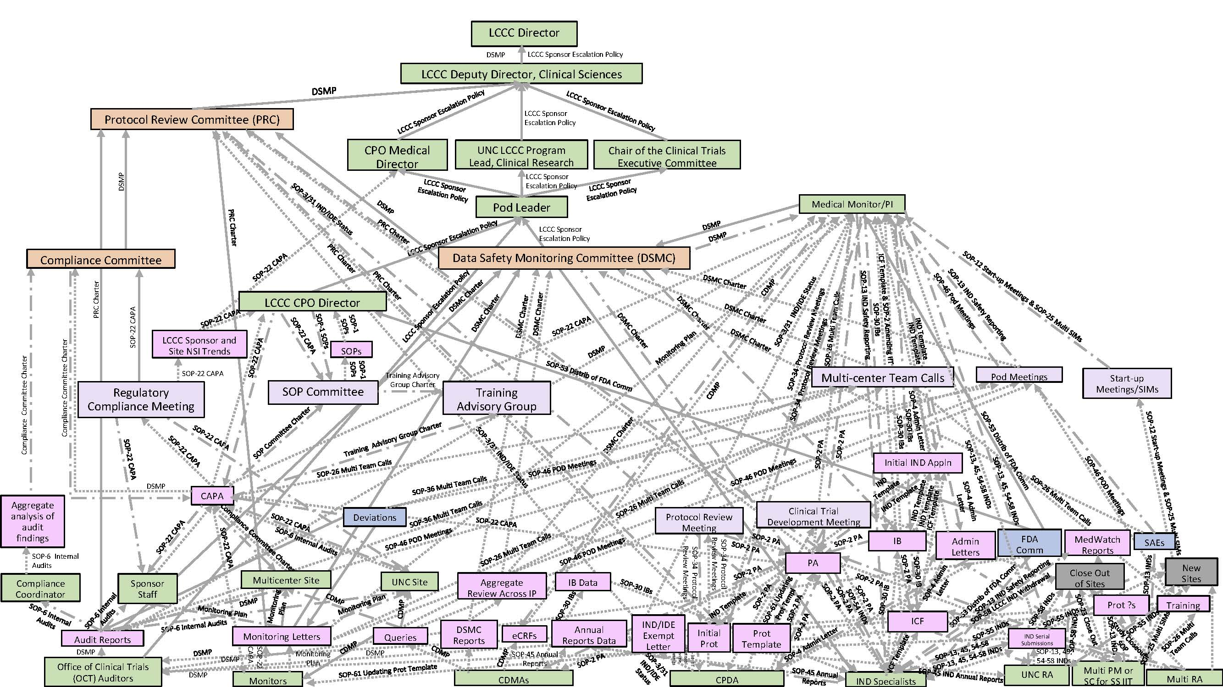
Monitor the progress of all clinical investigations being conducted under its IND
LCCC Sponsor Quality Management Plan- Launched March 23, 2021
Quality management systems focused on feedback loops and process improvement.

Slide 52
Other Available Resources
LCCC Investigator-Initiated Website: https://unclineberger.org/iit/
Available Additional Targeted Trainings- CMEs awarded:
Protocol Development:
Creating your Clinical Trial Protocol
Two Successful Clinical Trialist Reflect on How They Got Their Start (no CME for this one)
Protocol Amendments vs. Administrative Letters
IIT- Protocol Amendments
FDA- INDs and IDEs:
5 Tips for Developing and Maintaining an IND
Everything that a PI Needs to Know about Holding an IND
IND Boot Camp
IIT FDA Annual Reports
IND Safety Reporting- LCCC IITs
Working with Investigational Assay Results
Sponsor Responsibilities:
Everything a PI Needs to Know about LCCC as an IND Sponsor
Advanced Trainings IIT trainings:
Gene Therapy- FDA and Local Considerations
Hot and Cold Topics for Investigators
LCCC’s Single Subject Exception Policy
Understanding when Assays become Investigational Assays
Clinical Trial Activation
Activation 101- Who are the Players
Activation 201- What is the Role of the Activation PM
What is a “Critical Path” and How Can it Help Me?
Project Management of CPO Trial Activation 101

Slide 53
Questions???
Always feel free to email me: LCCC_IND@unc.edu

