Slide 1
Proposing Investigator-Initiated Clinical Trials (IITs)
Jared Weiss, MD
Assoc Professor of Medicine
Section Chief of Thoracic and Head/Neck Oncology
Notes:
Good morning. I’m here today to talk to you about chemotherapy for people who’s cancer can’t be cured with the state of science at this time.
Just to be clear about the topic—stage IV means that the cancer has spread to the point that it’s not curable.
I’d like in these 23 minutes to try to get across why chemotherapy is the main therapy for this stage of disease and how we choose it.
Along the way, we’re going to talk a bit about some science and some history, but the focus of the talk will be very practical—what I think patients want to know about, based on what my patients have told me.
I’m specifically avoiding the temptation to talk a lot about the history of this state or details on the science, except where it affects what I think you need to know. I’m happy to answer questions later on these topics if you have interest.

Slide 2
Topics
How to generate the idea
How to vet an idea
Funding sources for IITs
Selling the idea

Slide 3
Idea Generation Step 1: Become an expert in the clinic area
Time in clinic
Read all seminal papers—mentor can help select
Study relevant biology—textbook, review articles OK
Ask questions
Do not pepper mentor with, “Has anyone tried…” questions. Start with asking that question of pubmed and Dr. Google.
Understand the unanswered questions and unmet needs in the area
Attend relevant conferences

Slide 4
Idea Generation Step 2: Study Basic Biology of Disease State and its treatments
Key clinical papers—mentor can help guide selection
Key biology—can be textbook or review articles

Slide 5
Case Study: UPCC15309
Clinical unmet needs
SOC in head/neck was toxic and inconvenient
Multidrug regimens were SOC, but historic data supported similar survival with sequential cytotoxic regimens
Patients in Phili wanted easier, less toxic
There was great interest in HER1 (EGFR) and HER2 biology in SCCHN
5FU was a standard drug
Breast CA had shown safety of cap/lap

Slide 6
Idea Generation Step 3: Know other cancers—they have plenty to learn from
Related biology
Safety data on regimens

Slide 7
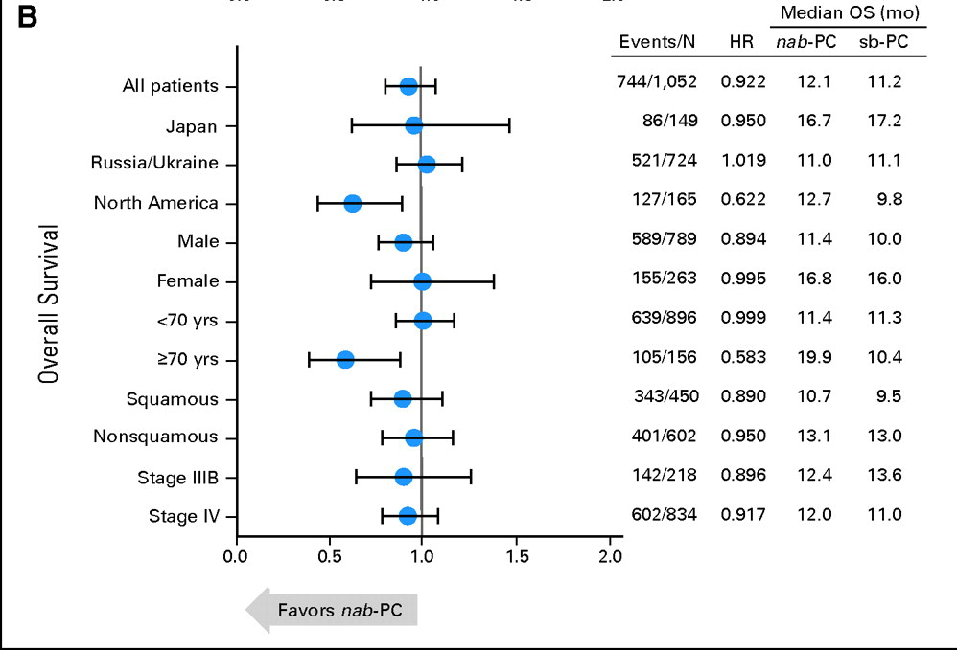
Case Studies: LCCC1103 and LCC1210
RR 25% vs. 33%
SqCC RR 24%
vs 41%

Slide 8
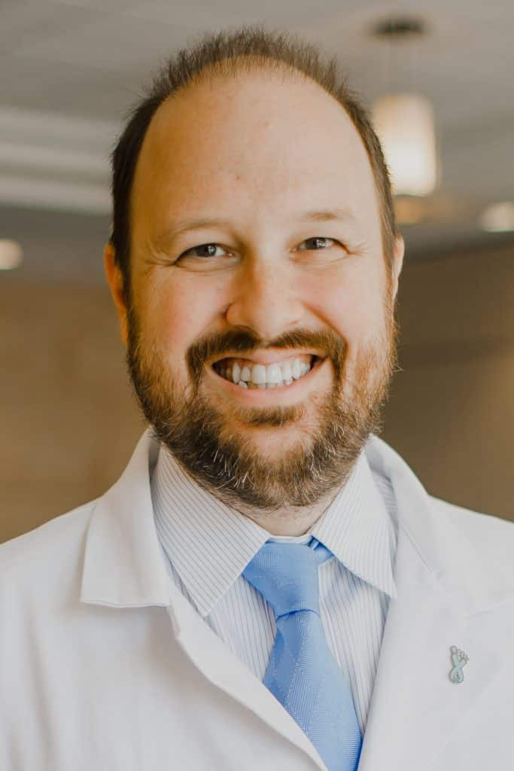
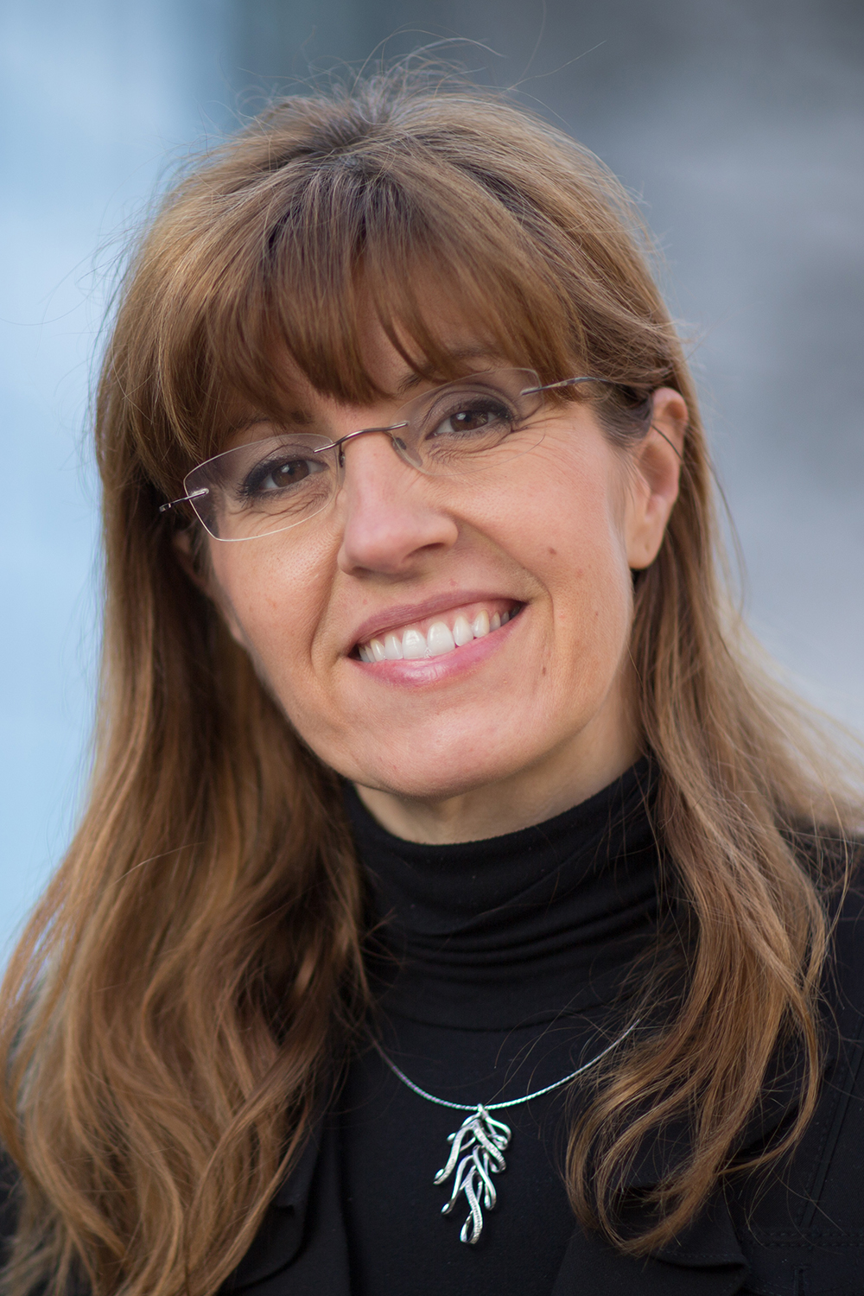
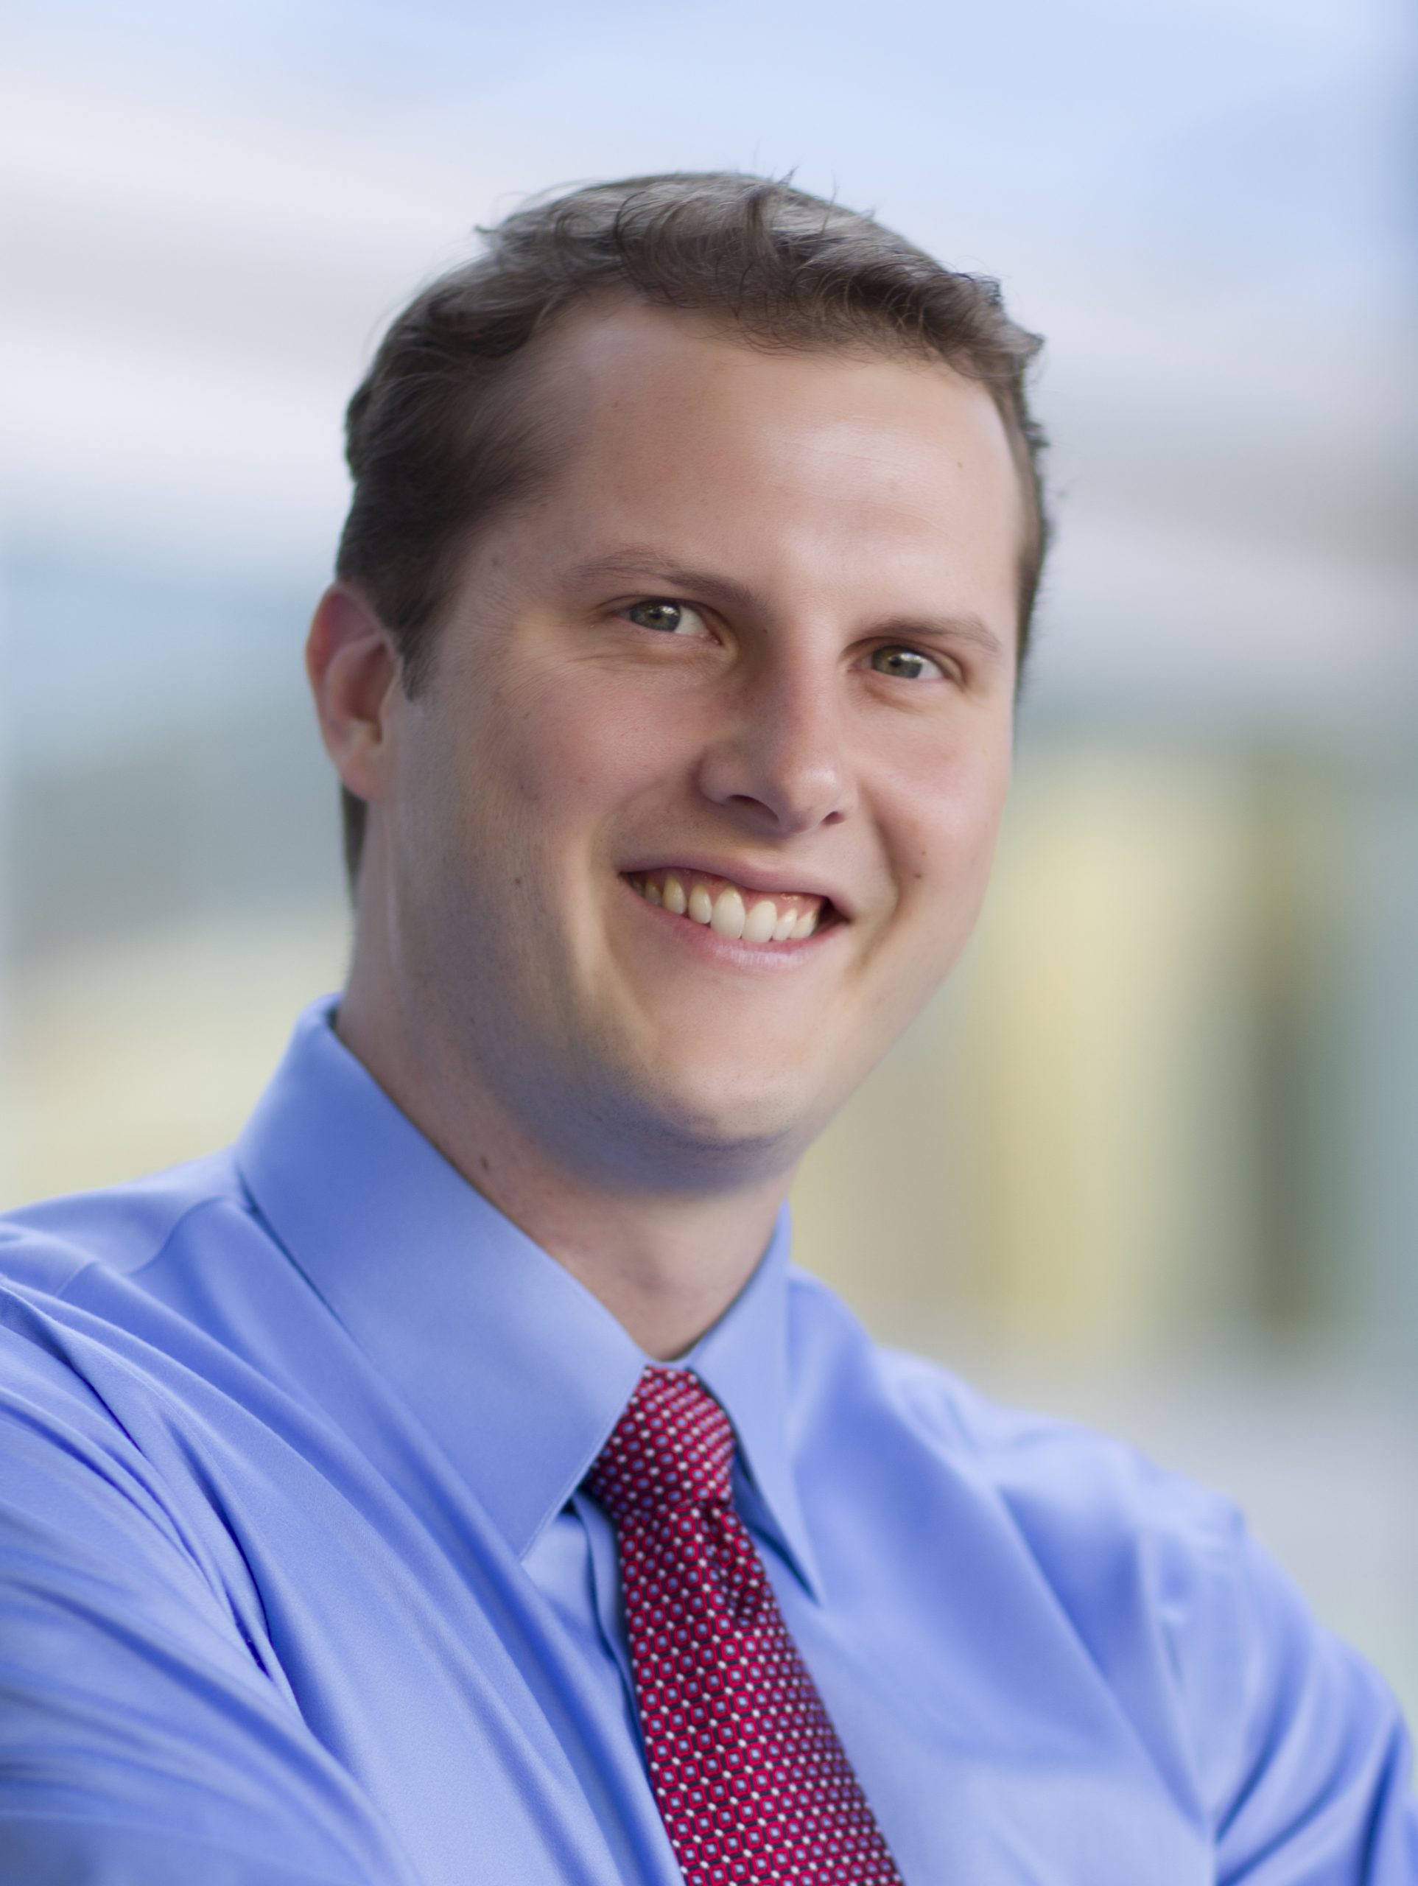
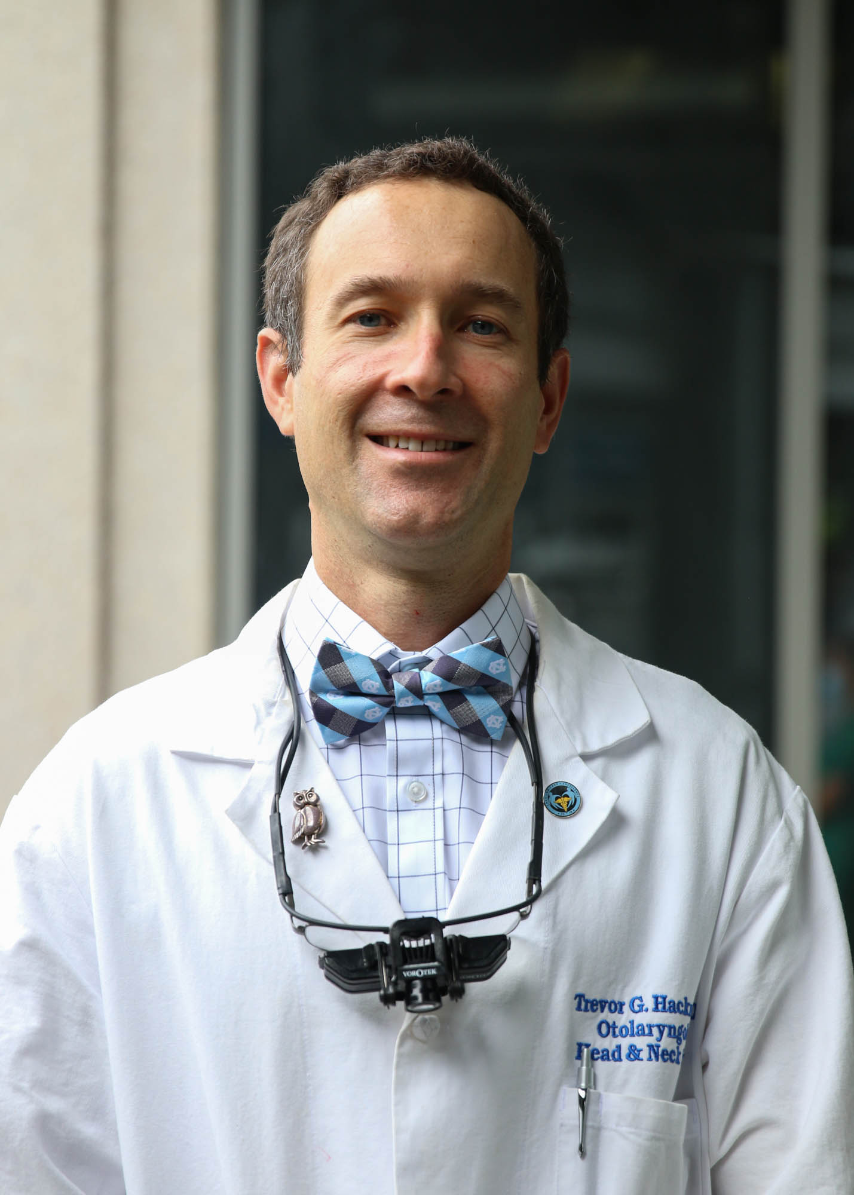
Idea Generation Step 4: Make Friends (Collaborators) and talk to them often
PANDA
LCCC2115ATL
LCCC2060ATL
LCCC2113
LCCC1125
LCCC1621

Slide 9
How to Vet an Idea
Search Literature
Pubmed
Key conferences
Dr. Google
Discuss with mentor and/or collaborators—brief slide deck helpful
Pressure test with friends and colleagues (both in area and in relevant funding sources)

Slide 10
Learn from My Failures
LCCC1410: Can you accrue to the population of interest?
LCCC1516: Will SOC change before you complete trial?
LCCC1626: Are you seeking to accrue a population that does not exist (or is rare)?

Slide 11
Consider Funding Sources
Company
Patent life left? On flip side, for new compound, adequate safety data?
What is position of company in marketplace?
What are companies interests (MSL can help)
What relationship? IIT? Company trial?
Peer reviewed grant
Is there sufficient scientific questions for grant mech?
Where will drug come from?
Cooperative group
Consortium

Slide 12
How to Sell A Trial
Know thy audience
Make relationships
As fellow, good mentors
As faculty: MSLs, VPs, cooperative group leaders
Have patience: Trials can take years to get funded.
Provide info in the format requested. You will often need to do this a frustrating # times.

Slide 13
Phase II trial of Lurbinectidin with Trilaciclib

Slide 14
Core Drivers of Concept
Lurbinectidin is effective against SCLC.
Lurbi’s dominant toxicity is hematologic. Myelosupression, particularly NTP limit Lurbi dose.
With increased exposure (AUC) RR goes up with lurbi.
Trilaciclib decreases myelosuppression with SCLC chemotherapy.
Trilaciclib does not improve survival.

Slide 15
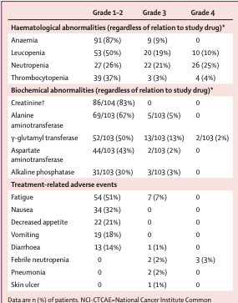
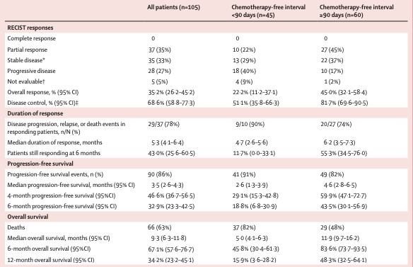
Lurbinectidin single agent
Trigo, Lancet Oncology 2020

Slide 16
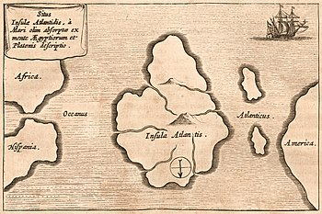
But, ATLANTIS

Slide 17
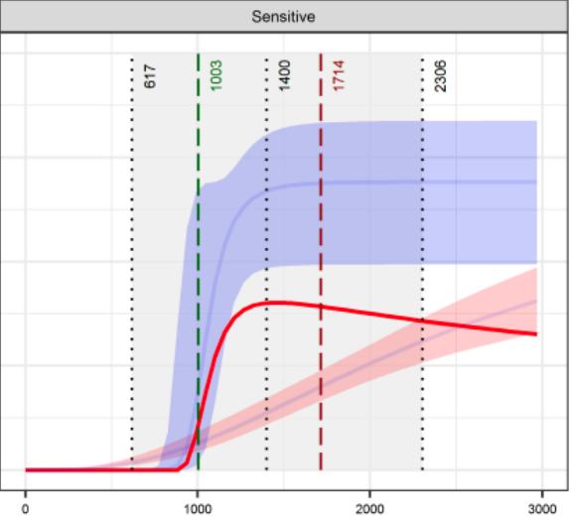
Is the Difference between Basket and Atlantis in Dose→Exposure?
Green vertical line is RR 19.3%, benchmarking topotecan while red line is NTP rate of topo. Idea is that an AUC between 1003 and 1714 would provide better TPI than topo.
Not quite Atlantis ancient, but CbP was “saved” by AUC dosing. However, CbP has very predicable renal clearance, while Lurbi is CYP3A4.
Of note, curve @ L is for CTFI < 90d. Although #s are much worse, the optimized AUC for CTFI > 90d is identical.

Slide 18
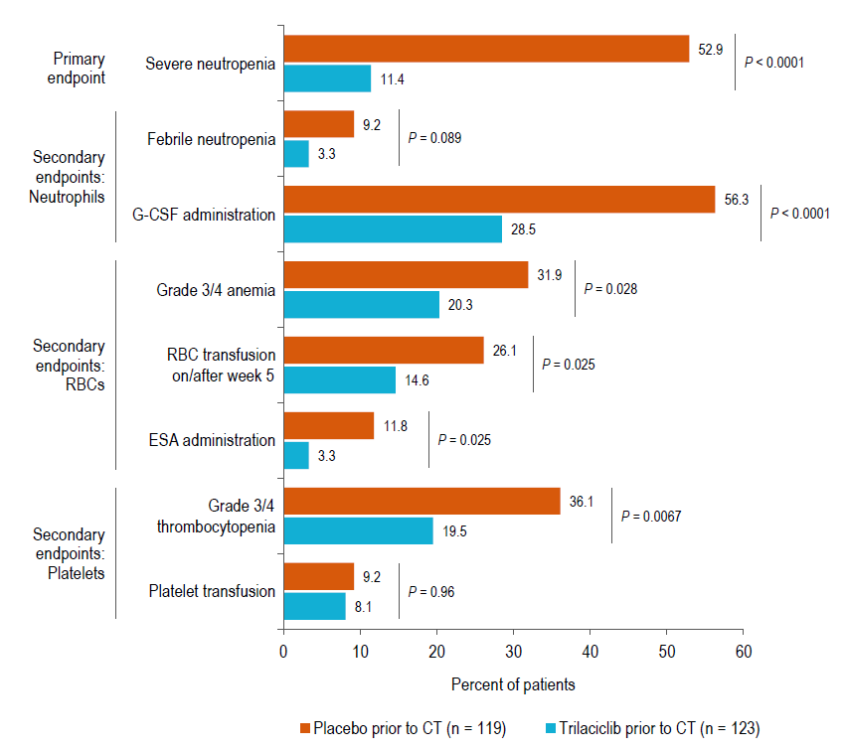
Trilaciclib
Short acting CDK4/6 inhibitor
Potent myeloprotection in 3 randomized studies
Decreases AE profile
Improves QoL
But, no survival advantage

Slide 19
Old Proposal (about a year ago)
3-arm randomized phase II trial of lurbi alone vs. 2 different schedules of trila.
Primary endpoint G4 NTP
Revised Proposal
Two cohort (CTFI > < 90d separate) phase II trial of Trilaciclib and PK-adjusted lurbinectidin
Primary endpoint RR

Slide 20
Basics
Inclusion: ES-SCLC w/PD post CbP/VP16/PDL1, PS0-1, standard organ criteria
2 Cohorts: One with CTFI <90d and other with CTFI >=90d.
Stats: Will require discussion. Gist is dramatic improvement in RR over topotecan, numeric improvement over that expected with SOC lurbi. First suggestion:
CTFI < 90d: 33%
CTFI >=90d: 66%
Of note, can effectively choose N (and resulting CIs) based on null chose: benchmark against topo for low n and against existing lurbi #s for high n

Slide 21
Events
C1
D1
C2
D1
C2
D15
C3
D1
Rx @ Dose until PD or intolerance
PK Analysis: A Black Box under Discussion
2017 paper showed linear kinetics
Can PharmaMar share (if existing) PK/PD model? If not, if provided data, we can build.
Does PharmaMar have data to suggest that a metabolite plays any role in acivity?
Can (under strict CDA) you provide AUC data for individual patients? Or, more to point, is it already known which PK factors (Cmax, trough) correlate with AUC in linear regression?
Generation of AUC based offvarious limited sample collections schemes
Validation
Baseline Biopsy
Flow
TCR
Possible pharmacogenomics
Possible other studies: probe drug? Endogenous CYP3A4 markers?
*Trila
*Lurbi (dosed per PK modeling)
*Post
Lurbi
PK
*Trila
*Adjusted Lurbi
*PK
Biopsy
Flow
TCR
*Trila
*Adjusted Lurbi
*Blood for correlatives

Slide 22
Secondary Endpoints
Usual clinical: PFS, OS, Toxicity
PROs
Evaluation of Immune changes hypothesized from combination
TCR and multiplex IFE on all subjects
Fresh flow cytometry on UNC subjects for Teff/Treg and for MDSC
MANAFEST available if desired on UNC subjects (expensive, but ”platinum” standard for IO monitoring in 2021)

