Slide 1
Clinical Trial Operations
10.20.2021
CPO Pre-Award Finance – Coleman Tew – Pre-Award Clinical Trials Manager
Clinical Data Operations – Mary O’Dwyer – Assistant Director, Clinical Data Operations
Regulatory Affairs – Shaw Scott –Assistant Director, Regulatory & Compliance
CPO Clinical Operations – Stefanie Belanger – Assistant Director, Clinical Research Operations & Medical Center Integration
Compliance – Tess Cummings – Director, Clinical Protocol Office & Sr. Advisor to UNC Office of Vice Chancellor for Research

Slide 2
CPO Pre-Award Finance
Coleman Tew, MPA
Notes:
Thank you Dr. Dees for inviting me to discuss the budget and contract process at Lineberger
While this may be an unfamiliar area to many new investigators, it is an important part of the current and future research performed at UNC

Slide 3
Pre-Award Team Responsibilities
Budget Development
Negotiation with External Funding Source
Ensuring Budget Covers Projected Costs
Contract Process Oversight
Notes:
Before I begin, I wanted to give you a brief overview of my team’s responsibilities
We primarily deal with two documents. The study budget and contract.
Our main charge is to shepherd the budget through the study activation process
This includes developing the cost projections and negotiating a final budget with the study sponsor
While the contract itself is negotiated at a central department, we are responsible for ensuring that it is moving forward concurrently with the budget process.
So we are in constant communication with the assigned contract manager

Slide 4
Common Funding Types – What’s the Difference?
Industry (Pharmaceutical Company)
Budget is Negotiable
Contract is Required
Cooperative (Funded by NCI)
Limited Non-Negotiable Budget
No Study Specific Contract
Investigator Initiated Trial
Budget is Negotiable but Limited
Contract is Required
Notes:
The three types of studies we most commonly deal with are industry, cooperative and Investigator Initiated Trials
Industry studies occupy the majority of our efforts –
Both the contract and budget are negotiated for each individual study
Cooperative Studies are funded by NCI and are run through groups such as Alliance and ECOG-ACRIN –
These studies operate under umbrella agreements so no individual contract is needed.
The budgets are limited and non-negotiable.
They typically cover minimal personnel costs and certain procedures such as a mandatory biopsy.
Investigator Initiated Trials are conceived by our PIs at Lineberger
The budget is created during the initial submission of the LOI with input from the PI
Our goal is to create a budget that not only covers our projected costs but also will be approved by the funding source
These are more similar to grant submissions than our standard industry sponsored clinical trials
They can be challenging as we are working to reconcile the scientific requirements such at accrual targets and correlative studies with funding limitations that are standard for many sponsors.
Like our industry studies, a contract is still required

Slide 5
Financial Process – Industry Study
OnCore Calendar Build
Contract Negotiation
BCA
Begin Study Activation
Budget Development
Study Opens to Accrual
Contract Fully Executed
Negotiation and Finalization
Notes:
Because the majority of our time in pre-award finance is spent on industry sponsored studies, I’ll take some time to go through the activation process
On a high level, there are 8 primary steps in the financial process to get a study opened at UNC
Before we even begin the budget development and negotiation, there are several requirements that need to be completed.

Slide 6
Requirements for Activation to Begin
Confidentiality Agreement (CDA)
LCCC Leadership Approval
All Study Documents
Protocol
Lab Manual
Pharmacy Manual
Draft Contract
Draft Budget
Notes:
The first is having a confidentiality agreement in place.
In order for the PI and study team to review the documents such as the protocol, a CDA must be executed between the sponsor and UNC
Once the PI decides to move forward, it must receive initial approval from Lineberger Leadership. They look at things like…
Staffing availability
Benefit to patients with certain disease
Ensure it will not adversely affect a similar study that is already opened.
Require several study documents be in place such as the
Draft Budget
Draft Contract
And the clinical documents

Slide 7
Financial Process – Industry Study
OnCore Calendar Build
Contract Negotiation
BCA
Begin Study Activation
Budget Development
Study Opens to Accrual
Contract Fully Executed
Negotiation and Finalization
Notes:
The next step involves our OnCore System.
Mary O’Dwyer will speak in more detail about OnCore and it’s functionality during her talk

Slide 8
OnCore Calendar Build
Notes:
Lineberger utilizes OnCore for a variety of functions.
It allows us to not only track patient visits but also is used for billing the sponsor once a study opens to accrual
One of the first steps we take in the budget process is to build the calendar in OnCore
We contract with a third party that takes the time and events table from the protocol and replicates it in OnCore.
This allows the study team to have a clear understanding of the visits and the types of procedures that will be performed.
It typically takes 1-2 weeks for an OnCore calendar to be built

Slide 9
Financial Process – Industry Study
OnCore Calendar Build
Contract Negotiation
BCA
Begin Study Activation
Budget Development
Study Opens to Accrual
Contract Fully Executed
Negotiation and Finalization
Notes:
At the same time as the OnCore Calendar build, we submit the contract for review and negotiation

Slide 10
Contract Negotiation
Negotiated by Office Industry Contracting
Data Collection
Intellectual Property
Publication Rights
Liability
Indemnification
Notes:
As I mentioned previously, the contract is handled by our Office of Industry Contracts, a central UNC office.
As UNC is a formal party to the contract, the language must align with university and state rules for these sort of agreements
The primary type of contract OIC negotiates is a Clinical Trial Agreement
This is a standalone document that is specific to a given study
A typical CTA is around 25 pages and incorporates items such as intellectual property, publication rights and indemnification

Slide 11
Financial Process – Industry Study
OnCore Calendar Build
Contract Negotiation
BCA
Begin Study Activation
Budget Development
Study Opens to Accrual
Contract Fully Executed
Negotiation and Finalization
Notes:
Once the OnCore Calendar is built, we are able to move forward with the Billing Coverage Analysis

Slide 12
Billing Coverage Analysis Process
Designate Each Billable Item (CPT Code) as Routine or Study
Study: Included in the Sponsor Budget
Routine: Billed to Patient/Insurance
Completed by Office Clinical Trials
PI Must Review and Confirm Coverage
Notes:
Even though an industry sponsor is paying for us to conduct a study, not all costs will be paid for by the negotiated budget
Many procedures included in the sponsor protocol will be charged to patients or their insurance.
Some procedures may be considered study-related, meaning they are charged to the industry sponsor
Other procedures may be considered Routine and will instead be charged to the patient or their insurance
The document used to determine which procedures are routine and which are study is called the Billing Coverage Analysis Document (BCA)
It is completed by the UNC Office Clinical Trials
After the BCA is completed, it is the PIs responsibility to review and ensure they are in agreement with the coverage designations

Slide 13
Billing Coverage Analysis Process – Deemed and Qualifying
Qualifying Studies: Routine Procedures may be billed to Patient/Insurance
Non-Qualifying Studies: No procedures may be billed to Patient/Insurance
Notes:
Before the Office of Clinical Trials can determine which procedures are routine and which are study, they first must verify that the clinical trial is eligible to charge any procedure to patient insurance
Studies eligible to charge procedures to patient insurance are called Qualifying Clinical Trials
To determine if a study is qualifying, four criteria must be met.
This is based on federal guidance from Centers for Medicare and Medicaid Services.
Does it fall into a Medicare benefit category
The vast majority of cancer studies fall into the Drugs and Biologics category
Does the study have therapeutic intent?
Meaning, is drug efficacy either a primary or secondary objective of the study?
Some Phase I studies may only look at safety and tolerability. In those cases, they would not qualify.
Does the study enroll patients with diagnosed diseases
Is it a deemed trial?
A study is considered to be “deemed” if it is funded by a federal agency or in this case, has an IND number for a drug that will be reviewed by the FDA.
Again, if a study is determined to be non-qualifying, no procedure may be charged to patient insurance.

Slide 14
Billing Coverage Analysis Process
How can a Procedure be Considered Routine?
Standard of Care
Administration of Investigational Product
Monitoring Effects of Investigational Product
Prevention and Treatment of Complications
National Coverage Determination (NCD) - Routine Costs in Clinical Trials 310.1
Notes:
Once a study is considered to be “Deemed and Qualified”, we know that routine costs are allowable.
But what makes a given procedure routine?
There are four ways
The first is if the procedure is standard of care. Meaning it would be performed regardless of the patient being enrolled in the trial.
The patient would be getting a Chest CT even if they were not on the study. So it can be charged to their insurance
Next is the Administration of the Study Drug.. While the investigational study drug is provided free of charge to the patient, it allowable to consider the administration of the drug to be routine. This could be the IV administration or a subcutaneous injection. Both of which carry separate hospital charges.
Another example of a routine cost is monitoring the effects of the study drug. Something like a comprehensive metabolic panel could be considered routine as it is measuring the effects of the study drug on liver and kidney function.
Finally, a procedure could be considered routine if it prevents or treats complications associated with the investigational product

Slide 15
Billing Coverage Analysis Process
Notes:
Once it is determined which procedures will be study or routine, OCT will provide a detailed time and events table.
This is similar to the time and events table built in OnCore
The key difference is the level of detail
Since the hospital prices out procedures by CPT code, certain tests are broken out to show that level of detail
For example, the Serum Chemistry Line in the OnCore Calendar Build is too vague to determine the costs
So it is broken out to show the CMP, Magnesium, total protein and uric acid
Any study related procedure will have a price provided from the hospital chargemaster
Those prices will be used to build the budget

Slide 16
Financial Process – Industry Study
OnCore Calendar Build
Contract Negotiation
BCA
Begin Study Activation
Budget Development
Study Opens to Accrual
Contract Fully Executed
Negotiation and Finalization
Notes:
After PI review and approval, the BCA is provided to the assigned financial analyst.
We are then able to move forward with developing the budget.

Slide 17
Budget Development
All Procedures Determined to be “Study” by BCA
Personnel Effort
PI
Coordinator
Lab Team
Other Fees
Study Start-Up Fee
IRB Fee
Investigational Drug Services
Patient Reimbursements
Notes:
Putting together a budget involves taking information from multiple sources in order to project costs
This includes the study related procedures from the BCA as well as personnel cost projections for the PI, coordinator, lab and other clinical staff
Personnel projections are provided based on review of the protocol and lab manual
We also have additional administrative budget items that cover other costs outside of the patient budget
Includes Study Start-Up fee that covers finance, regulatory and PI time to actually open the study
Also includes Investigational Drug Services costs
IDS charges the study budget for each month they hold the investigational product.
Their prices can vary based on factors such as blinding, randomization, after-hours distribution and number of drugs
Patient reimbursements such as parking, meals, hotels and mileage.
These are especially important since most of our patients are from outside of Chapel Hill
There are several other fees that we include such as monitoring visit time, No Cause FDA Audits, ICF Translation and record archiving

Slide 18
Financial Process – Industry Study
OnCore Calendar Build
Contract Negotiation
BCA
Begin Study Activation
Budget Development
Study Opens to Accrual
Contract Fully Executed
Negotiation and Finalization
Notes:
Once we project our costs to conduct the study, we will then edit the sponsor budget to align with our numbers

Slide 19
Budget Negotiation and Finalization
Notes:
This is an example of a sponsor budget
Looks very similar to the OnCore calendar that was built earlier in the process
Only now we have added in pricing for some items and included the coverage designations
It is critical for the coverage designations in the budget to match those in the BCA.
Failure to do this could lead to double billing, which is charging the sponsor and the patient insurance for the same procedure
This is illegal and can potentially result in millions of dollars in fines.
The revised budget is sent to the sponsor for review
They will usually come back with counteroffers or questions
Sponsors typically have reasonable expectations about costs, especially for cancer studies.
It helps if we have a prior relationship with them as there is a baseline for what costs each side will accept
After a couple iterations of the budget negotiation and perhaps a conference call, the budget will be finalized

Slide 20
Financial Process – Industry Study
OnCore Calendar Build
Contract Negotiation
BCA
Begin Study Activation
Budget Development
Study Opens to Accrual
Contract Fully Executed
Negotiation and Finalization
Notes:
While we are going through the budget development and negotiation, the contract language should be finalized at the Office of Industry Contracts
This is something we are monitoring throughout the budget development process

Slide 21
Contract Fully Executed
Final Budget
Final Contract Language
Fully Executed Contract
Notes:
We will then combine the final budget with the finalized payment terms and then all parties will sign

Slide 22
Financial Process – Industry Study
OnCore Calendar Build
Contract Negotiation
BCA
Begin Study Activation
Budget Development
Study Opens to Accrual
Contract Fully Executed
Negotiation and Finalization
Notes:
At that point, the study will be ready to open to accrual from a budget and contract perspective.
Of course there are other steps that need to be checked off in order to activate, including the regulatory team completing the IRB submission and approval.
Shaw Scott will discuss the IRB approval process next as a part of her presentation

Slide 23
Any Questions?
Notes:
But before I hand it off to Shaw, I would be happy to try and answer any questions you may have about clinical trial budgets and contracts.
Thank you!

Slide 24
Clinical Data Operations
OnCore, Data Management & More
Mary O’Dwyer, MRP, CCRP
Notes:
Hello, I’m Mary O’Dwyer, Assistant Director for Clinical Data Operations. Today I want to give you an overview of our services and talk with you about how OnCore can be helpful to you as an investigator.

Slide 25
Clinical Data Operations
CRMS - OnCore
Part 11 Compliance - Advarra EDC
Data Management – Analytical Datasets
ClinicalTrials.gov
Reporting – Insights
Notes:
Clinical Data Operations supports oncology clinical research data, providing administration, quality control, quality assurance, and compliance. We administer OnCore, the Clinical Research Management System in use at Lineberger for operational support and as a data collection point for information required by funders. We also administer Advarra EDC, a Part 11 compliant data capture system for Lineberger sponsored studies (IITs) conducted under an IND with the FDA. Clinical Data Management Associates, or CDMAs, conduct data management on these trials to produce analytical datasets with the end goal of publication. We provide support for registration and results reporting to ClinicalTrials.gov as a service to Cancer Center Members. We generate reports, including access to metrics-based dashboards from a product called Insights. I’ll show you a couple of screen shots from Insights as part of this presentation. We are a team of 12 and our organizational home is Lineberger Bioinformatics under Sai Balu.

Slide 26
OnCore for Clinical Research Operations
Protocol Set Up, regulatory tracking and documents
Subject Registration and Status Tracking (Epic Interface)
Safety Reporting
Deviations
SAEs
Study Calendars
Financial Management pre- and post-award
Data Management and Monitoring
Notes:
Lineberger utilizes most of the functionality offered in OnCore. Central components are protocol and subject registration. Investigators and Study teams use OnCore to access essential documents, including protocols, investigator’s brochures, and consent forms. OnCore feeds protocol and subject data to Epic, saving coordinators from duplicate entry and creating an indicator to the clinical team that a patient is a subject on a trial. Serious Adverse Events and deviations from the protocol are entered into OnCore. This facilitates review by the PI as well as by regulatory authorities. Study calendars in OnCore track subject visits and are a means of documentation for added or missed procedures. These calendars support the Financial functionality OnCore, which is utilized both by Coleman’s team during study activation and by Tracey Conrad’s teams in sponsor billing. Finally, OnCore is used to facilitate study monitoring and is our legacy system for electronic data capture for investigator-initiated trials.

Slide 27
OnCore for Reporting to the NCI and Others
All clinical trials through PRC
Type of Research, Protocol Type, Sponsor Type, Cancer Center and Other Accrual
Protocol registration and status tracking
Subject registration and status tracking
Notes:
Another purpose of OnCore is to aggregate data for reporting to the National Cancer Institution or NCI. The NCI requires all clinical trials conducted at an NCI Comprehensive Cancer Center undergo scientific review prior to activation. The Lineberger Protocol Review Committee (PRC) is managed out of OnCore, which houses a system for paperless coordination and administration of scientific review. Numerous data fields in OnCore align with NCI requirements, including definitions of research types and accrual reporting by Lineberger and multisite affiliates, all cross linked by Principal Investigator and Cancer Center Research Program.

Slide 28
OnCore for Investigators
Review information on subjects, protocols
Accrual status per protocol and per subject
Activation status
Team Console – overview by Pod
SAEs – widgets
Notes:
Investigators use OnCore to help manage trials and subjects, and to support clinical work. If you are on call and need information about a patient unknown to you who is on a trial, you can use OnCore to ascertain the subject’s trial and treatment arm assignment and to review the Investigator’s Brochure for relevant safety information. You will find the treating physician and coordinator named in the subject console in OnCore. As a PI, you can use OnCore to see the activation and accrual status for your trial. You can also set up widgets on your home page to easily access information about your trials or subjects.

Slide 29
OnCore Widgets
Notes:
Here is how the widgets can look on your OnCore home screen. You can see I made myself PI on an old trial of Claire’s, LCCC0509. I’ve book marked that and another trial, AMC-075, that I want to follow. I also bookmarked a particular patient. So, I have a widget for protocols and subjects. Then I also have the widget for SAEs. From these links, I can visit these SAE reports, or go to the subject or the protocol. You can set parameters for your widgets such that SAEs will appear here as soon as entered by the coordinator.

Slide 30
OnCore Reports
Data for Grants
Minority accrual
Accrual monitoring reports
Operational Reports
Screening logs
Subject visit tracking
IRB / Quality reports
Insights
Accrual breakdown by demographic
Activation
Notes:
We regularly provide reports on accrual, including demographic enrollment reports needed for grant applications. Study teams, including investigators, can access reports directly from OnCore. Insights provides dashboards in the areas of Accrual, Financials, and Trial Activation

Slide 31
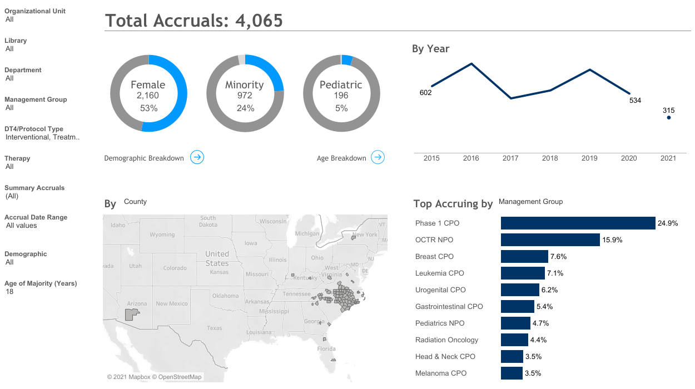
Notes:
Here is a dashboard from Insights. This shows our treatment accrual since 2015. Here you can drilldown to dashboards on race and age. The map shows accruals by subject’s zip code at the time of registration. All supporting data are pulled from OnCore.

Slide 32
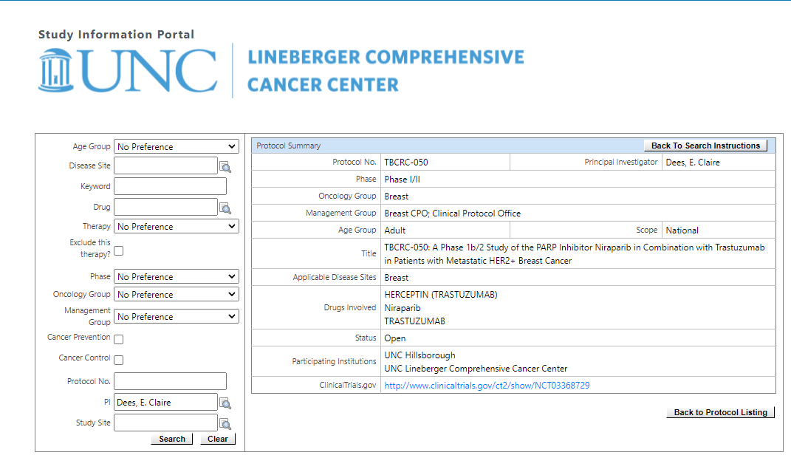
Notes:
OnCore also feeds the Find a Clinical Trial functionality on the Lineberger Website. You can see in this example where I have searched for trials by PI, and then selected one of our breast cancer trials. Note the link to the trial registration at ClinicalTrials.gov.

Slide 33
OnCore Expansion
Optimization and Training Opportunities
Non-protocol office teams - protocol creation; IRB reviews; status updates; subject management
Integrations – IRBIS, more with Epic
Notes:
The Office of the Vice Chancellor for Research is leading an expansion of OnCore to serve the rest of the clinical research community here at UNC. Our team is involved in the work of the expansion, which began with a move from housing OnCore within Lineberger Bioinformatics to cloud hosting by Advarra, the vendor. We are helping to support the expansion and safeguarding the existing Lineberger data in OnCore. We are leveraging the expansion to optimize our utilization of OnCore’s financial management functionality. We are also participating in the training available as part of the roll-out to retrain our staff. Since the launch of OnCore for Lineberger in 2005, staff within the Clinical Protocol Office maintained data on their trials and subjects, while study maintenance outside of the Clinical Protocol Office was supported by the PRC Coordinator and staff within Clinical Data Operations. With the enterprise expansion, all study teams will be trained to maintain data in OnCore. In the future, OnCore will be integrated with IRBIS, so IRB reviews will be populated into OnCore rather than entered manually. More robust integrations are planned for Epic as well.

Slide 34
OnCore Task Lists & Activation Critical Path
Critical Path defines measurable milestones to activation
OnCore Task Lists utilized by all functional groups (Regulatory, Finance, Contracting…)
Complete rebuild of Task Lists
Revamp and expansion of reporting
Notes:
We use task lists in OnCore to manage trial activation within the Clinical Protocol Office. Kaitlin Morrison led a Protocol Evaluation Review Technique (PERT) project and defined all the measurable milestones to activation. All the possible timelines to activation were evaluated – the longest path of required milestones to activation is called the critical path. In the past year or so, we’ve rebuilt the task lists to accurately reflect this defined critical path. Within the Clinical Development team, Activation Project Managers will monitor milestones to facilitate activation. Along the way we are capitalizing on opportunities to expand our reporting.

Slide 35
PERT Chart Milestones Indicate Critical Path
Notes:
Here is a snippet of the PERT Chart, with tasks shaded for each functional group, such as regulatory, finance, and beacon build. The red arrows indicate the critical path and illustrate the expected durations between tasks in the path.

Slide 36
What a Task List Looks Like Milestones Activate Tasks Across Groups…
Notes:
Here is a view of a task list. The blue triangles indicate a milestones in the pert chart. Milestones in the OnCore task list activate tasks across functional groups

Slide 37
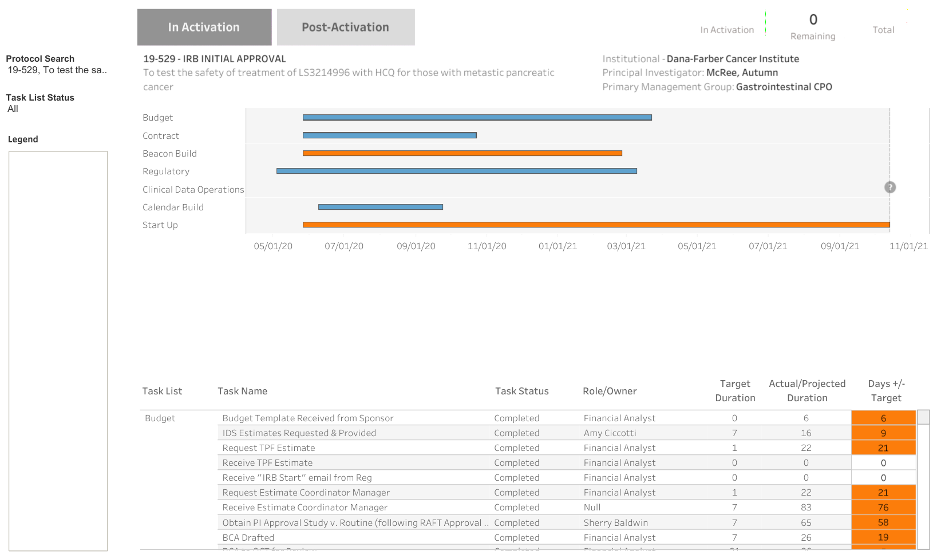
Notes:
Here is a screen shot from Insights of a GANTT chart showing activation progress for an individual trial. The blue bars indicate task lists that are within the timeline, and the orange bars show task lists exceeding the timeline. Individual tasks are visible in the table below, which scrolls to show the status of all the tasks associated with a trial.

Slide 38
Part 11 Compliance and Advarra EDC
Part 11 Compliance
Electronic Signatures
Audit Trails
CDISC Data Standards
CDASH – Data collection
STDM – Data tabulation for transmission
ADaM – Analysis model for clinical data
Validated Systems
Technology components fulfills its purpose in alignment with regulatory guidelines
Workflows support validation
SOPs
Notes:
Part 11 is the portion of the Code of Federal Regulations for FDA and is a component of GCP, or Good Clinical Practice. This part of the code relates to electronic records, electronic signatures, and their equivalency to paper documentation and handwritten signatures. We are accountable to this code specifically for data that will be submitted to the FDA. Here are some highlights. Electronic signatures must be certified as legally binding and employ at least 2 forms of identification. Audit trails are records of when any individual has entered, edited, or viewed data in a system. CDISC is the Clinical Data Interchange Standards Consortium. The standards established by the consortium "enable information system interoperability to improve medical research and related areas of healthcare". The standards support the ability of researchers at the FDA to analyze data across studies and across sponsor. CDASH establishes a standard way to collect data including prespecified variables within established domains. SDTM provides a standard for organizing and formatting data to streamline processes in collection, management, analysis and reporting. ADaM defines dataset and metadata standards that support efficient generation, replication, and review of clinical trial statistical analyses, and
traceability among analysis results, analysis data, and data represented in the Study Data Tabulation Model (SDTM).​
In order to comply with Part 11, we implemented Advarra EDC as our electronic data capture system. This is the system in which we build forms and collect data for our IITs with INDs. Prior to implementation in April 2020, data for our treatment IITs was collected in OnCore EDC and most of the data still reside there. The vendor, Advarra, owns both OnCore and Advarra EDC. The two systems are connected by an interface hub, facilitating registration of trials and subjects into Advarra EDC. In Advarra EDC, PI’s are enabled to login and approve data in the EDC electronically.

Slide 39
Advarra EDC by the Numbers
82 global CDASH (CDISC) eCRFs developed to be used across protocols
16 protocols built in Advarra EDC
SDTM datasets in process in preparation for our CD30 data submission to the FDA for LCCC1532-ATL, LCCC1904-ATL, and LCCC1524-ATL
9 trials built within the Infectious Disease department
Notes:
To date, we have developed 82 global forms and built 16 protocols in Advarra EDC. The programming required for STDM datasets is nearly complete. Additionally, we’ve partnered with the Infectious Diseases to provide a Part 11 Compliant system to support their Covid-19 research.

Slide 40
LCCC IIT Data Management - Activation
Protocol development + consultation with PI and Statistician
Data Management Plan
Identify Critical/Complete Data Values (CDVs)
Create Data Validation Plan (DVP)
Create eCRFs, test, review, release
Form completion guidelines, Start Up
Notes:
CDMA’s involvement in a trial begins with providing input during protocol development, to ensure the language of the protocol enables the collection and management of data. In reviewing the protocol, the CDMA identifies the Critical and Complete Data Values required to analyze safety and the study endpoints. The compiled critical data values is called the CDV and is approved by the PI and Biostatistician. The CDV is incorporated into the Data Management Plan, which details the tools and expectations of data management over the life of the study. eCRFs are developed according to data standards. The eCRFs are tested internally, with the study coordinators participating in user acceptance testing. The Data Validation Plan defines how data will be reviewed for each form. As part of study activation, we also write form completion guidelines and develop training to be conducted at study initiation meetings.

Slide 41
Complete Data Values (CDV)
Notes:
Here are illustrations of these documents as they relate to data management of adverse events. The first step is identified the values to be collected per protocol in the CDV.

Slide 42
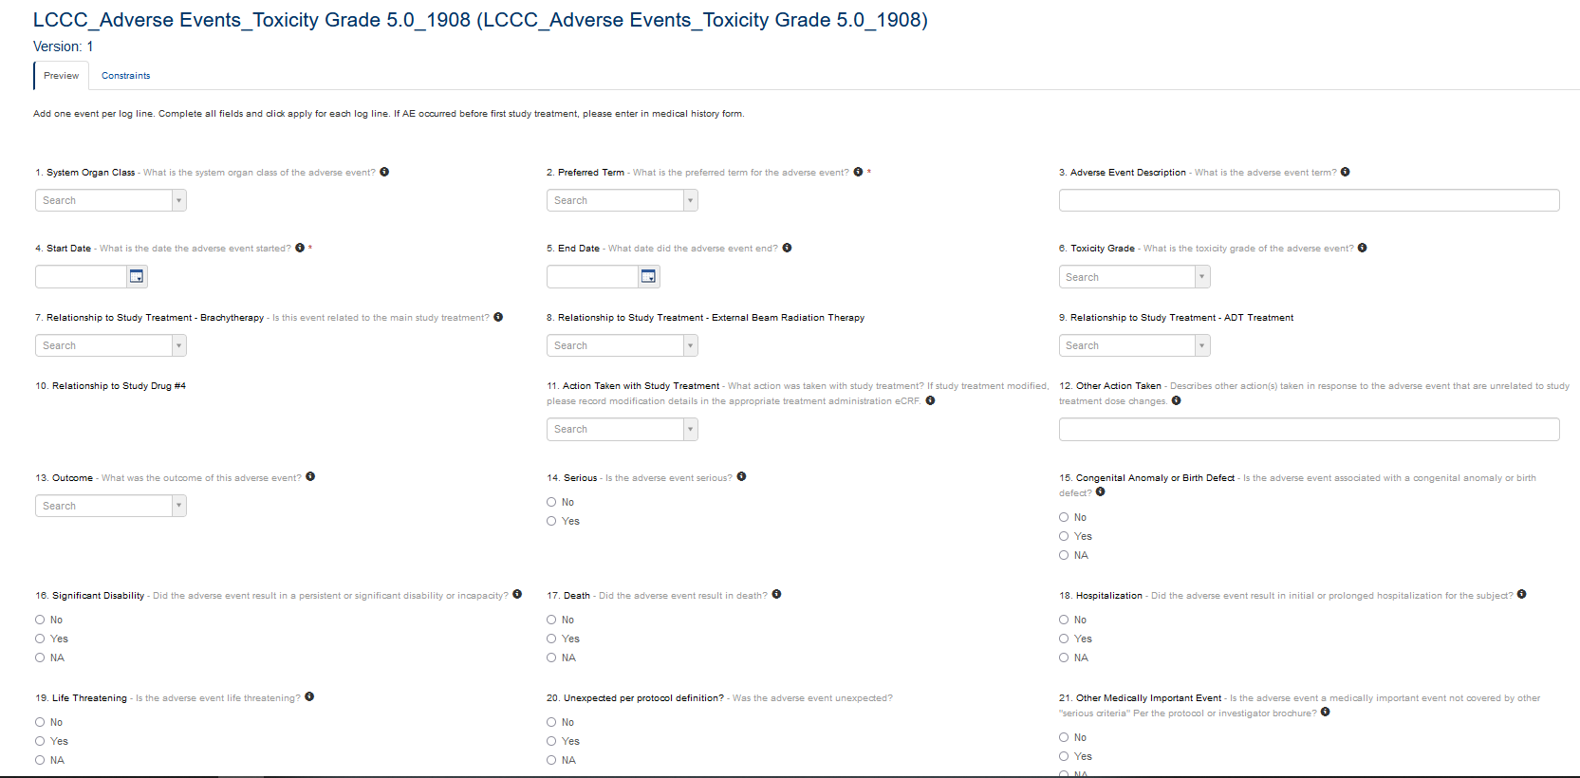
Notes:
The case report form (eCRF) is developed according to the CDV and according to the data standards. For example, the criteria for a serious event are broken out over sections 15 through 19.

Slide 43
Form Completion Guidelines
Notes:
The Form Completion Guidelines support data quality and provide guidance to the coordinator in how to complete forms.

Slide 44
Data Validation Plan (DVP)
Notes:
The data validation plan is a guide for the CDMA during data review. The DVP helps us ensure accuracy and quality of the data, facilitates consistency of review and enables coverage when the assigned CDMA is on leave.

Slide 45
LCCC IIT Data Management – Life of the Study
Clinical Data Review - safety, outcomes, other elements
DSMC reports quarterly or monthly
IND reports annually
PI reports
Datasets for posters, abstracts, manuscripts
Results reporting to ClinicalTrials.gov
Database lock
Notes:
In addition to conducting data review, the CDMAs run reports and ensure complete datasets. The Lineberger Data & Safety Monitoring Commeee meets monthly, and each trial is reviewed according to the risk and complexity score assigned by the PRC. Each month, the CDMA works with coordinators to ensure safety data are entered and accurate. We use SAS programming to extract data. These SAS reports are reviewed by the CDMA prior to distribution to the study team for inclusion in the report to the DSMC. Similarly, each month we run reports of safety and other data as required by the FDA for their annual reporting. When we receive a request from an investigator for data to support a presentation or publication, we conduct additional review of the data for quality. At the end of the study, we prepare the data for database lock.

Slide 46
Data Sharing
For IITs, PI directs usage of the data
Clinical Data Management Associate shares data within UNC at the request of the PI
Biostatistician shares analyses at request of the PI
Clinical Data Operations may share data outside of UNC according to a Data User Agreement (DUA)
DUA is a legal contract between institutions stipulating
Who may receive data
What they may use it for
If recipients can share said data
Notes:
Principal Investigators own their research data. We share it internally at the direction of the PI. The biostatistician may share analyses at the direction of the PI. If data are to be shared outside the institution, a data use agreement or DUA is required. DUAs are…

Slide 47
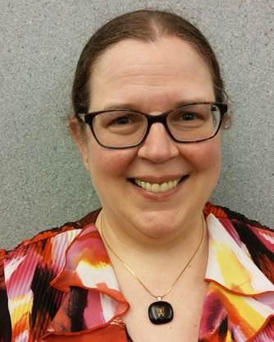
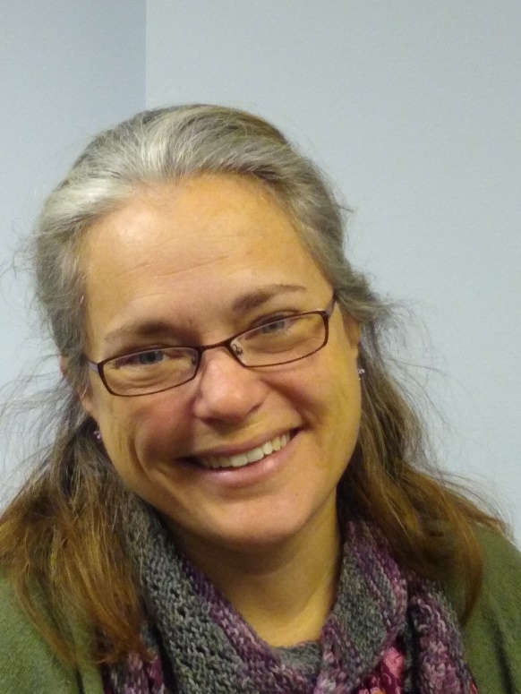
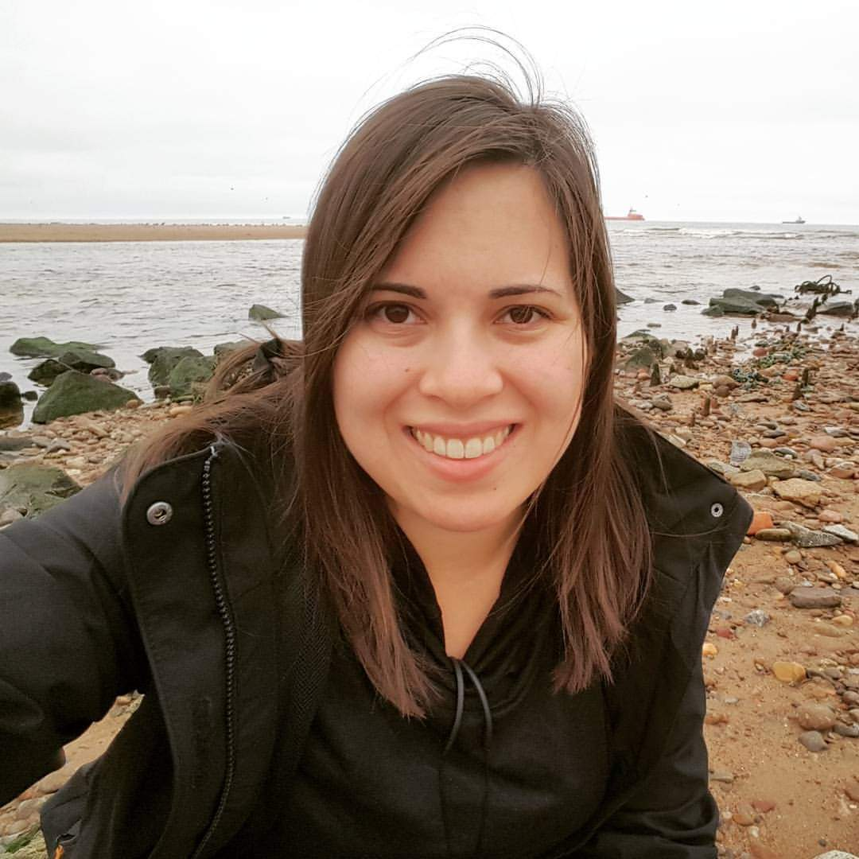
Clinical Data Operations
Contact us at LCCC_OnCore@med.unc.edu
Notes:
Here’s a slide showing of our team, minus a couple for whom I’m missing pictures. We’re a helpful crew – please reach out to us for OnCore access and support, for information about any of our services, or if you have any questions from today’s presentation.

Slide 48
Regulatory Affairs
Shaw Scott
Assistant Director of Regulatory Affairs and Compliance

Slide 49
Topics Covered
Purpose of the IRB
Types of IRBs
Types of IRB Submissions
IRB Determinations
PI Certification of IRB Submissions
Good Clinical Practice
Key Essential Documents
Florence eRegulatory Binder

Slide 50
What is the Purpose of the Institutional Review Board (IRB)?
The IRB was established to protect the rights and welfare of human subjects
Previous incidents of unethical research that harmed human subjects (e.g., Nazi experiments, Tuskegee study) led to government regulations for establishing legal protections
National Research Act (1974)
Belmont Report Principles (1979)
Respect for persons – Informed consent
Beneficence – Assessment of risks/benefits
Justice – Selection of subjects
Department of Health and Human Services Regulations (46 CFR – protection of human subjects)
FDA regulations (21 CFR Parts 50 (protection of human subjects) and 56 (IRBs))

Slide 51
UNC IRB
Office of Human Research Ethics (OHRE) is responsible for ethical and regulatory oversight of human subject research at UNC-CH
OHRE administers and supports the work of the Institutional Review Boards (IRBs) at UNC-CH
6 Boards at UNC: A, B, C, D, E, F
Reviews are conducted by individual members or by full board meeting + vote (depending on risk)
Boards: at least 5 members with diverse backgrounds
Men + Women | Scientists + Non-scientists | Affiliated + Non-Affiliated

Slide 52
Research Reviewed by IRB
The IRB reviews all proposed research involving human subjects to ensure that subjects are treated ethically and that their rights and welfare are adequately protected.
Research
Systematic investigation designed to develop or contribute to generalizable knowledge.
Human Subjects
Living individuals about whom an investigator obtains identifiable private information OR data through an intervention or interaction.
IRB Review

Slide 53
Types of IRBs Used by UNC
UNC IRB (local IRB)
Used for investigator-initiated trials (IITs), federally-funded, or non-funded research
Commercial IRBs (WCG, Advarra, Sterling)
Used for industry-sponsored, multi-site research studies
Request reliance on external IRB from UNC IRB
UNC IRB must review personnel additions and other institutional requirements (e.g., COI language in ICF, Radiation Safety)
National Cancer Institute Central IRB (NCI CIRB)
Used for NCI-sponsored studies (cooperative group studies)
Request reliance on CIRB from UNC IRB
UNC IRB must review personnel additions and other institutional requirements (e.g., COI language in ICF, Radiation Safety)

Slide 54
Types of IRB Submissions
Initial
Modifications
Continuing Reviews (Renewals)
Eligibility Exceptions/Single Subject Exceptions
Promptly Reportable Information (unanticipated problems, protocol violations)
Closures

Slide 55
Modifications
A modification cannot be implemented until it is IRB-approved.
Personnel Changes (UNC IRB)
Protocol Amendments
Administrative Letters
Accrual Goal Change (UNC IRB)
Investigator Brochure Updates
Revised Consent Forms
Updated or New Patient Materials

Slide 56
Continuing Reviews / Renewals
As long as the study is not terminated (closed with the IRB), it must be renewed at least annually
Even if subjects are no longer being treated or followed? Yes!
In order to do analysis of the data? Yes!

Slide 57
Eligibility Exceptions
A request to enroll a subject who does not meet one or more of the eligibility criteria
Must be approved by the PI and the Sponsor
Must be submitted to and approved by the IRB
Should be a rare request because the eligibility criteria are there to protect the subject and the research integrity
Requires a rationale
Not permitted for:
NCI Cancer Therapy Evaluation Program (CTEP) protocols (Alliance, SWOG, ECOG) / CIRB Studies
LCCC Investigator-Initiated Studies (per LCCC policy)

Slide 58
Non-Eligibility Single Subject Exceptions
A request to alter some aspect of a subject’s participation other than eligibility criteria
Requires approval by:
Sponsor
PI
IRB
Not permitted for:
NCI Cancer Therapy Evaluation Program (CTEP) protocols (Alliance, SWOG, ECOG)
NCI CIRB does not review or approve SSEs
May need FDA approval if LCCC IND

Slide 59
LCCC IIT Single Subject Exception Decision Tree

Slide 60
IRB Closure
A study is complete and should be closed with the IRB when the following are complete:
data collection + data analysis

Slide 61
Promptly Reportable Information to the IRB
Each IRB has its own requirements for prompt reporting of unanticipated problems and noncompliance events – consult with your Regulatory Associate
UNC IRB – must submit PRI form within 7 calendar days of identification of the event

Slide 62
Examples of Reportable Events (UNC IRB)
Unanticipated Problems
Unexpected
Related or possibly related to participation in research
Subjects or others placed at greater risk of harm
Protocol deviation that harmed or placed subjects or others at increased risk of harm
Failure to obtain informed consent or re-consent
Deviating from the informed consent or recruitment process approved by the IRB
Initiating changes to protocol without IRB approval, including using unapproved materials
Audit, inspection, or inquiry by federal agency
Complaint or concern expressed by subjects or others about the conduct of a study or a subject’s participation
External IND safety reports
Failure to complete institutionally-required human subjects protection training prior to engaging in human subject research
Failure to complete the IRB application in a true and accurate manner
Over-enrollment

Slide 63
Notification to OHRP and FDA of IRB Determinations
If the IRB makes one or more of the following determinations, it is required to notify OHRP (federally-funded research) and/or FDA (FDA-regulated research)
UPIRSO - Any incident, experience, outcome, or new information that are (1) unexpected, (2) related or at least possible related to participation in the research, and (3) indicates that subjects or others are at a greater risk of harm (including physical, psychological, economic, legal, or social harm
Serious Non-Compliance - defined as noncompliance that increases risk of harm to subjects; adversely affects the rights, safety, or welfare of subjects; or adversely affects the integrity of the data or the research
Continuing Non-Compliance - defined as a pattern of repeated noncompliance which continues after it has been identified that noncompliance occurred, including inadequate effort to take corrective actions or comply with IRB requirements within a reasonable timeframe.
Suspension - Temporary withdrawal of approval by the IRB of some or all research activities associated with a study.
Termination - Permanent withdrawal of approval by the IRB of all research activities associated with a study.

Slide 64
PI Certification of IRB Submissions
The PI must certify that the information provided
in applications submitted to the IRB is complete and
accurate.
The PI has ultimate responsibility for the conduct of
the study, the ethical performance of the project, the
protection of the rights and welfare of human participants,
and strict adherence to the study protocol.
This Photo by Unknown Author is licensed under CC BY-NC

Slide 65
Good Clinical Practice (GCP)
Good Clinical Practice (GCP) is an international ethical and scientific quality standard provided by the Internal Conference on Harmonisation (ICH) for designing, conducting, recording and reporting trials that involve the participation of human subjects.
Recognized as a critical requirement to the conduct of research involving human subjects.
GCP training is required to conduct clinical research.

Slide 66
ICH GCP E6 (R2) Sections
Section 1 of ICH GCP Guideline –Glossary
Section 2 of ICH GCP Guideline –Principles
Section 3 of ICH GCP Guideline -IRB/IEC
Section 4 of ICH GCP Guideline - Investigator
Section 5 of ICH GCP Guideline –Sponsor
Section 6 of ICH GCP Guideline –Clinical Trial Protocol/Amendments
Section 7 of ICH GCP Guideline –Investigator’s Brochure
Section 8 of ICH GCP Guideline -Essential Documents

Slide 67
ICH/GCP
The investigator’s responsibility according to ICH GCP guidelines:
4.1 Investigator qualifications and agreements
4.2 Adequate resources
4.3 Medical care of trial subjects
4.4 Communication with IRB
4.5 Compliance with the protocol
4.6 Investigational product
4.7 Randomization procedures and unblinding
4.8 Informed consent of trial subjects
4.9 Records and reports
4.10 Progress reports
4.11 Safety reporting
4.12 Premature termination or suspension of a trial
4.13 Final report(s) by the investigator

Slide 68
Essential Documents for a Clinical Trial
Documents that “individually and collectively permit evaluation of the conduct of the trial and the quality of the data produced”
“Serve to demonstrate the compliance of the investigator, sponsor, and monitor with the standards of GCP and the applicable regulatory requirements”
Must be organized and retained for the conduct of clinical studies
These organized documents are referred to as the REGULATORY BINDER
Key Essential Documents Investigators Will Be Asked to Sign:
Form FDA 1572 Statement of Investigator
Financial Disclosure Form
Delegation of Authority Log
Protocol Signature Page
IB Acknowledgment of Receipt
Training Documentation

Slide 69
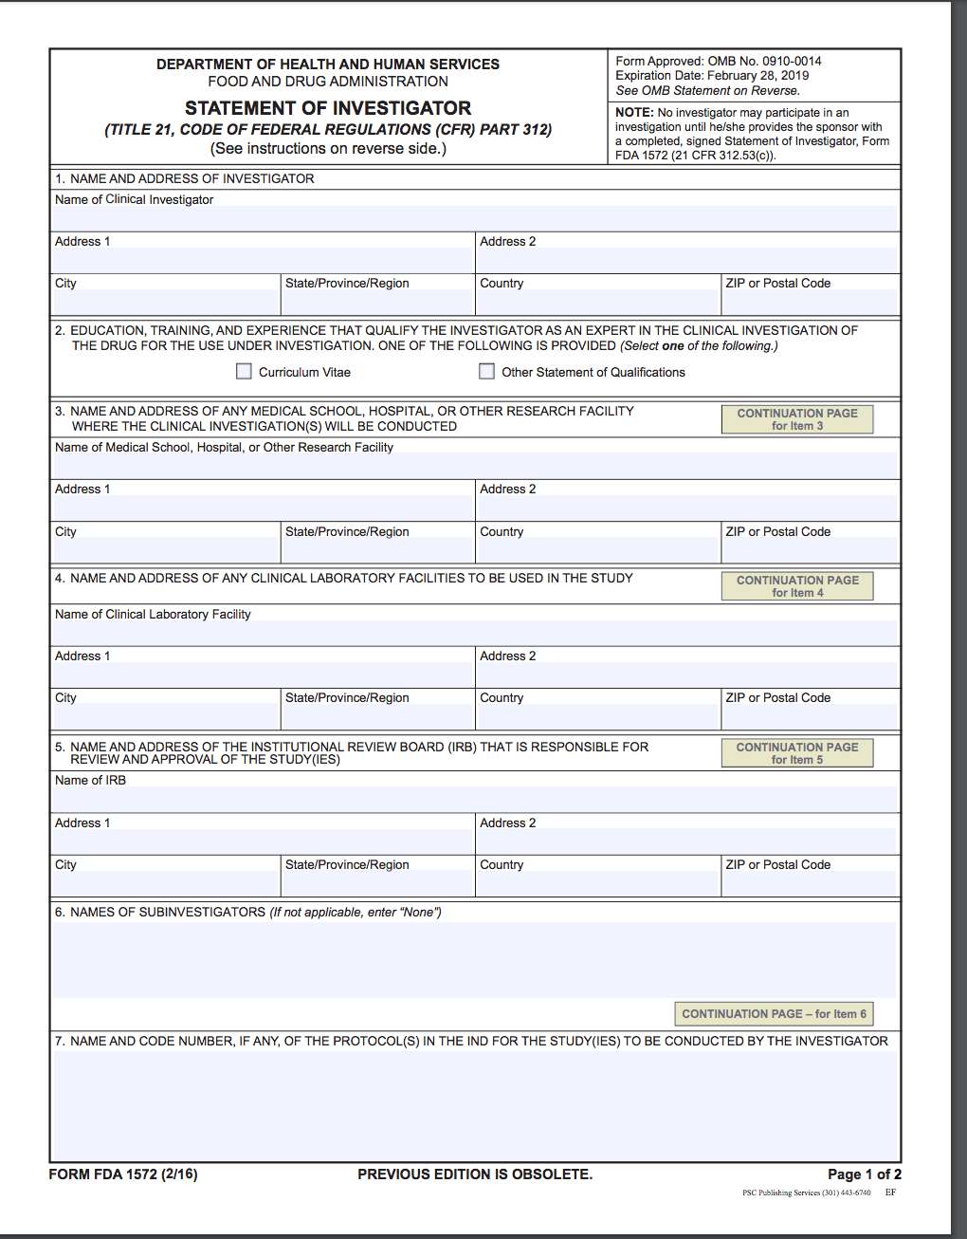
Form FDA 1572 – Statement of Investigator
This form signed by the investigator has 2 purposes:
to provide the sponsor with information about
the investigator’s qualifications and the clinical site
that will enable the sponsor to establish and document
that the investigator is qualified and the site is an appropriate location at which to conduct the clinical investigation, AND
2. to inform the investigator of his/her obligations and obtain
the investigator’s commitment to follow FDA regulations.

Slide 70
FDA Form 1572: Eight Investigator Commitments
Maintain protocol adherence
Personally conduct or supervise
Ensure informed consent of subjects
Report adverse experiences
Provide training to sub-investigators
Ensure adequate and accurate recordkeeping
Ensure proper IRB review and reporting
Comply with all regulatory requirements

Slide 71
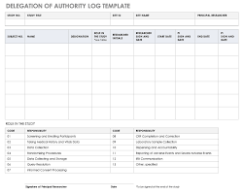
Delegation of Authority (DOA) Log
The PI is responsible for the overall conduct of the clinical trial but may delegate specific tasks to qualified and trained study staff.
The PI is responsible to maintain a “List” of appropriately qualified persons to whom significant trial-related tasks have been delegated (ICH section 4.1.5)
The DOA log lists all the assigned study staff members, along with each of their delegated tasks, start date and end date on the study. The start date must precede the performance of any study specific tasks.
The PI must sign off on the start and stop dates of all staff confirming delegated tasks and dates of participation in the clinical trial on the DOA log.

Slide 72
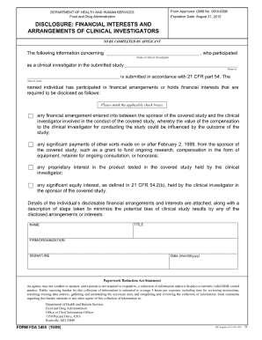
Financial Disclosure Form (FDF)
Each PI and co-investigator (anyone listed on the FDA Form 1572 for the study) is required to disclose the aggregated financial interests of themselves, their spouse and dependent children, as they relate to the study sponsor and/or study product(s). (21 CFR 54)
If any of the financial interest questions are checked “Yes,” a statement disclosing those financial interests and arrangements and identifying steps taken to minimize the potential for bias must be attached to the signed FDF.
Financial disclosures must be completed prior to study involvement and updated if needed.

Slide 73
Florence eRegulatory System
Electronic Regulatory Binder - where we store all the essential documents for a study
FDA 21 CFR Part 11 Compliant - eliminates need for paper files and wet ink signatures
Allows for:
Electronic signatures
Remote monitoring
Audit trail
Requires training from investigators on e-signatures

Slide 74
Questions?
Contact Shaw Scott – shaw_scott@med.unc.edu
Thank you!

Slide 75
CPO Clinical Operations
Stefanie Belanger, MHA, CCRP
Assistant Director, Clinical Research Operations & Medical Center Integration

Slide 76
Overview
Clinical Organizational Structure
Consenting
Screening
Enrolling
Patient Visits
Visit Wrap-up
Other Responsibilities
Research vs. SOC
Things to Know

Slide 77
Clinical Organizational Structure
Assistant Director, Clinical Research Operations & Medical Center Integration
Stefanie Belanger
Interpreter
Ruben Gonzalez-Crespo
Clinical Research Manager
TBD
Clinical Research Manager
Jennifer Gruhn
Lead Study Coordinator (SC3)
TBD
Lead Study Coordinator (SC3)
Julie Maccarone
SWAT
GYN
Rad Onc
GU
Neuro
Assistant Director, Clinical Research & Network Operations
Stephanie Ladd
Clinical Research Manager
Blair Adams
Epic Coordinator
Teresa Nuttall
Clinical Research Manager
Erica Moore
Lead Study Coordinator (SC3)
TBD
Lead Study Coordinator (SC3)
Brian Burgess
Lead Study Coordinator (SC3)
Megan Laffan
Breast
GI
Melanoma
Phase I
Lead Study Coordinator (SC3)
TBD
Lead Study Coordinator (SC3)
Allison McKinney
Lead Study Coordinator (SC3)
Kelly Hoye
H&N
Lung
Leukemia
Lymphoma
Myeloma
https://unclineberger.org/research/cpo/
Notes:
CPO website has more info on roles and leadership structure.
From the clinical perspective, each pod consists of Study Coordinators (patient facing) and Data Coordinators (non-patient facing).
SCs: mostly unlicensed, so the few licensed SCs assist with orders in Epic
SCs are who they will interact most with, so will mostly focus on that role

Slide 78
SIVs
CRPNs (Visit
Documentation)
AE
Assessment
Clear
Patients
Con Med
Collection
Pod
Meetings
Consenting/
Reconsenting
Screening
Tumor
Board
Startups
QOLs
Drug
Accountability
Scheduling
Data
Abstraction
& Entry
Monitor
Visits
Staff
Meetings
SAEs
Rad Core
Requests
Lab Kit
Inventory
Management
SAE
Follow Ups
Lab Kit Prep
& Delivery
Queries
Treatment Plan
Management
Oral Drug
Patient
Education
Subject
Registration
Process
Patient
Reimbursements
Conference
Calls
Billing
Calendars
Survival
Follow Up
QA Visit
Assessments
Tissue
Requests
Coordinate
TPF Services
Patient
Communication
Request
Outside
Records
Audits
Research
Chart Creation
& Maintenance
Officewide &
Study-Specific
Training
Documenting
& Reporting
Deviation
CAPA
Development
& Execution
DSMC
Reports
Perform
& Transmit
ECGs
Notes:
SC role is an iceberg in that there will be areas where they interact with investigators, but that is just a fraction of their responsibilities – and this iceberg doesn’t list everything SCs do
All clinical staff are assigned multiple trials based on complexity and enrollment, but all clinical staff are approved on all studies within the pod
We’re going to focus on the tip of the iceberg but will also address some of the pieces below the surface as well

Slide 79
Consenting
Investigator
Identify prospective patient
Confirm slot availability
Introduce trial to patient
SC
Maintain wait list (if applicable)
Compile ICFs
Coordinate interpretation
Review with patient and collect signatures
Reach out to reg if LAR needed
Notes:
ICFs always from OnCore
Interpretation: Ruben or Language Line (Spanish backup or other); serve as witness (not study team member); NO hospital interpreters

Slide 80
Screening
Investigator
Ensure patients can be seen
If fresh tissue biopsy required, determine anatomic location and method
Cosign CRPN (Clinical Research Progress Note)
Attest to individual eligibility criteria not already in Epic
Review eligibility packet and sign (if determined eligible)
SC
Schedule appointments
Apply billing timeline
Coordinate with TPF (Tissue Procurement Facility)
Write CRPN, route for co-signature
Compile eligibility packet
Secure 2nd level and investigator reviews
Notes:
e.g., life expectancy of greater than or equal to 3 months; Known hypersensitivity to biopharmaceutical agents produced in Chinese hamster ovary cells.
Scheduling – their calendars make this difficult, so may need their intervention; sometimes requires coordinating different protocol-specific methods for scans

Slide 81
Enrolling
Investigator
Coordinate SOC needs with care team (e.g., nurse navigator, CPP)
SC
Register with sponsor
Schedule appointments/admission
Prep lab kits
Queue up treatment plan
Notify IDS (Investigational Drug Services)
Notes:
CPP = clinical pharmacist practitioner

Slide 82
Patient Visits
Investigator
Coordinate SOC needs with care team (e.g., nurse navigator, CPP)
Confirm grading and provide attribution for AEs
Review assessments and make medical decisions
Clear patients and sign orders (attending physicians only)
SC
Reconsents
QOLs
Perform AE assessment
Conduct con med review
Drug education & accountability (for PO drugs)
Ensure all assessments completed per protocol and clear patients
Notes:
In addition to scheduling, prepping lab kits, and queuing up treatment plans, SCs also…
Assessments = ECGs, labs, disease assessments (scans, bmbx, Rad Core)
AEs = CTCAE (will need investigator input/confirmation)

Slide 83
Visit Wrap-up
Investigator
Sign ECG tracings
Cosign CRPN
Complete office visit note
Provide risk determination for deviations
SC
Complete CRPN
Report deviations (due to error, patient refusal/noncompliance, adverse weather, etc.)
Beacon – complete the day
Scheduling/adjustments
Notes:
All these investigator interactions and responsibilities are how they demonstrate proper oversight of their trials.

Slide 84
Back to that iceberg…
SIVs
CRPNs (Visit
Documentation)
AE
Assessment
Clear
Patients
Con Med
Collection
Pod
Meetings
Consenting/
Reconsenting
Screening
Tumor
Board
Startups
QOLs
Drug
Accountability
Scheduling
Data
Abstraction
& Entry
Monitor
Visits
Staff
Meetings
SAEs
Rad Core
Requests
Lab Kit
Inventory
Management
SAE
Follow Ups
Lab Kit Prep
& Delivery
Queries
Treatment Plan
Management
Oral Drug
Patient
Education
Subject
Registration
Process
Patient
Reimbursements
Conference
Calls
Billing
Calendars
Survival
Follow Up
QA Visit
Assessments
Tissue
Requests
Coordinate
TPF Services
Patient
Communication
Request
Outside
Records
Audits
Research
Chart Creation
& Maintenance
Officewide &
Study-Specific
Training
Documenting
& Reporting
Deviation
CAPA
Development
& Execution
DSMC
Reports
Perform
& Transmit
ECGs
Notes:
Note DCs, importance of prompt response from investigators
SAEs: clock starts for reporting from the moment a study team member becomes aware – and that includes you!

Slide 85
Research vs. SOC
Care of patients participating in a clinical trial is a shared responsibility!

Slide 86
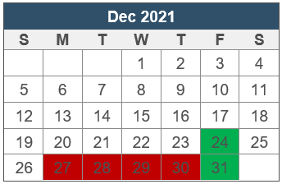
Things to Know
Trial assignments made by SC3s (leads)
CPO staff are University employees
Holidays differ
Adverse weather policies differ – CPO staff not designated as mandatory
Business hours
Monday – Friday 8:30AM – 5:00PM
Outside this time: oncology fellow on call
https://hr.unc.edu/benefits/leave-holidays/weather-emergency/
Notes:
Trial assignments partially using OPAL (Ontario Protocol Assessment Level)
Condition 1: flexible
Condition 2: must not report to work and must leave campus – must use personal leave time (comp, vacation, or bonus) if absent
Condition 3: must not report to work and must leave campus – not required to use leave

Slide 87
Thank you! https://unclineberger.org/research/cpo/

Slide 88
Compliance
Tess Cummings RN, DBA, CCRP
Director, Clinical Protocol Office
Sr. Advisor to the Office of the Vice Chancellor of Research

Slide 89
Topics Covered
Audits
Monitoring
Root Cause Analysis
Corrective and Preventive Actions

Slide 90
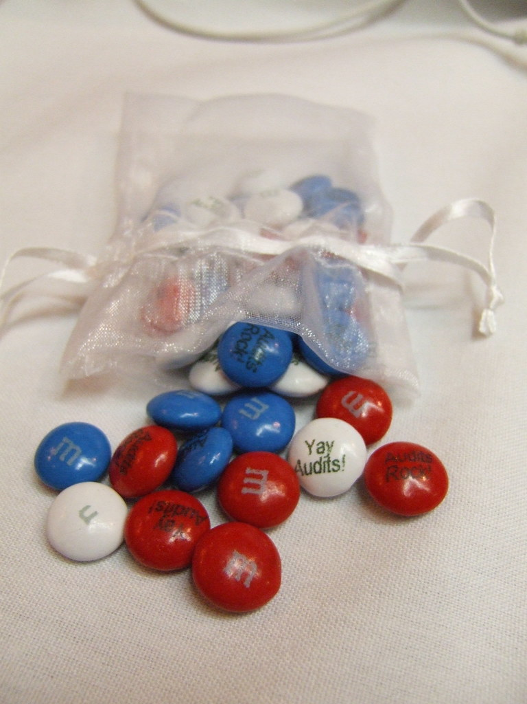
Audits
Who?
What?
When?
Why?
How?

Slide 91
Audits – Who?
Food and Drug Administration
Sponsors
Contract Research Organizations
Institutional Review Boards
Clinical Trials Quality Assurance Unit (UNC)

Slide 92
Audits – What?
Informed consent process
Eligibility process
Treatment administration
Adverse Event collection

Slide 93
Audits – When?
New Drug Application being/has been submitted
Serious and/or continuing noncompliance occurring at a site
Data irregularities

Slide 94
Audits – Why?
Data Integrity
Assurance that Rules of Engagement were followed
Appropriate delegation to properly trained staff
Human Subjects protections in place
Billing compliance

Slide 95
Audits – How?
In person OR Remote
Prepare ahead of time
All source data must be made available to the auditors as requested
Team members involved in hosting the audit must be seasoned to manage and audit
Ensure all teams involved in research are informed and available
Debrief with the team

Slide 96
Monitoring – sponsor responsibility
SIV – site initiation visit
IMV – interim monitoring visit
COV – close out visit
Comparison of source data to case report forms
All to ensure data is accurate, reproducible

Slide 97
So, what do you do if……

Slide 98
Root Cause Analysis (RCA)
Process of discovering the root cause of problems in order to identify appropriate solutions.
Focus on HOW and WHY the issue arose, not WHO is responsible
Notes:
Focus on correcting and remedying the root cause, not

Slide 99
FDA expectations related to Root Cause

Slide 100
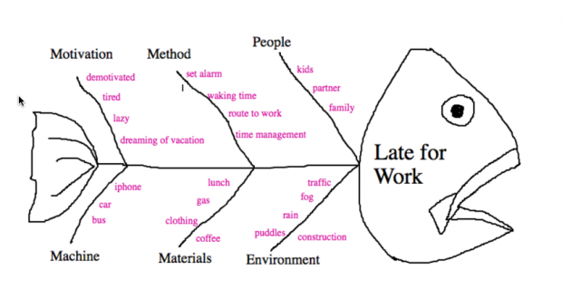
RCA Techniques & Outcome
5 Why’s
Fishbone Diagram
Identification of the Causative Factors

Slide 101
Corrective and Preventive Actions (CAPA)

Slide 102
CAPA Cont.

Slide 103
CAPA Cont.

Slide 104
FDA expectations related to CAPA

Slide 105
CAPA management:
CAPA MUST include a Risk Assessment by the PI – does the problem pose actual or possible increased risk to the subject?
CAPA are discussed at weekly CAPA meeting led by regulatory and effectiveness is monitored during this meeting as well

Slide 106
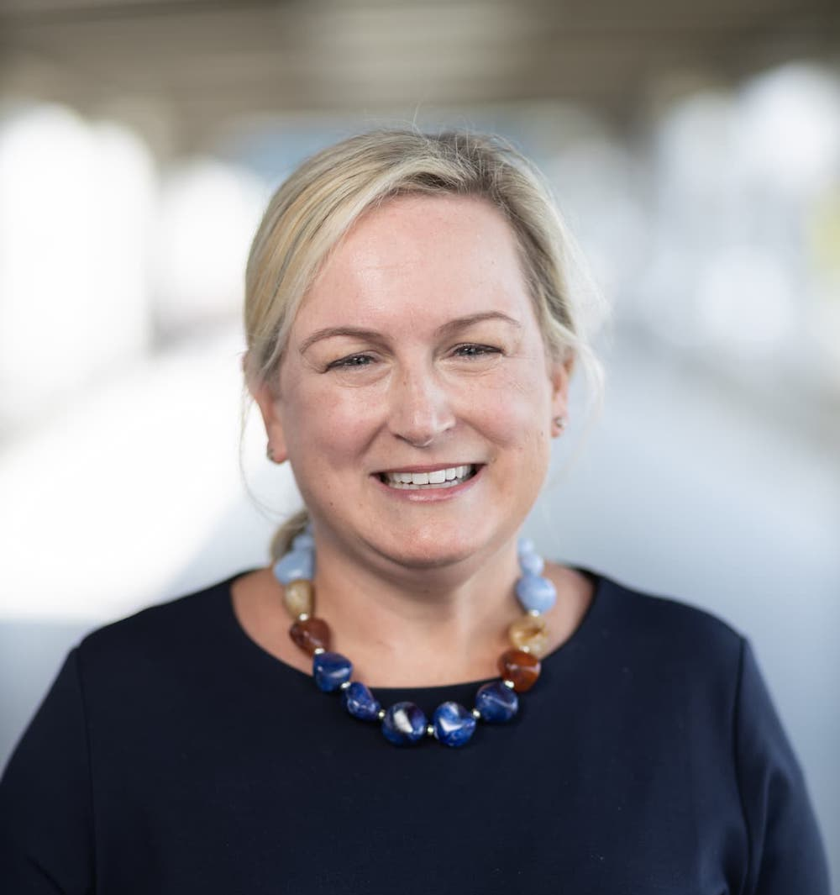
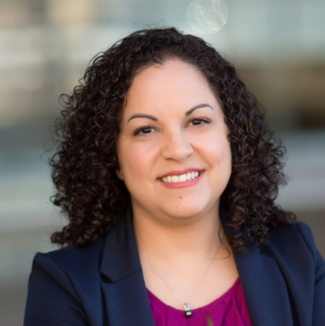
Questions?

