Slide 1
The role of advocates in clinical trials research
Patty Spears
Research Patient Advocate
November 10, 2021
@paspears88

Slide 2
What you need to know
Who
Why
What
When
How
Who are patient advocates?
Why should you include patient advocates?
What do you want patient advocates to do?
When do you need to include an advocate?
How do you engage patient advocates?
Example of Patient Engagement in Clinical Trials
Patient Engagement at UNC Lineberger

Slide 3
Who are patient advocates?
Who
Types of Patient Advocacy
What we
advocate for
Who we are
Political
Support
Fundraising
Watchdog
Research
Patients
Patient Groups or Organizations (PG)
Research Patient Advocates (RPA)

Slide 4
research and disease
knowledge
patient
patient
patient
patient
patient
patient
PG
patient
patient
patient
patient
patient
patient
patient
RPA
patient
patient
patient
researchers
PG
PG
patient
patient
patient
PG
PG
Individual Patients
Personal experiences
Patient Groups (PGs)
Access to many patients with the disease
Easy to find
Research Patient Advocates (RPAs)
Personal experiences
Knowledge of the disease
Understand research policy and programs
Hard to find
Spears, Collyar. DIA Global Forum, September 2017 9(6) 14-15

Slide 5
NCI definition of a research advocate (2011)
Someone who brings a nonscientific viewpoint to the research process and communicates a collective patient perspective.
A collective patient perspective is created when a person has knowledge of multiple disease experiences and conveys this collective perspective rather than his or her own exclusive experience
Collective Patient Perspective
Broad Impact
Interested in Science, NOT a Scientist
REF: Advocates in Research Working Group. Recommendations. (National Cancer Institute, Bethesda, MD, 2011)

Slide 6
Why involve patient advocates?
Why
The Perception of Value
Different stakeholders may have different perspectives about value
Government/non-profit
vs.
Pharmaceutical Industry
Individual
vs.
Population
Researcher
vs.
Society
Patient
vs.
Physician

Slide 7
Patient vs. Doctor Perspective
Evidence
Cure
It’s not about agreement
It’s about understanding each others VALUES
normal activity/ function
Benefit
Risk
Pain
Experience
Living
Communication
Doctor
Patient

Slide 8
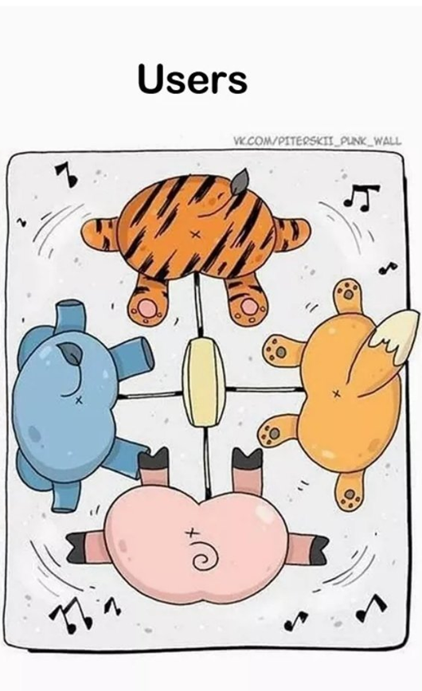
Perception matters --- Context matters
Doctors
Patients
“Oncologists most valued gains in survival, whereas patients assigned a higher monetary value to treatments that enhanced QoL.” (Dilla 2016)

Slide 9
Patients can help you communicate your science to the public
Why
We know
producing bad science for the sake of a good story is wrong
We don’t think about
producing good science but never communicating it with a good story is failing to do what is right and necessary
“Unless good science is communicated …., the public will only pay attention to bad “science”
…politicians will listen only to ideological arguments free of data.”
“...when good science is produced, that science
needs to be better communicated to nonscientists.”
T. Campbell, N&O
December 26, 2013

Slide 10
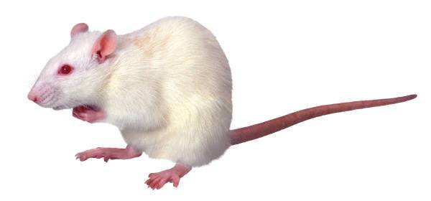
What can advocates do?
What
Patient advocates are involved in all types of research
Basic Research
Bench research in laboratories
Translational Research
Pre-clinical research in animal models
Clinical Research
Clinical trials in patients
Epidemiology/Population
Studies of associations in populations
Drug Approval
FDA panels and Pharma

Slide 11
What can advocates do?
What
Patient advocates are involved in all types of research
Basic Research
Bench research in laboratories
Translational Research
Pre-clinical research in animal models
Clinical Research
Clinical trials in patients
Epidemiology/Population
Studies of associations in populations
Drug Approval
FDA panels and Pharma

Slide 12
Patient engagement in clinical cancer research
Putting some effort into specific ways patients can be involved to make a meaningful difference will enhance the overall engagement experience for both the researcher and the patient.
Patient involvement in clinical trial development will ensure the trials answer questions important to patients and have considered patient burden, broad inclusion and patient relevant endpoints.

Slide 13
Drug Development Process
Research question is important to patients
Addressing an unmet need
Help define eligibility criteria
Help educate and motivate patients
Input on trial adaptions and modifications
Help return study results to patients
Publish and communicate results
Discovery
Preclinical
Phase I/II/III
FDA approval
Outcomes
Input on meaningful clinical benefit/PROs
Assistance on informed consent form and consent process
Provide public testimony at FDA advisory committee meetings and hearings
Provide patient perspective on guidance documents
Adapted from CTTI

Slide 14
Drug Development Process
Research question is important to patients
Addressing an unmet need
Help define eligibility criteria
Help educate and motivate patients
Input on trial adaptions and modifications
Help return study results to patients
Publish and communicate results
Discovery
Preclinical
Phase I/II/III
FDA approval
Outcomes
Input on meaningful clinical benefit/PROs
Assistance on informed consent form and consent process
Provide public testimony at FDA advisory committee meetings and hearings
Provide patient perspective on guidance documents
Adapted from CTTI

Slide 15
What can patient advocates add to clinical trials?
Concept
Lifecycle of the clinical trial
Conduct
Completion

Slide 16
Engagement in a clinical trial
Conception
Conduct
Completion
Identify clinical question important to patients Give guidance on study design regarding patient burden Identify trial endpoints important to patients Review patient reported outcome assessments Review protocols and consent forms | Help define relevant patient populations Insure inclusion of patients who may benefit Identify patient burdens to participation Help develop patient educational materials Help identify ongoing barriers to accrual | Highlight the importance of the study results for patients Help write study results summaries for the public Co-present study results with researchers Facilitate communication of study results to patients and the community Participate in preparing and writing manuscripts
Clinical Trials

Slide 17
Engaging patients adds urgency to clinical research
Early and often – throughout the entire clinical trial process
Patients understand the burden of treatments
Patients know what is important to them – they know what is patient centric and what is not
Patients can help design clinical trials that will accrue and retain participants
Patients can help identify barriers and potential accrual problems before trials open, saving time and money and ensuring the completion of trials

Slide 18
When do you engage patient advocates?
When
Early and often
Each project is different
Clinical Trails can begin in different ways
Government funded
Investigator initiated
Sponsored

Slide 19
When do you engage patient advocates?
When
Start Here
Developing a clinical trial?
Idea
Concept
Protocol
ICF
Accrual
planning
Conduct of the study
End of the study

Slide 20
How do you begin to engage an advocate in your research?
How
Have a purpose for engagement
Each project is different, one size does not fit all projects
Build a foundation with common goals
Have an idea about what a successful engagement will be
Have an environment of respect, equitable power and trust
Compensate if possible, shows you value the patients time and expertise
Collyar, Nat Rev Can, 2005; Perlmutter, Can Res, 2013, ARWG 2011; Deverka JNCI, 2018; Harrison Health Exp, 2019; Hamilton, PLoS One, 2018; Ciccarella, Ann Trans Med, 2018

Slide 21
Decide why patients will be engaged in the clinical trial
How will including patients benefit the clinical trial?
How will patients contribute?
What information will be gained from patient engagement?
1
Steps
to meaningful
engagement
Identify patients for the clinical trial
What type of patients are needed for the project?
Do the patients need to have a specific experience?
Should there be more than one patient included?
How will patients be identified?
2
Discuss roles, responsibilities,
and expectations
What is the role of patients on the project?
What will patients be required to do?
Will patients be involved at different levels?
What is the expectation of the patient?
3
Discuss how the study team and patients will communicate
How often will the study team and patients communicate?
How will the study team and patients communicate?
Who are the contact people on the study team and their roles?
4

Slide 22
Patient Advocate Engagement
Alliance for Clinical Trials in Oncology

Slide 23
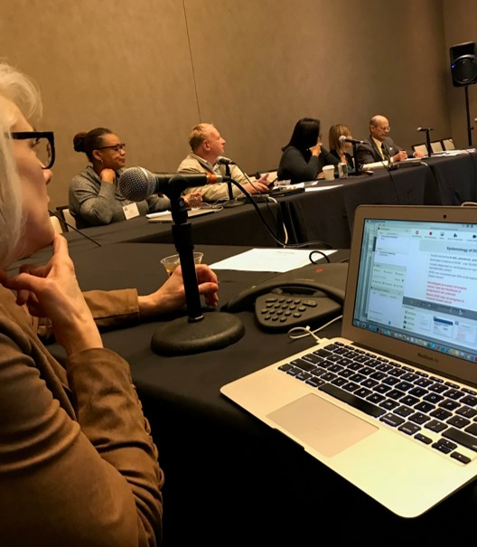
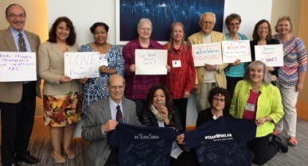
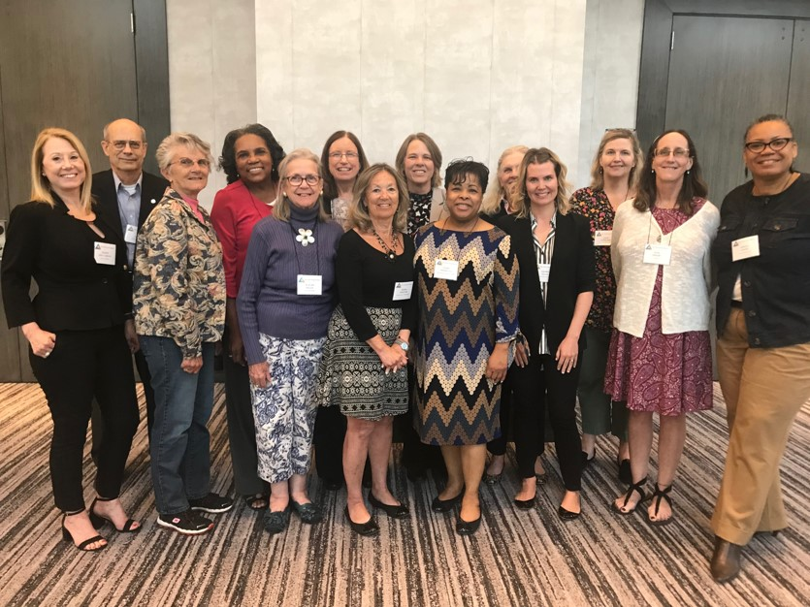
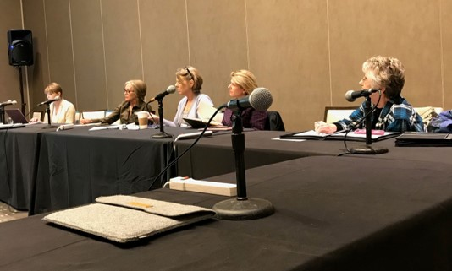
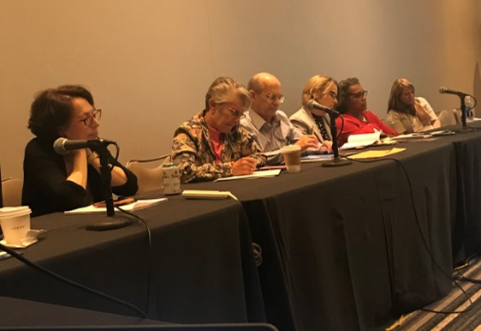
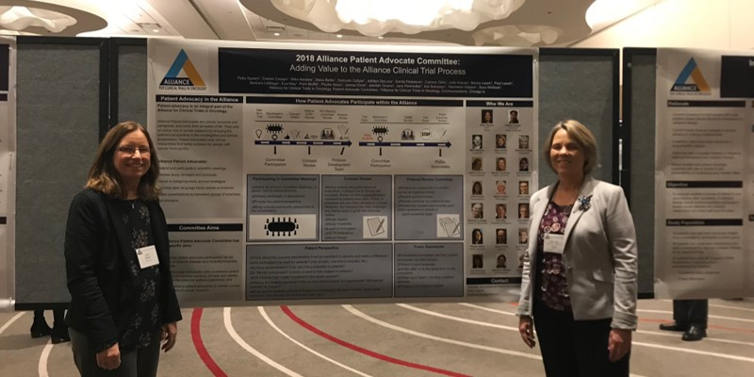
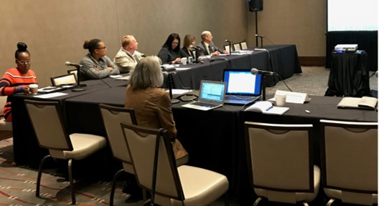
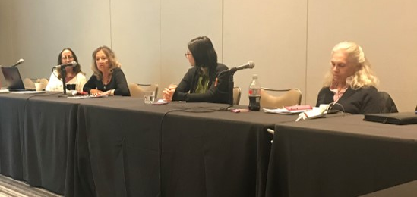
Alliance for Clinical Trials in Oncology Patient Advocate Committee
Example
Nov 2018 PAC Meeting
May 2019 PAC Meeting
May 2016 PAC Meeting
Nov 2018 Poster Session

Slide 24
Key Patient Advocate Roles in the Alliance
Participate in Committees
Concept Review
Protocol Development
Public Summaries

Slide 25
Idea
for a
Trial
Alliance
SCRC
Review
NCI Steering
Committee
Review
Developed in
Committee
Concept
Written
Protocol
Written
Participate in Committees
Concept Review
Protocol Development

Slide 26
Public
Summary
Written
Trial
Open
Monitored in
Committee
DSMB
Review
Trial
Done!
TRIAL
IS OPEN
Participate in Committees
Public Summaries

Slide 27
What do advocates consider?
Participate in Committees
Are there added costs to patients?
Are the patient exclusion and inclusion criteria appropriate?
Is the trial complicated? Do we need patient educational materials?
Is there randomization?
Is it acceptable by patients?
Will the outcome be important to patients?
Will this make a difference in patient care? In a positive way?
Will participation be hard for patients?

Slide 28
SCRC review guidance for advocates
Concept Review
These suggested topics and questions are helpful reminders of points, which may need to be addressed while doing a review.
The five main headings below are criteria used to guide the review.
Study Impact
Study Feasibility
Level of Innovation
NCTN Relevance
Study Design
Overall Impression

Slide 29
What does the advocate consider?
Protocol Development
Participate as protocol is written to review:
Eligibility criteria
Questionnaires (PROs, QoL)
Schedule for patient burden
Review the consent form and help write parts if they are struggling to keep it at a good readability level.
Other protocol specific patient concerns (accrual, equipoise, patient population, etc…)

Slide 30
Alliance Public Results Summaries
Public Summaries
Within Alliance operations
Template (via Deb Collyar)
Written in plain/regular language
Written after or at the same time as the publication
Written by a ‘team’ including a patient advocate
On the Alliance web-site.

Slide 31
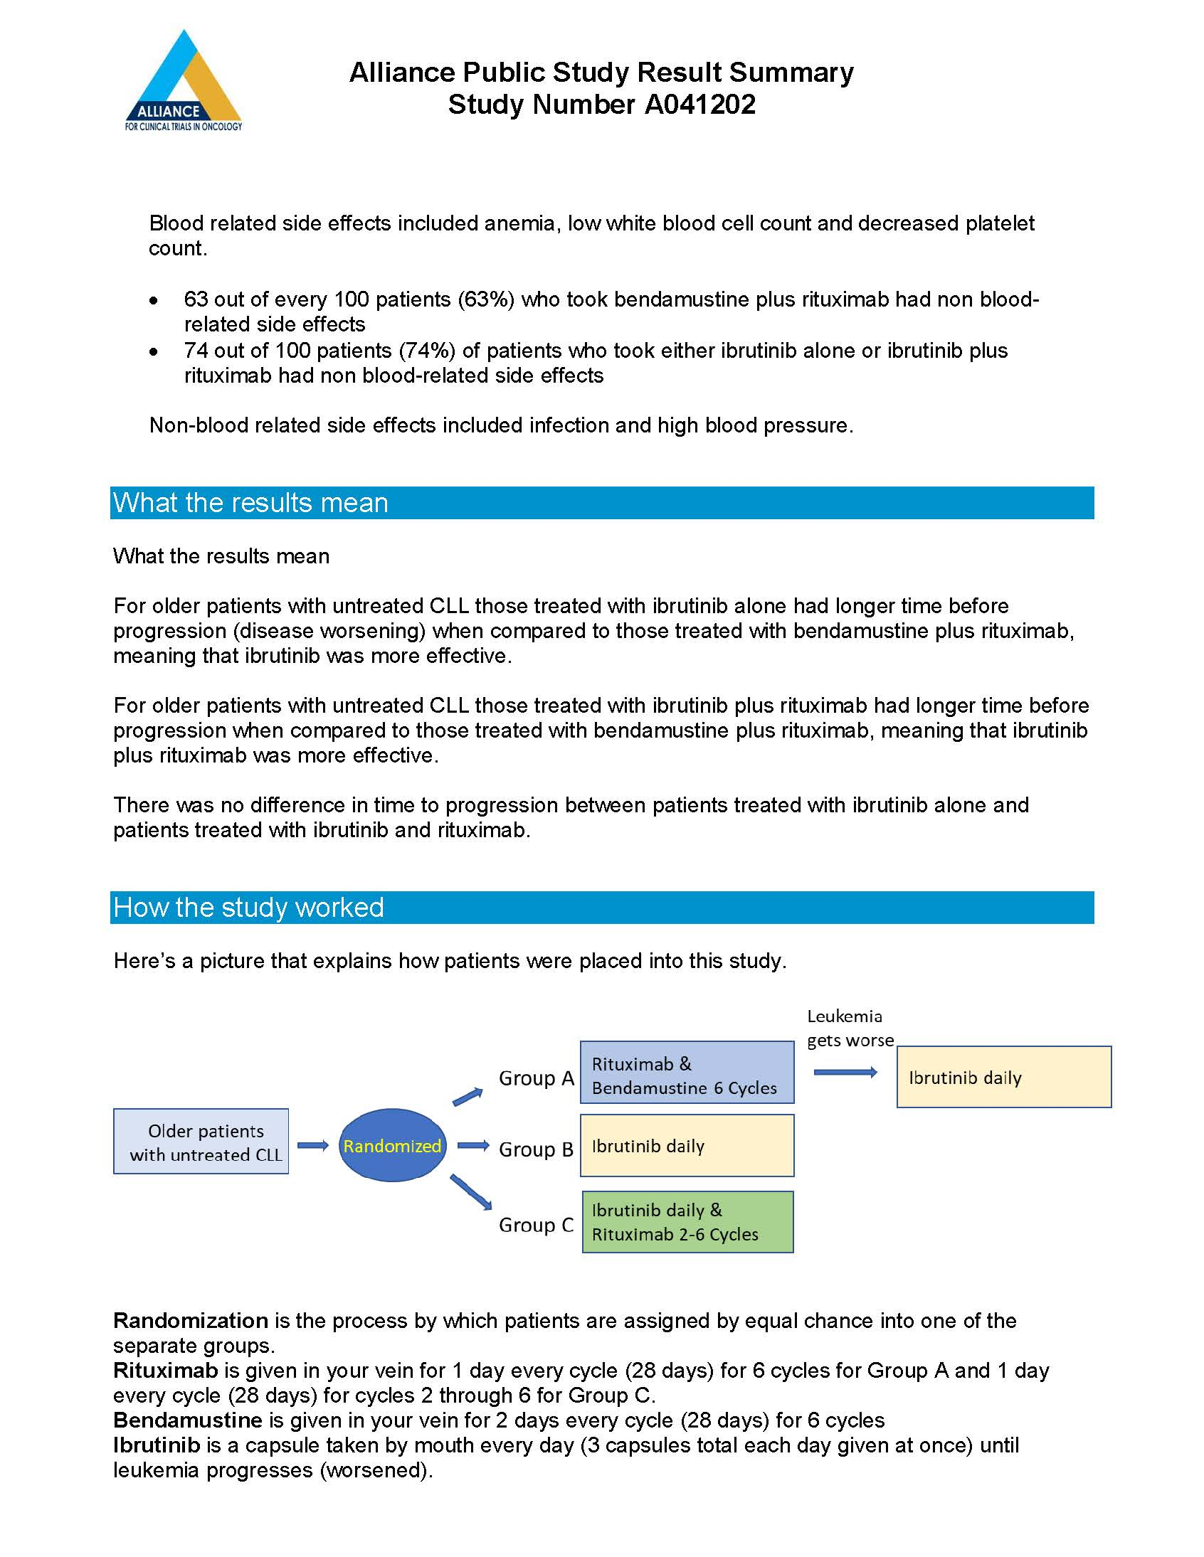
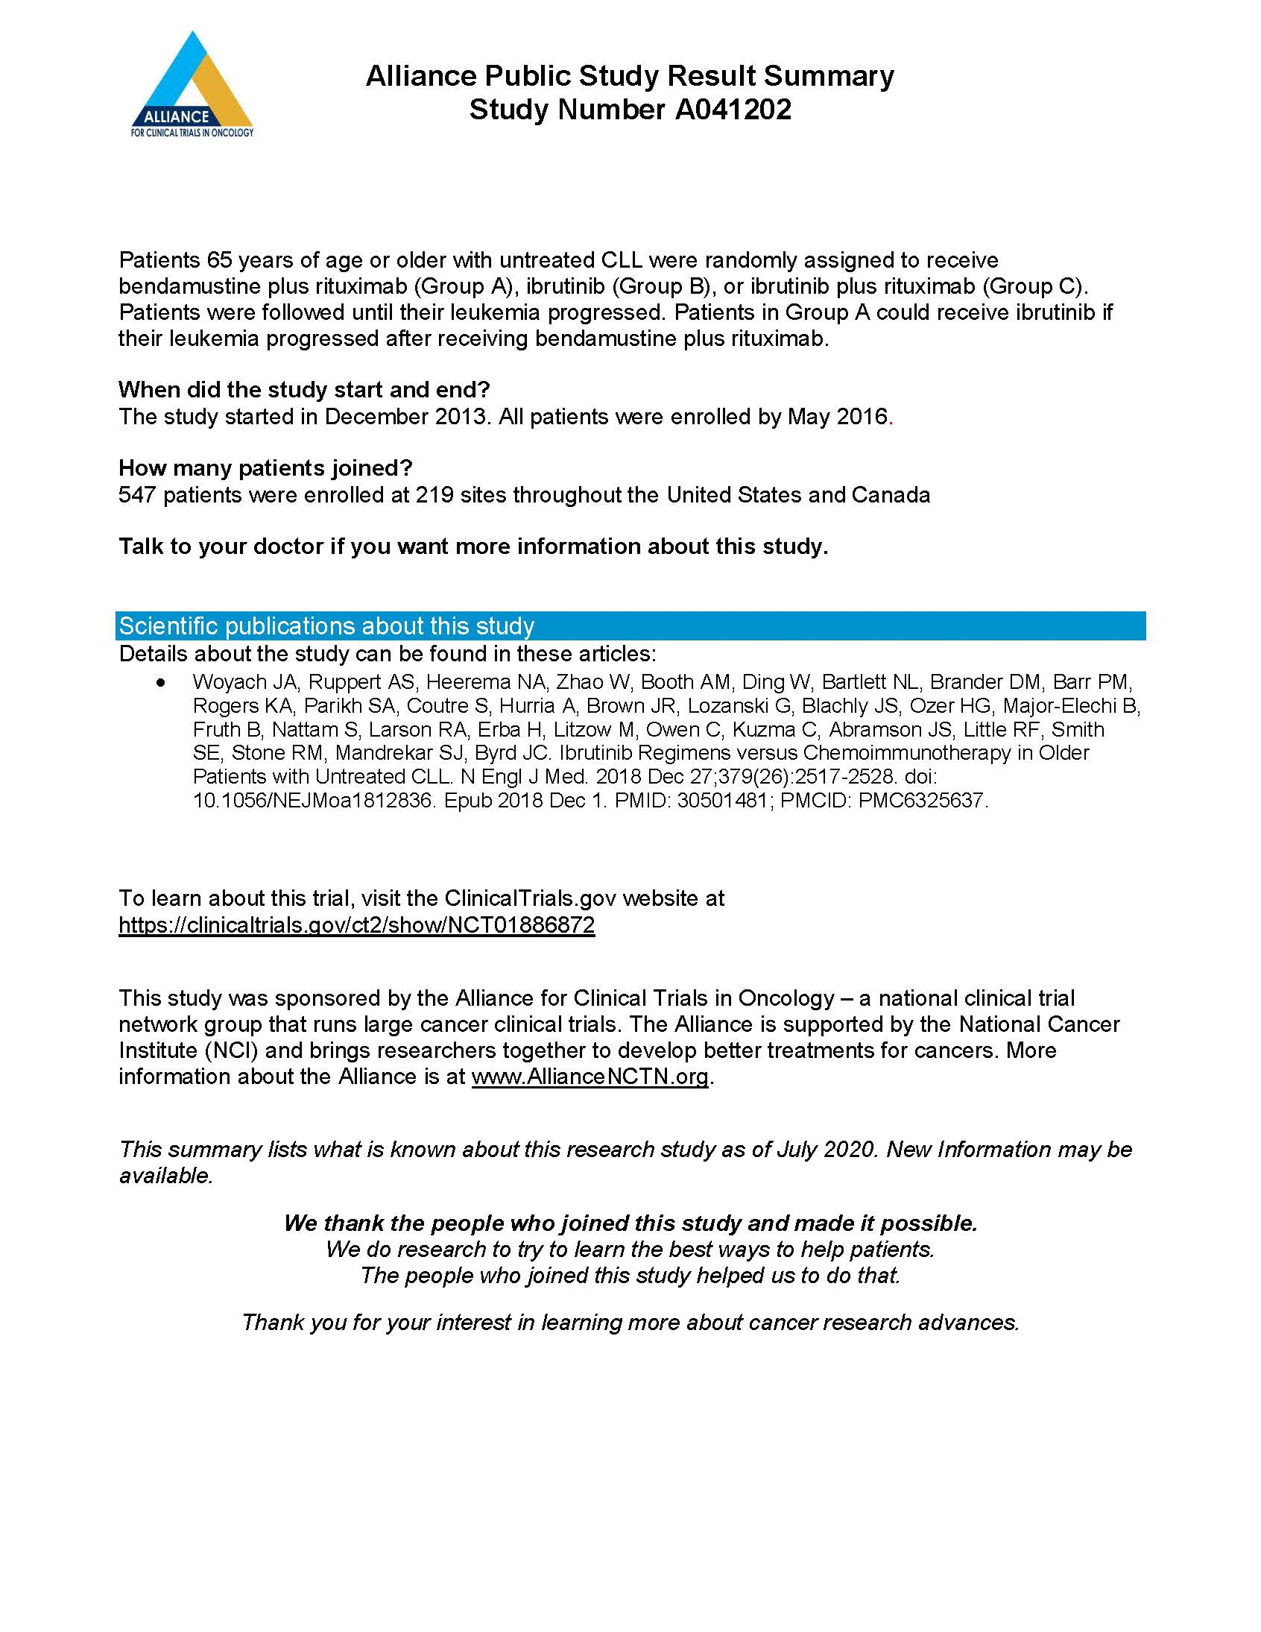

Slide 32
Patient Advocate Engagement in Research @ UNC Lineberger
Patient Advocates for Research Council
UNC Breast SPORE Advocates

Slide 33
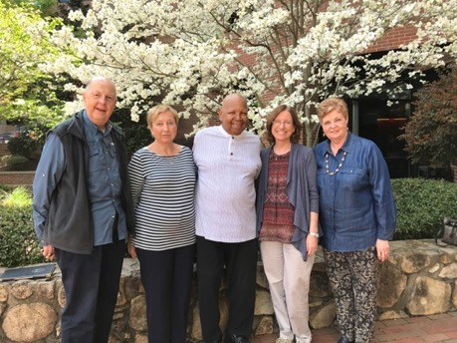
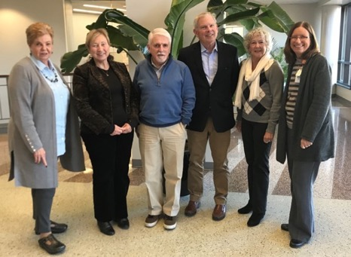
UNC Patient Advocates for Research Council (PARC)
Patients, survivors, caregivers and researchers working together on research projects and clinical trials to create knowledge that will improve the lives of all cancer patients.
Patient Advocates
Laurie Betts
Clay Brumbaugh
Barbara Dean
Catherine Huffman
Laura Jensen
Aishia McClellan
David McNelis
Susan Palmer
Patty Spears (Chair)
Multiple cancers
Breast
Colon
Ovarian
Cervical
Esophageal
Prostate
Survivors
Living with metastatic cancer
Caregivers

Slide 34
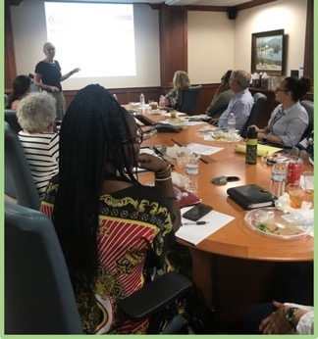
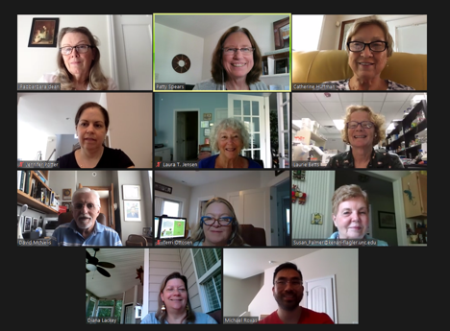
PARC Monthly Meetings
Attendees
Patient advocates
LCCC advisors
Clinical staff
Health literacy expert
Community outreach and engagement liaison
Topics
Special topics like “science in the media”
Ongoing clinical trials
Health disparities and outreach
Input on clinical trials in the planning stage

Slide 35
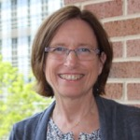
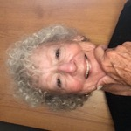
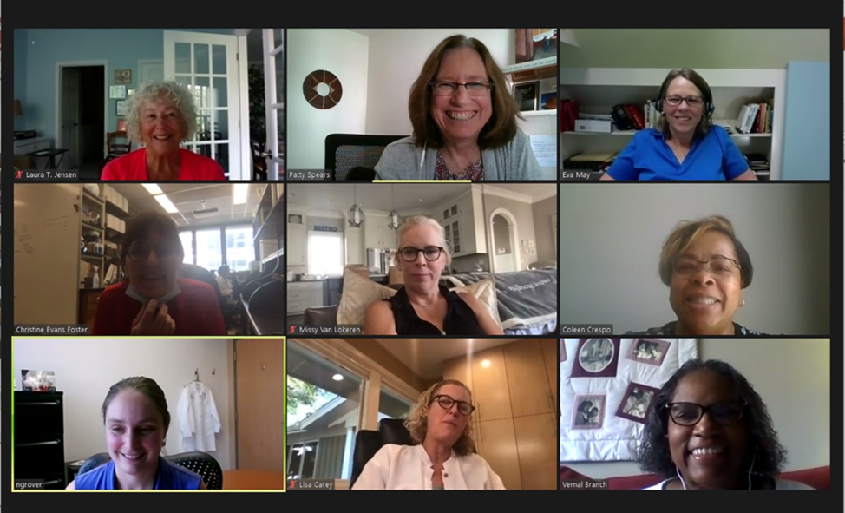
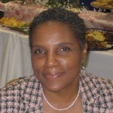
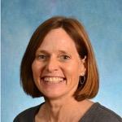
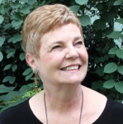
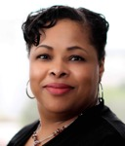
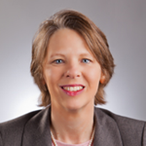
UNC Breast SPORE Advocates (Specialized Program of Research Excellence)
Patty
Spears
(Chair)
Marian
Johnson-
Thompson
Laura
Jensen
Vernal
Branch
Chris
Foster
Susan
Palmer
Photo
Coming
Soon
Coleen
Crespo
Eva
May
Missy
Van Lokeren

Slide 36
Project Assignments
Project 1
Project 2
PIs
Melissa Troester
Lisa Carey
Advocates
Laura Jensen
Susan Palmer
PIs
Hector Franco
Al Baldwin
Claire Dees
Advocates
Eva May
Chris Foster
Missy Van Lokeren
Project 3
Project 4
PIs
Chuck Perou
Lisa Carey
Advocates
Marian Johnson-
Thompson
Vernal Branch
PIs
Gary Johnson
Shelley Earp
Advocates
Patty Spears
Coleen Crespo
Notes:
Project 1 – Carolina breast cancer study
Project 2 – ER postitive breast cancer
Project 3 – TNBC
Project 4 – Kinome – drug development project

Slide 37
PARC/SPORE: Patient Engagement in Research
Provide the patient perspective in research to ensure the knowledge created will improve the lives of all cancer patients
Promote the inclusion of patient centered materials to help educate patients volunteering to participate in clinical trials
Facilitate communication of research to the public
Participate in clinical trial design and conduct to improve accrual, retention and ensure clinically meaningful benefits to patients

Slide 38
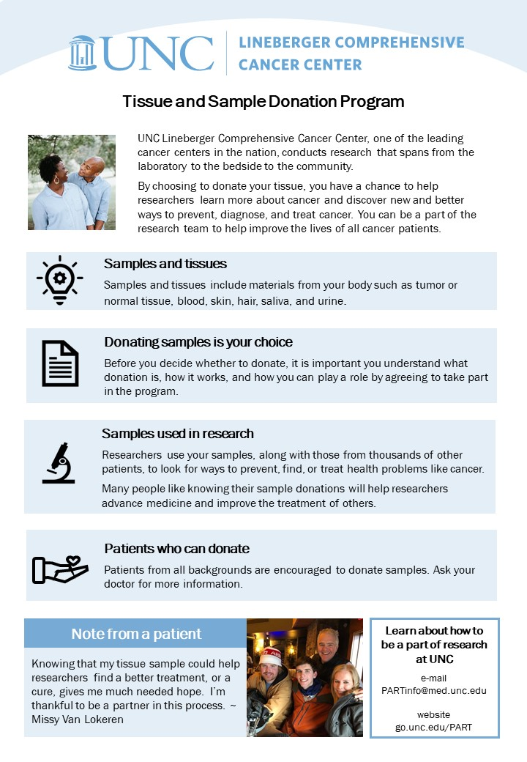
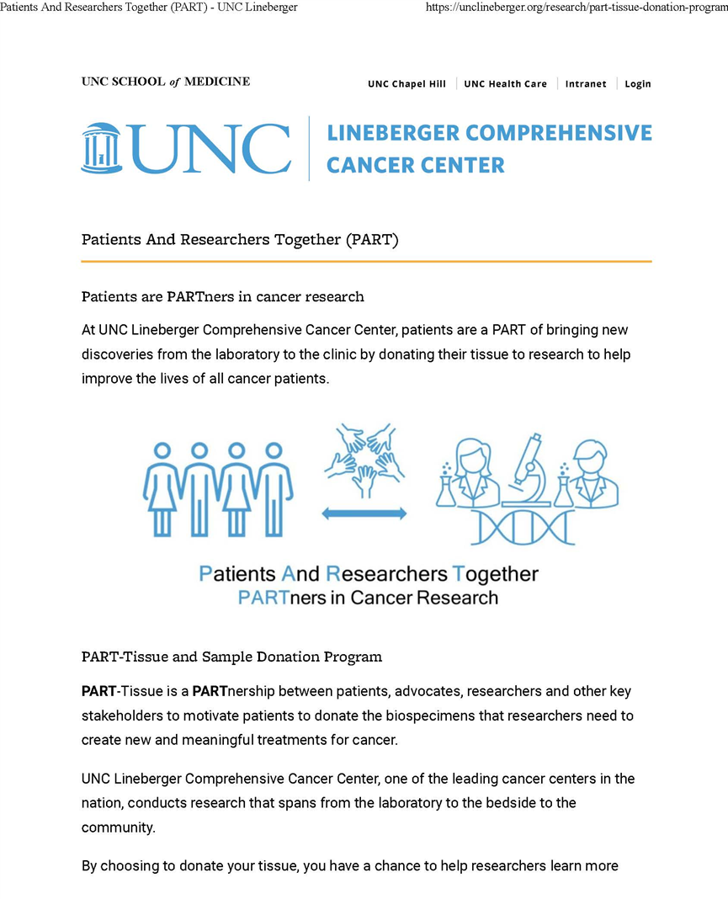
PART
Patients And Researchers Together
Patient Materials
Public Website
PARTnership between patients, advocates, community members, researchers, oncologists, surgeons and clinical staff (CPO/OCTR).
Motivate patients to donate the biospecimens that researchers need to create new and meaningful treatments for cancer.
Ensure biospecimen donations reflect the UNC Lineberger catchment area.
Notes:
The patient advocates and community partners have initiated and are participating in two bi-directional patient and researcher partnership programs.
The PART program began in response to the increase in researchers need for tissue to conduct translational research. Our patient advocates initiated the PART program to ensure Lineberger had a patient-centered tissue donation program to motivate and appreciate patients who donate tissue for research.
In the PART program we have developed patient education materials about tissue donation through a rigorous process of review including health literacy and patient feedback. We have also developed a patient friendly website to talk about tissue donation and translational research which is now live, with links to our first patient flyer and resource. We also are in the process of conducting assessments of tissue use at Lineberger

Slide 39
Materials Development Process Steps
Step
1
Materials Working Group
Draft materials using standard outline for content
Step
2
Content Experts
Review material for accuracy
Step
3
Health Literacy Consultant
Review material for understandability and reading level
Edits incorporated before moving to next step
Step
4
Patients & Patient Advocates
Review material for understandability and clarity
Step
5
Marketing & Communications
Review material to ensure branding standards met
Step
6
Institutional Review Board (IRB)
IRB approval of direct to patient materials

Slide 40
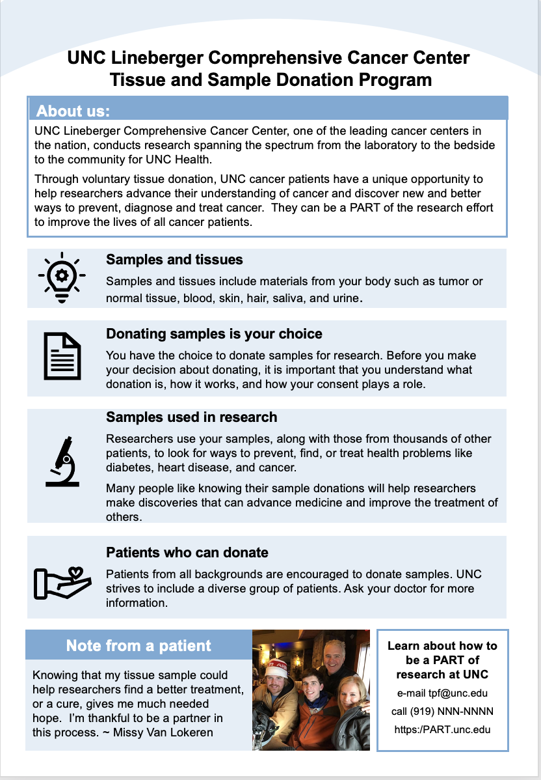
First Draft
Final Document

Slide 41
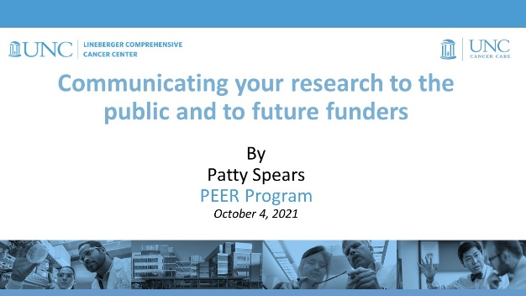
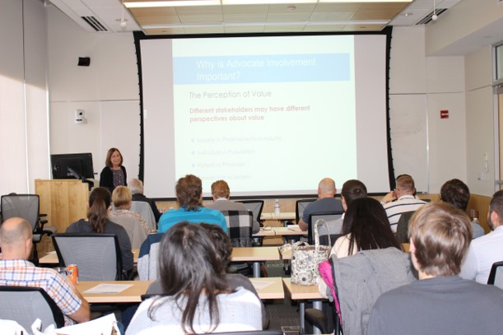
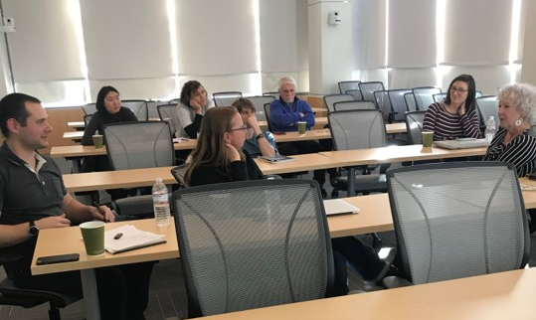
PEER
Patient and Community Engagement to Educate Researchers
PARTnership between patients, advocates, community members, researchers, trainees, CRCE and community organizations.
PEER Lectures
PEER Engagements
Expand the education of researchers and trainees to include the human element of cancer by engagement with patients and community members.
Instill a sense of responsibility to the public by preparing them for and providing outreach opportunities
Notes:
In the PEER program we are working with our T32 trainees and CRCE to provide lectures on communicating science to the public and engaging patients and community members in their research. We are also planning larger engagement events with researchers, patients and community members. All of the materials developed through PEER will be available to the public through the education resources website.
The PEER program is based on similar programs in other institutions (Cornell) to train researchers and particularly trainees on how to communicate their science to the public and to engage patient and community members into their research. This gives our researchers a true connection to patient and community members.

Slide 42
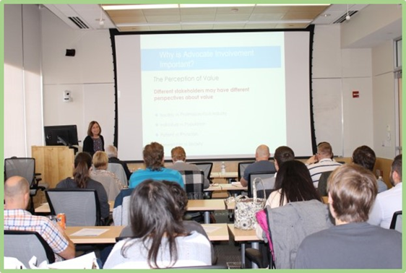
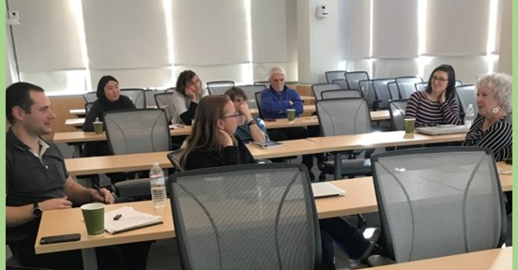
PEER Outcomes
Connections through engagement
Well-rounded training for researchers
Appreciation of research
Connect young researchers, patients, and community members for grant submission requiring consumer advocates, lay abstracts and translational potential.
The PEER program will produce well-rounded researchers who are aware of translational potential of their research
Researchers who participate in the PEER program will be able to speak in community settings to enhance the scientific knowledge of society.
Patients and community members who participate in the PEER program will appreciate the complexity of the research process.
Notes:
The hope is to
Connect patients and community members to researchers through engagement
We want to train well-rounded researchers at Lineberger
And we want patients and community members to know what we do at Lineberger and appreciate the complexity of the research process.

Slide 43
UNC Lineberger Advocates Collaborate with Researchers and Providers
Over 50 advocates representing communities across NC contribute to research and programs.
Notes:
Membership (some overlap):
CAB-13
PARC-15
PFAC-35

Slide 44
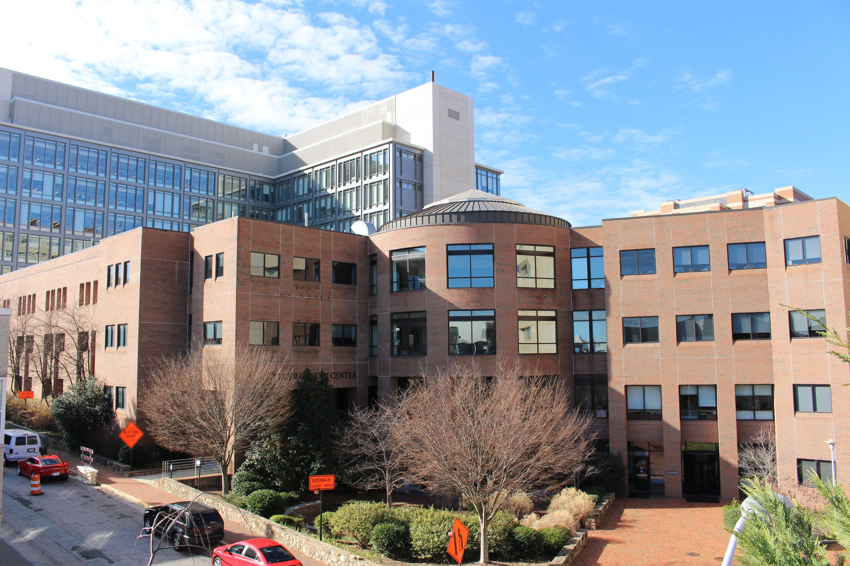
Questions?
Contact us
PARTinfo@med.unc.edu
PEERinfo@med.unc.edu
paspears@med.unc.edu

