Slide 1
Centering Racial Equity in Clinical Trial Participation: A Patient Engaged Research Approach
Marjory Charlot, MD, MPH, MSc
UNC Comprehensive Cancer Support Program and Palliative Care Grand Rounds
March 16, 2022

Slide 2
No Disclosures
Notes:
No relevant disclosures

Slide 3
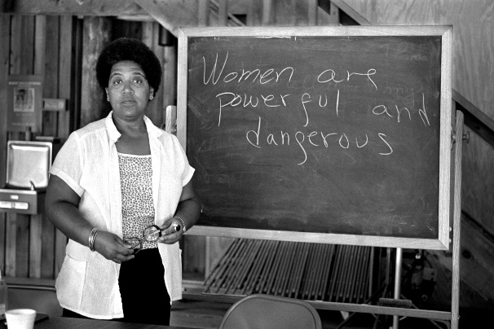
Celebrating African American Heritage and Women’s History Months as a Pathway to Health Justice
“If one really wishes to know how justice is administered in a country, one does not question the policemen, the lawyers, the judges, or the protected members of the middle class. One goes to the unprotected—those, precisely, who need the law’s protection most!—and listens to their testimony.”
-James Baldwin from “No Name in the Street”

Slide 4
Objectives
Racial inequities in cancer clinical trial participation
Potential solutions to achieve racial equity in clinical trials
Patient engaged research as a tailored approach to racial equity in clinical trials
Notes:
My objectives today are to discuss: read slide
I know that this is a Rheumatology, Allergy & Immunology group but my hope is that what I present will be applicable to your field as it is to oncology.
we should have plenty of time for questions and answers at the end. Since I will not be able to see the chat while presenting feel free to unmute and stop me as needed

Slide 5
Clinical Trials and Racial Inequities
Advancements in cancer care result from clinical trials
Cancer clinical trials improve survival and quality of life
Not all racial & ethnic groups have equitable opportunities to contribute to nor benefit from these advancements

Slide 6
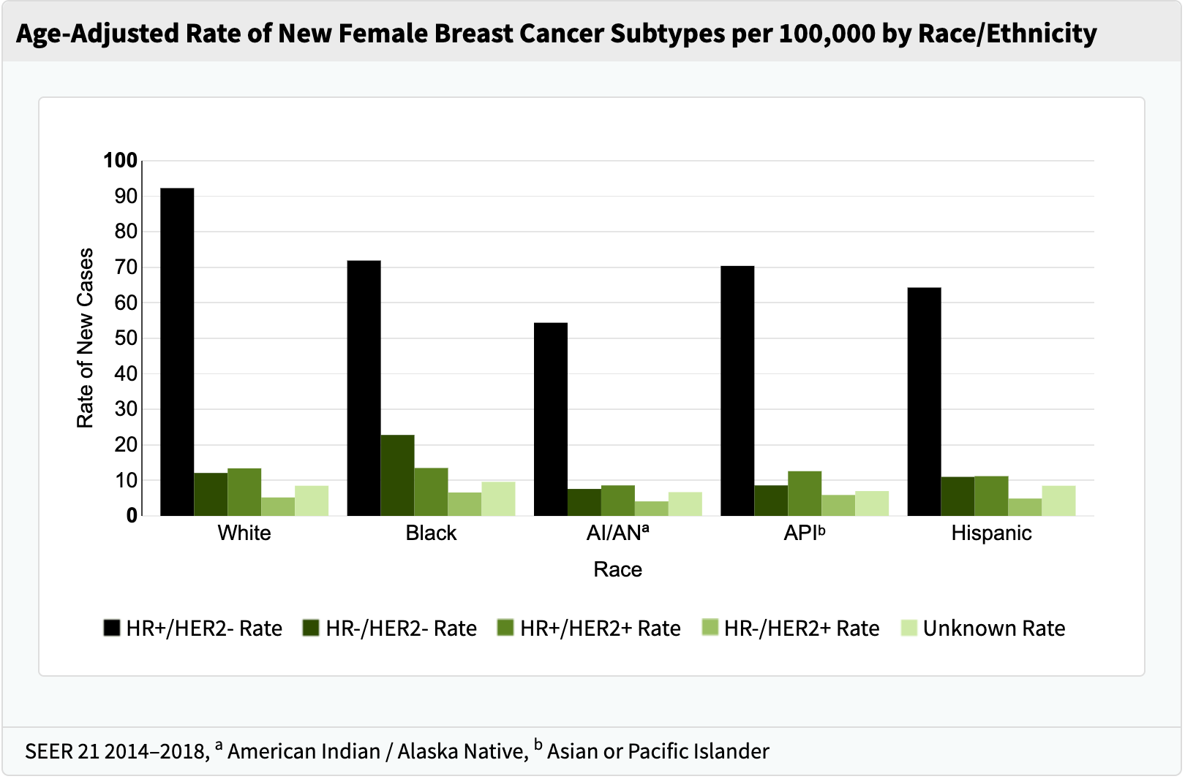
Breast Cancer Subtype and Clinical Trial Representation by Race
Keynote-355: Pembrolizumab plus chemotherapy in triple negative breast cancer (N=847).
Black women are 40% more likely to die from breast cancer than white women
SEER, Cancer Stat Facts Accessed January 2021.
Enrollment of patients of color in cancer clinical trials worse over time.
Cortes J et al, Lancet, 2020
Duma et al, J Oncol Prac, 2018

Slide 7
Multilevel Barriers to Equitable Clinical Trials Participation
Policy
Provider
Patient
Institution
Community

Slide 8
Policy Level Factors
NIH Revitalization Act & Accountability
Health Insurance Coverage

Slide 9
Institution Level Barriers
Clinical trials not available ~56%*
Trial eligibility exclusion criteria ~ 22%*
Lack of research infrastructure
*Unger et al., JNCI, 2019

Slide 10
Provider Level Factors
Racial bias
Poor communication in racially discordant dyads
Lack of workforce diversity
Black patients are just as willing as whites to participate in clinical trials when offered.
Niranjan et al, J Cancer Educ,2020
Unger et al, JNCI, 2021

Slide 11
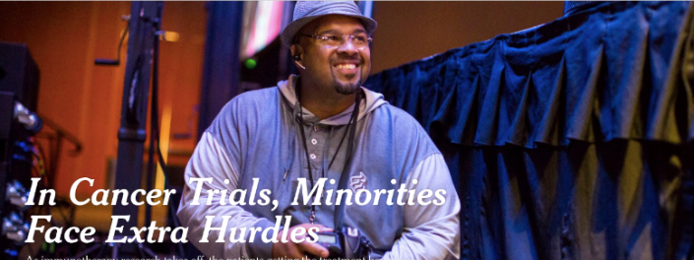
Patient Level Factors
Changing the Narrative
Systems of oppression
Distrust
Mistreatment
By Denise Grady, New York Times December 23, 2016
https://www.nytimes.com/2016/12/23/health/cancer-trials-immunotherapy.html
TRUSTWORTHINESS

Slide 12
Matching Solutions to Barriers

Slide 13
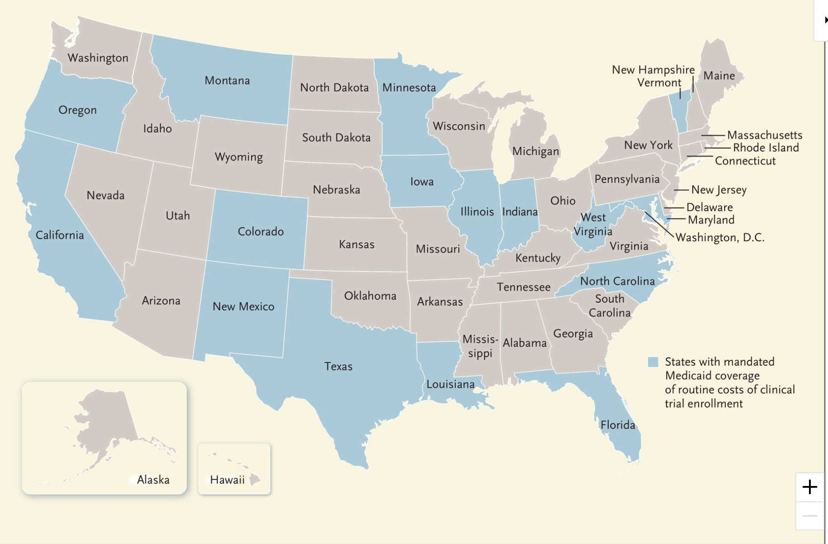
Medicaid Expansion
INCREASED ACCESS TO CARE
COVERAGE OF CLINICAL TRIAL COSTS
Status of State Medicaid Expansion Decision, Interactive Map https://www.kff.org/medicaid
Takvorian et al., NEJM, 2021

Slide 14
Clinical Trial Opportunities in Community Settings
Trials conducted where patients receive care
Trials that meet the needs of the patient population
Removal of unnecessary clinical trial exclusion criteria

Slide 15
Clinical Trial Patient Navigation
Patient navigation pioneered by Dr. Harold Freeman in 1990
Increasing Minority Participation in Clinical Trials (IMPaCT)
Lay navigation
Stakeholder engagement
Clinical trial participation among African Americans nearly doubled in 7 years
Freeman HP, Rodriguez RL.,Cancer, 2011
Fouad MN, et al., J Oncol Pract. 2016

Slide 16
Opportunities for Improvement
Systematic monitoring of trial screening and recruitment processes by race
Successful recruitment and retention strategies to ensure a diverse and inclusive oncology workforce
Engagement of historically underrepresented/excluded populations in clinical trial design and recruitment

Slide 17
Patient Engaged Research
“The active, meaningful, and collaborative interaction between patients and researchers across all stages of the research process…”
Patients are experts of their lived experience
Informs research questions
Promotes equity through partnership
Harrington et al.,Value Health, 2020

Slide 18
Mindfulness based smoking cessation (MBSC) Pilot Study
Study population: Black patients and patients with low income actively smoking with a cancer diagnosis
Study adapted from a chronic pain management study
African American mindfulness trainer
Smoking cessation curriculum
Monetary incentives for study participation
Charlot et al. JACM 2019

Slide 19
MBSC Pilot at Boston Medical Center
Recruitment
Clinic Medical Assistants
Cancer Center Support Group Director
Patient Navigators
Providers
Enrollment
54 referrals
33 patients reached and 32 eligible
18 enrolled
Charlot et al. JACM 2019

Slide 20
MBSC Study Outcomes
Demographics
56% self-identified as Black race
56% reported an income of <$20K/yr and 22% $20-50K/yr
Results
66% attended 4 or more of the 8 weekly sessions
Mean weekly cigarettes was 75 at baseline and 44 at 3 months follow up
No participant continuously quit smoking at 3 months
Charlot et al. JACM 2019

Slide 21
MBSC Participant Feedback
‘‘I just wish it could go on and on. That’s like us you know, we like the program and we keep coming.’’
‘‘Yeah it takes me two and half hours to get here…I’ve enjoyed every day I’ve been here.’’
‘‘…nobody in here judged me, which made me feel good...They encouraged me.’’
‘‘But we were more mindful, I was mindful of the fact that cut down, slow down, sleep more, cut it out, don’t light it.’’
Charlot et al. JACM 2019

Slide 22
Establishing a Safety Net Hospital Cancer Center Patient Advisory Council (PAC)
Recruited members representative of the patient population at Boston Medical Center
Engaged the PAC as research partners to address racial inequities in clinical trials
Facilitated capacity building through a collaborative partnership:
Charlot, et al, Res Involv Engagem, 2021

Slide 23
Establishing the PAC
Stages of small group development:
Forming: orientation to the purpose of the group (PCORI guide)
Storming: establishing trust and comfort with voicing opinions
Norming: establishing mutual goals (modified Charette)
Action Planning
Tuckman BW, Jensen MAC Group & Organization Management. 1977

Slide 24
PAC Process: Framework for Planned Change
Convene Action Group
Define Mission & Values
Assess Conditions, Assets, Needs
Set Goals & Objectives
Select Strategy & Tactics
Evaluate & Adjust
Implement Action Plan
Process Evaluation
Capacity
Building & Empowerment
Process Evaluation
MP 579: Framework for Planned Change (2015), courtesy of Linda Sprague Martinez
Charlot et al, Res Involv Engagem, 2021

Slide 25
PAC VMOSA
Vision
Empowered patients in relationship with empathetic providers
Mission
Advocating for patients to be in charge of their cancer care, supported by their doctor
Objective
Understand the relationship between cancer survivors and family members/caregivers with their providers
Strategy
Survey patients/caregivers/family members at the cancer care clinic
Action Plan
Patient/caregiver led communication training for providers
Charlot et al, Res Involv Engagem, 2021

Slide 26
PAC Conducted Survey Demographics
Results presented to Boston Medical Center Cancer Care Center Leadership (Manuscript in progress)

Slide 27
Patient Engaged Research Lessons Learned
Requires time
Trust
Readiness to engage
Methodological rigor
Guided by theory
Application of frameworks
Co-learning & power sharing
Charlot et al, Res Involv Engagem, 2021
Carolan K, Charlot M, et al. Transl Behav Med, 2020

Slide 28
Patient Engaged Research: Triumphs & Challenges
PAC member presentation at 2018 American Public Health Association annual meeting
Sustainability
Variable readiness to engage
Scholarship

Slide 29
Current Initiatives

Slide 30
Equity in Clinical Trials Initiative
Stakeholder engagement
Bidirectional training for research staff and patient navigator
Leverage electronic health record

Slide 31
Centering Racial Equity App for Trial Engagement (CREATE) Study
Community informed study concept and design
Patient research partners

Slide 32
UNC Lineberger Equity Council
73 faculty, staff, post-docs, patients, and community partners
Required racial equity training for all members
Subcommittees to address equitable clinical trial participation, patient care, workforce diversity and, culture and climate

Slide 33
Summary
Multilevel barriers to equitable clinical trial participation are actionable and require multilevel solutions
Engaging Black individuals in research must be intentional. BLACK VOICES & DATA MATTER
“Anything for us should include us”*
*Quote from Ms. Patricia Peele (LCCC Community Outreach and Engagement Community Advisory Board member)

Slide 34
Acknowledgements
Dr. Jean Nazaire
Dr. Paula Gardiner
Dr. Adam Lerner
Dr. Linda Sprague Martinez and Mr. Elmer Freeman
Ms. Lauren Matthews
My patients and patient/caregiver and community research partners
Multiple scholars and thought leaders of the past and present that inform my work

Slide 35
References
1. Galarneau, C. (2018). Getting King's Words Right. Journal of Health Care for the Poor and Underserved 29(1), 5-8.
2. Cancer Stat Facts: Female Breast Cancer. https://seer.cancer.gov/statfacts/html/breast.html, (accessed January 2022).
3. Cortes J, Cescon DW, Rugo HS, et al. Pembrolizumab plus chemotherapy versus placebo plus chemotherapy for previously untreated locally recurrent inoperable or metastatic triple-negative breast cancer (KEYNOTE-355): a randomised, placebo-controlled, double-blind, phase 3 clinical trial. Lancet. 2020;396(10265):1817-1828. doi:10.1016/S0140-6736(20)32531-9
4. Duma N, Vera Aguilera J, Paludo J, et al. Representation of minorities and women in oncology clinical trials: review of the past 14 years. J Oncol Pract. 2018;14(1):e1-e10. doi:10.1200/JOP.2017.025288
5. Unger JM, Vaidya R, Hershman DL, Minasian LM, Fleury ME. Systematic Review and Meta-Analysis of the Magnitude of Structural, Clinical, and Physician and Patient Barriers to Cancer Clinical Trial Participation. J Natl Cancer Inst. 2019;111(3):245-255. doi:10.1093/jnci/djy221
6. Unger JM, Hershman DL, Till C, et al. “When Offered to Participate”: A Systematic Review and Meta-Analysis of Patient Agreement to Participate in Cancer Clinical Trials. J Natl Cancer Inst. 2021;113(3):244-257. doi:10.1093/jnci/djaa155
7. Niranjan SJ, Durant RW, Wenzel JA, et al. Training needs of clinical and research professionals to optimize minority recruitment and retention in cancer clinical trials. J Cancer Educ. 2019;34(1):26-34. doi:10.1007/s13187-017-1261-0
8. Denise Grady, New York Times December 23, 2016, https://www.nytimes.com/2016/12/23/health/cancer-trials-immunotherapy.html
9. Status of State Medicaid Expansion Decision, Interactive Map. https://www.kff.org/medicaid (accessed January 2022)
10. Takvorian SU, Guerra CE, Schpero WL. A Hidden Opportunity - Medicaid’s Role in Supporting Equitable Access to Clinical Trials. N Engl J Med. 2021;384(21):1975-1978. doi:10.1056/NEJMp2101627
11. Freeman HP, Rodriguez RL. History and principles of patient navigation. Cancer. 2011;117(15 Suppl):3539-3542. doi:10.1002/cncr.26262
12. Fouad MN, Acemgil A, Bae S, et al. Patient navigation as a model to increase participation of african americans in cancer clinical trials. J Oncol Pract. 2016;12(6):556-563. doi:10.1200/JOP.2015.008946

Slide 36
References (Continued)
13. Harrington RL, Hanna ML, Oehrlein EM, et al. Defining Patient Engagement in Research: Results of a Systematic Review and Analysis: Report of the ISPOR Patient-Centered Special Interest Group. Value Health. 2020;23(6):677-688. doi:10.1016/j.jval.2020.01.019
14. Charlot M, D’Amico S, Luo M, Gemei A, Kathuria H, Gardiner P. Feasibility and Acceptability of Mindfulness-Based Group Visits for Smoking Cessation in Low-Socioeconomic Status and Minority Smokers with Cancer. J Altern Complement Med. 2019;25(7):762-769. doi:10.1089/acm.2019.0016
15. Charlot M, Carolan K, Gawuga C, Freeman E, Sprague Martinez L. Patient powered research: an approach to building capacity for a hardly reached patient population to engage in cancer research. Res Involv Engagem. 2021;7(1):74. doi:10.1186/s40900-021-00317-7
16. Tuckman BW, Jensen MAC. Stages of Small-Group Development Revisited. Group & Organization Management. 1977;2(4):419-427. doi:10.1177/10596011770020040
17.Carolan K, Charlot M, Gawuga C, Freeman E, Kim JH, Sprague Martinez L. Assessing cancer center researcher and provider perspectives on patient engagement. Transl Behav Med. 2020;10(6):1573-1580. doi:10.1093/tbm/ibz132

Slide 37
Thank You!!!
"None of us, including me, ever do great things. But we can all do small things, with great love, and together we can do something wonderful.“
– Mother Teresa

