Slide 1
Neuropsychological Considerations in Oncology
Robert Kanser, PhD
Assistant professor
UNCH PM&r

Slide 2
Outline
General Info on Neuropsychology (NP)
Definition, Populations
Origins/Evolution of NP Assessment
Modern NP Assessment
Screening vs. Comprehensive testing
Goals of Assessment
NP considerations in Oncology
CNS vs Non-CNS cancer

Slide 3
Neuropsychology
Definition: the study and application of brain-behavior relationships to diagnosis and treatment
This is typically assessment but can be intervention-focused
Therapeutic assessment
An applied science concerned with the behavioral expression of brain dysfunction

Slide 4
Clinical Populations
Aging & Dementia
Traumatic Brain Injury (mild to severe)
Stroke
Epilepsy
MS & Autoimmune
Movement Disorders
SUDs & Psychiatric Illness
Oncology
Acute encephalopathy

Slide 5
Common Referral Questions
Memory complaints
Depression vs. MCI vs. dementia
Hx of acquired brain injury
Pre/post op evals -epilepsy, resection, RT
Somatoform disorders (PNES, FND, conversion)
Accommodations @ work/school for deficits
Decision making capacity
Litigation/Disability Claims

Slide 6
Neuropsych: Beginnings
Primary Goal: establish a cutoff between brain damage and control
Localization – ‘where’s the lesion’
1st neuropsychology lab (1935; U Chicago)
1st Battery of measures to detect brain damage (Halstead-Reitan)
Differentiated brain damage from control (90% sensitivity & specificity)

Slide 7
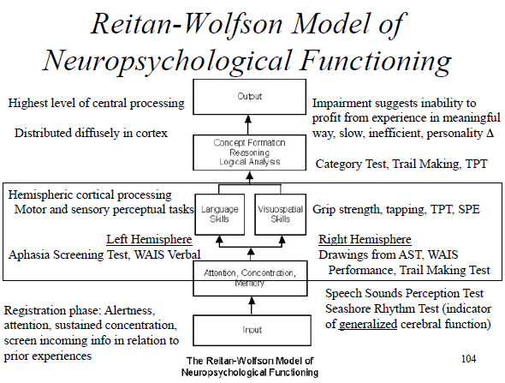

Slide 8
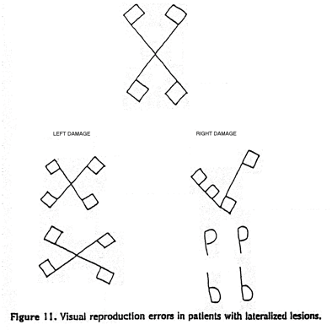
Neuropsych: Beginnings
Change in Focus
Brought on by accuracy/availability of neuroimaging
CT by mid 1970s
MRI by mid 1980s
Boston Process Approach – qualitative emphasis
Goals – not just cut-off; how did it happen?
What behaviors drove impaired performance
How does that relate to cognitive neuroscience concepts/theories?

Slide 9
Neuropsych: Beginnings
Integrating localization & process/function
Key Figure: Alexander Luria (1902-1977)
‘father of modern neuropsych’
Brain has 3 functional units
Unit 1 = Arousal, alertness, and tone (brainstem & RAS)
Unit 2 = Reception, integration, analysis & storage of info (temporal, parietal, and occipital lobes)
Unit 3 = planning, execution, regulation and verification of behavior (frontal lobes)
All behavior require – interaction of those 3 functional units
Impaired performance – can be driven by deficit at any of those levels

Slide 10
Modern Neuropsych Assessment
Screening & Comprehensive Testing
Goals of Assessment

Slide 11
Screening vs. Comprehensive Assessment
Screening
Fast and cheap snapshot of cognition
Useful in signaling underlying impairment
Typical structure: 1-2 items per relevant cognitive domain
Risk of both over and under-pathologizing
Sensitive to non-organic issues: poor effort, mood/sleep/pain
Common forms
Mini Mental State Exam (MMSE)
Montreal Cognitive Assessment (MoCA)
Saint Louis U Mental Status Exam (SLUMS)
Repeatable Battery for Assessment of NP Status (RBANS) = screen +
Less common
Modified MMSE (3MS)
Free, more reliable, 5-10 min longer, more sensitive to MCI and dementia (particularly VaD)

Slide 12
Comprehensive Neuropsych Assessment
Interview: ~ 1 hour
Neurologic symptoms, sleep, substance use, psychiatric hx, psychosocial hx (e.g., educational/occupational hx)
Chart review
Testing: ~1-4 hours (more in private practice)
Cover all cognitive domains
Several smaller tests, typically 5-20 minutes each, with breaks
Often includes mood/personality and achievement tests
Fixed vs. Flexible/Process Approach
Report
Feedback
Same day vs. delayed

Slide 13
Screening vs. Comprehensive Assessment
Benefits of Comprehensive Assessment
Basic statistical superiority
More tests/items = more reliable
More reliable = more valid
Better ability to identify/quantify decline
Demographically adjusted normative data
Premorbid estimates of intellectual functioning
Less susceptive to bias (effort, pain, mood, etc.)
Can reveal pattern of impairment, assist with localization, and etiology differential

Slide 14
Comprehensive Neuropsych Assessment
**Validity & Premorbid Ability**
Attention
Simple, complex (i.e., working memory), and sustained
Processing speed
Motor and motor-free
Language
Comprehension, fluency, repetition, naming
Visuocognitive
Discrimination, construction, reasoning/problem solving
Memory
Initial encoding, learning, recall, recognition
Executive Functioning
Initiation, inhibition, mental flexibility, abstract reasoning, problem solving
Motor
Sequencing, fine motor speed, dexterity
Mood/Personality

Slide 15
Validity
Are the results an accurate measure of their ability?
Performance Validity Tests
Stand alone – just assess effort/engagement
Benefit: robust to many levels of impairment
Embedded – derived from standard cognitive tasks
Benefit: don’t add time to testing
Symptom Validity Tests
Look at symptom over or under-reporting
Personality measures
MMPI-2 indices for: somatic, cognitive, and psychiatric (mood & psychotic) over-reporting
PAI – some validity indices
Stand alone forms

Slide 16
Goals of Neuropsych Assessment
Address referral Q
Diagnose dysfunction and localize it if possible
Identify mild disturbances
Provide info regarding suspected etiology
Including external, modifiable contributing factors
Rehabilitation
Prognostics, document recovery/decline, cog rehab, etc.
Therapeutic feedback/psychoed to Pt. and family
Facilitate patient care

Slide 17
Neuropsych in Oncology
What are the relevant concerns?
CNS tumors
NP mechanism
Treatment effects
Non-CNS cancers
NP mechanism
Treatment effects

Slide 18
Neuropsych in Oncology
High rates of cognitive dysfunction, behavioral change, psychological distress, and fxnal decline
2x rate of depression in cancer vs. other medical inpts ₁
Rates lowest at Sx onset and Dx, increase w. time
Anxiety also common
Tumor recurrence
Etiology often multifactorial
Cancer itself, treatment, modifiable health factors
Important consideration: CNS vs Non-CNS

Slide 19
CNS Cancers – primary tumors & mets
Rates of cognitive impairment: 90% + ₂
Behavioral/emotional problems: ~40% ₃
NP Mechanism
Brain tissue is damaged by compression/infiltration/edema
Hydrocephalus; Seizures
Brain tissue damaged by treatment/intervention
Resection - short-term decline with gradual recovery x 1-2 years
Radiotherapy- depends on volume, dose, phases, age effects
1. Acute: mem & attn deficits, but not prognostic
2. Subacute: (weeks – 6 mo) Cog Sx often improve x 1 year
3. Late-delayed: (1-2 years +) Cog decline

Slide 20
CNS Cancers – primary tumors & mets
Benefit of NP Eval
Unpredictable nature/extent of cog impairment
More so than other acquired brain injuries (e.g., stroke) but why?
Functional tissue can be intermingled with tumor ₄
Slower rate of change = better neuroplastic response
Higher grade = greater cognitive effects
Cognitive & psych effects can be delayed
Cognitive change can signal tumor progression & associated w. prognosis _{5,6}
6 weeks before MRI detected tumor growth

Slide 21
Non-CNS Cancers
Subjective cognitive complaints: > 75% ₇
NP Mechanism
Brain tissue affected by cancer? - Unclear
Testicular & breast cancer - Elevated CI pre-chemo₉ (post resection) ₈
Pathology & psych factors non-contributory
Blood cancers: elevated CI pre-Tx ₁₀
Cytokine immune activation – cross BBB & directly disrupt vs. stress hormone cascade?
Cognitive difficulties due to indirect factors (e.g., mood, phys Sx)
Brain tissue damaged by treatment?
‘Chemo brain’ aka Chemo-induced cognitive impairment (CICI)

Slide 22
Non CNS Cancer: Chemo brain; CICI
Estimated rates: ~20-35% ₁₁
Important considerations
Neurotoxicity of agent & can it cross BBB?
Methotrexate, isosfamide, cisplatin
Route of admin – intrathecal vs. intravenous vs. PO
Dosage & length of Tx
Comorbidities: mood & phys Sx’s
Research still mixed
Subjective report far surpass objective findings (2-4x)
Unrelated to objective deficits; related to depression/negative affectivity
Objective changes are often modest/subtle
Limited, conflicting research on long-term effects

Slide 23
*Paraneoplastic Syndromes*
Consequence of cancer outside the system of dysfunction
Can affect numerous systems, including CNS
PNS = paraneoplastic neurologic syndromes
Pathogenesis of PNS becoming more clear
Autoimmune response (onconeural antibodies) to cancer
Response to metabolic disturbance from tumor secretion of hormones/cytokines
Diagnostic Challenge
Syndrome can precede tumor detection/diagnosis by years
Antibodies not always present
Differential diagnosis is broad
Encephalopathy (infection, toxic-metabolic) vs. neurodegeneration vs. psychiatric vs. functional
Rare : < 1% ₁₂ ; up to 5% in SCLC ₁₃

Slide 24
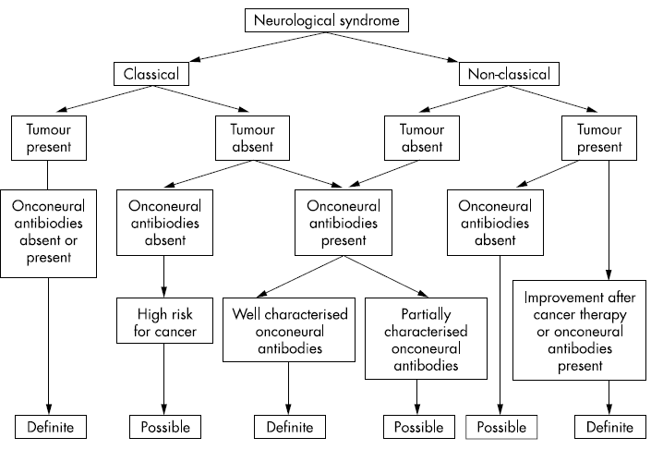
Paraneoplastic syndromes of the central nervous system
Encephalomyelitis*
Myelitis*
Limbic encephalitis*
Brainstem encephalitis*
Cerebellar degeneration*
Opsoclonus myoclonus ataxia*
Visual syndromes
Cancer associated retinopathy*
Melanoma associated retinopathy*
Optic neuritis
Necrotizing myelopathy
Motor neuron syndrome
Subacute motor neuronopathy
Other syndromes
Stiff-person syndrome*
Subacute sensory neuronopathy*
Paraneoplastic syndromes of the peripheral nervous system
Chronic sensorimotor neuropathy
Association with plasma cell dyscrasias
Acute sensorimotor neuropathy
Guillain-Barré syndrome
Plexitis (eg, brachial neuritis)
Autonomic neuropathy*
Vasculitis of nerve and muscle
Paraneoplastic syndromes of the neuromuscular junction and muscle
Myasthenia gravis*
Lambert-Eaton myasthenic syndrome*
Dermatomyositis/polymyositis
Neuromyotonia*
Acute necrotizing myopathy
Cachectic myopathy

Slide 25
Revisiting Common Referral Questions
Depression vs. MCI vs. dementia
Hx of acquired brain injury
Somatoform disorders (PNES, FND, conversion)
Accommodations @ work/school for deficits
Decision making capacity
Litigation/Disability Claims
Oncology
Cognitive decline secondary to: tumor (re)occurrence, resection, RT, chemo
Cognitive status for rehabilitation program and/or following intervention to track recovery
Psychiatric status to determine possible intervention

Slide 26
Summary
Neuropsychology is still helpful despite CT and MRI (I hope)
Goal: use knowledge of brain-behavior relationships to diagnose dysfunction, delineate contributing etiologies, with ultimate goal of enhancing treatment/care
NP can complement treatment in Oncology
Numerous (in)direct (in)organic etiological considerations
Identifying/differentiating above can inform treatment over time
CNS cancer: high rates of objective cognitive impairment
Due to tumor & treatment
Non-CNS cancer: high rates of subjective cognitive complaints
Etiology of objective decline is less certain, but likely multifactorial
Some chemotherapies lead to modest declines in cognition,
But these patient’s don’t often report cognitive concerns

Slide 27
Questions?

Slide 28
References
1. Newport DJ, Nemeroff CB. Assessment and treatment of depression in the cancer patient. J Psychosom Res. 1998;45:215–37.
2. Tucha, O., Smely, C., Preier, M., & Lange, K. W. (2000). Cognitive deficits before treatment among patients with brain tumors. Neurosurgery, 47,324–334.
3. Mulhern R, Crisco J, Kun L. Neuropsychological sequelae of childhood brain tumors: a review. J Clin Child Psychol. 1983;12:66–73.
4. Skirboll SS, Ojemann GA, Berger MS, et al. Functional cortex and subcortical white matter located within gliomas. Neurosurgery. 1996;38:678–85.
5. Meyers C, Hess K, Yung W, Levin V. Cognitive function as a predictor of survival in patients with recurrent malignant glioma. J Clin Oncol. 2000;18:646–50.
6. Armstrong CL, Goldstein B, Shera D, et al. The predictive value of longitudinal neuropsychological assessment in the early detection of brain tumor recurrence. Cancer. 2003;97:649–56.
7. Rosano, C., Ikram, M. A., & Ganguli, M. (2016). Neuroepidemiology of cancer and treatment-related neurocognitive dysfunction in adult onset cancer patients and survivors. Neuroepidemiology, 138, 297.
8. Wefel, J. S., Vidrine, D. J., Veramonti, T. L., Meyers, C. A., Marani, S. K., Hoekstra, H. J., ... & Gritz, E. R. (2011). Cognitive impairment in men with testicular cancer prior to adjuvant therapy. Cancer, 117(1), 190-196.
9. Hermelink K, Untch M, Lux MP, et al. Cognitive function during neoadjuvant chemotherapy for breast cancer: results of a prospective, multicenter, longitudinal study. Cancer. 2007;109(9):1905–1913.
10. Meyers, C. A., Albitar, M., & Estey, E. (2005). Cognitive impairment, fatigue, and cytokine levels in patients with acute myelogenous leukemia or myelodysplastic syndrome. Cancer, 104(4), 788-793.
11. Whittaker, A. L., George, R. P., & O’Malley, L. (2022). Prevalence of cognitive impairment following chemotherapy treatment for breast cancer: A systematic review and meta-analysis. Scientific reports, 12(1), 1-22.
12. Vogrig, A., Gigli, G. L., Segatti, S., Corazza, E., Marini, A., Bernardini, A., ... & Valente, M. (2020). Epidemiology of paraneoplastic neurological syndromes: a population-based study. Journal of Neurology, 267(1), 26-35.
13. Soomro, Z., Youssef, M., Yust-Katz, S., Jalali, A., Patel, A. J., & Mandel, J. (2020). Paraneoplastic syndromes in small cell lung cancer. Journal of thoracic disease, 12(10), 6253.

Slide 29
Case #1
Referral : 65-year-old, right-handed male referred due to R frontotemporal meningioma (Grade 1) s/p craniotomy for resection (~5 mo prior).
Complaints: No current cog Sx. Reported “fog” in the weeks b4 detection/resection (processing speed, attention, memory).
No current physical Sx. Reported headaches, fatigue, and “flashes” across visual field in weeks b4 Dx. Transient dizziness with changes in head orientation x6-7 weeks post op.
Psych/SUDs: non contributory
Psychosocial Sx: Neurodevelopmental Hx unremarkable. Strong student (20 + years) and successful MD.

Slide 30
-Performance Validity: The patient’s scores on performance validity measures indicated adequate task engagement, consistent with behavioral observations. Thus, results are thought to reflect a valid measure of his current neurocognitive functions.
-Premorbid Functioning: The patient’s premorbid level of intellectual functioning was estimated to be in the Superior range (WTAR Predicted FSIQ: 116, 86th percentile; WAIS-IV MR: 98th percentile)

Slide 34
Case #2
Referral : 59-year-old, right-handed female referred due to L frontal astrocytoma (Grade II) s/p cranio for resection (x2 yrs prior), radiation (total dose 5400 cGy in 30 fractions over 2 mo), and chemotherapy (6 cycles TMZ completed 6 mo prior). Subacute L thalamic lacunar infarct 2 mo prior
Complaints: Issues with executive functioning (multi-tasking, planning/org, perseveration), speed, attention, memory, and aspects of speech
Course: Sx onset 1 yr before detection, improved following surgery, modest decline w RT & CT w. subsequent improvement; progressive worsening x1 mo
Physical Sx: photophobia, intermittent postural tremor (R hand), RUE/RLE paresis, imbalance
Psych/SUDs: Dx with anxiety pre-cancer w. intermittent pharmacotherapy; no current substance use
Psychosocial Sx: Neurodevelopmental Hx unremarkable. Strong student (16 years). Worked as PT before switching to high-level hospital admin positions. Currently on disability leave.

Slide 35
Case #2
NEUROCLINICAL
Cognitive Screening with SLP (1 year ago, during CT)
Per my read, results revealed below expectation performance on processing speed and the executively mediated aspects of memory (e.g., organization/learning; RBANS-D).
Neuropsychological evaluation (2 yrs ago, during RT)
Per my read, results revealed evidence of deficits in processing speed (Borderline Impaired to Low Average) as well as lateralized declines in fine motor speed/dexterity. Intact performance was observed across tasks of: attention, visuocognitive abilities, language, memory, and abstract reasoning. Though not impaired, suspected declines were observed on tasks of simple and complex attention.

