Slide 1
Reflections on the Coalescing of Integrative Medicine and Palliative Care Professional and Personal Experiences
Denise Spector, PhD, MPH, ANP, FAIHM
Oncology Nurse Practitioner and Integrative Medicine Clinician
Notes:
Very early in my oncology nursing career I had the desire to focus in two areas, risk-reduction and health promotion for the prevention of cancer and cancer pain & symptom management. I was fotunate to have had the great privilege of working in one of the first nurse-run symptom management consult programs, which was at the Dana-Farber Cancer Institute in the earl 1990’s. This was a time before the onset of Palliative Care programs in cancer centers. Of course, we utilized pharmacologic strategies to help reduce pain and other side effects, but we also incorporated many other modalities such as guided imagery, progressive muscle relaxation, massage, and meditation among other things. Looking back this was the blending of what is now palliative cancer care and integrative oncology. These specialties were very early in their infancy and 30+ years later I am delighted to see that they are now accepted specialties and provided as services in many cancer centers around the world, with Palliative Care being more visible and accepted by providers and perhaps IM more accepted by patients. We’ve coma a long way and still have much work to do to promote the benefits of these services!

Slide 2
Learning Objectives
Define both integrative medicine (IM) and palliative care
Name two similarities between integrative medicine and palliative medicine
Describe three evidence-informed IM strategies that may help improve quality of life for individuals living with cancer
Identify two integrative medicine strategies that have been shown to reduce cancer-related pain

Slide 3
What is the difference between integrative medicine and alternative medicine?
Notes:
Examples are high-dose vitamin C, mistletoe, etc.

Slide 4
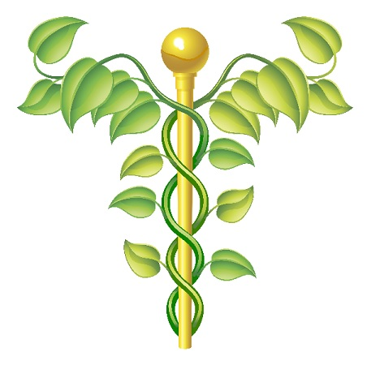
CAM
Complementary and Alternative Medicine
“Complementary” practices typically refer to the use of non-mainstream approaches along with conventional medical approaches.
versus
“Alternative” practices which usually refers to using non-mainstream medical approaches instead of conventional medicine.
Source: National Center for Complementary and Integrative Health http://nccaih.nih.gov

Slide 5
Integrative Medicine Defined
Integrative Medicine
Integrative Oncology
“A healing-oriented practice that takes account of the whole person, including all aspects of lifestyle. It emphasizes the therapeutic relationship between practitioner and patient, is informed by evidence, and makes use of all appropriate therapies.”
Arizona Center for Integrative Medicine (2021). http://integrativemedicine.arizona.edu/about/definition.html
“Integrative oncology is a patient-centered, evidence-informed field of cancer care that utilizes mind and body practices, natural products, and/or lifestyle modifications from different traditions alongside conventional cancer treatments. Integrative oncology aims to optimize health, quality of life, and clinical outcomes across the cancer care continuum and to empower people to prevent cancer and become active participants before, during, and beyond cancer treatment.”
Society for Integrative Oncology (2017). https://integrativeonc.org/knowledge-center/what-is-integrative-oncology

Slide 6
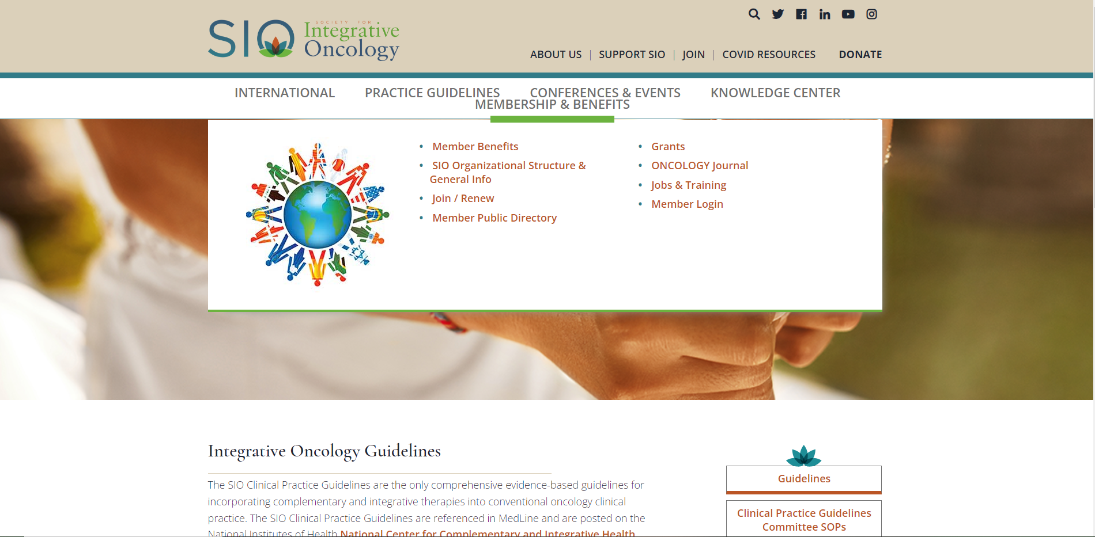

Slide 7
Palliative Care Defined
Broad Definition
Specific Definition
“Palliative care is care meant to improve the quality of life of patients who have a serious or life-threatening disease, such as cancer. It can be given with or without curative care. Palliative care is an approach to care that addresses the person as a whole, not just their disease. The goal is to prevent or treat, as early as possible, the symptoms and side effects of the disease and its treatment, in addition to any related psychological, social, and spiritual problems.”
National Cancer Institute (2021). Palliative care in cancer. https://www.cancer.gov/about-cancer/advanced-cancer/care-choices/palliative-care-fact-sheet
“Palliative care is patient and family-centered care that optimizes quality of life by anticipating, preventing, and treating suffering. Palliative care throughout the continuum of illness involves addressing physical, intellectual, emotional, social, and spiritual needs and to facilitate patient autonomy, access to information and choice.”
National Hospice and Palliative Care Organization (2021). https://www.nhpco.org/palliative-care-overview/

Slide 8
Both specialties in oncology have evolved over the past couple of decades and are often offered under the same umbrella of Supportive Care Services
Supportive Care Services
Palliative Medicine
Hospice
Palliative Cancer Care
Integrative Medicine
Integrative Oncology
Services that provide patients who are suffering from a serious or life-threatening illness with the best possible quality of life.
Both began in the 1990s
Notes:
NCI defined Supportive Care – above. 1990 - WHO recognized PC as a distinct specialty from hospice care.
Practitioners formally adopted integrative medicine in the early 1990s. In 1994, the University of Arizona Center for Integrative Medicine was founded, with a primary focus on educating physicians in integrative medicine.
IO formally recognized with the development of SIO

Slide 9
Integrative
Health
Palliative
Care
Integrative Palliative Care
Chiaramonte, DR & Adler, SR. (2020). J Altern Complement Med, 26, 761-765.
Notes:
A visual provided in the article, Integrative palliative care: A new transformative field to alleviate suffering. 1. Integrative health and palliative care have substantial overlap in philosophy and scope. The combined field, integrative palliative care, expands the conventional palliative care toolbox and extends the impact of integrative health approaches across the life course.
They share core values and goals, Both highlight QOL. Optimizing well-being, reduce physical and emotional suffering, emphasize interprofessional team-based collaboration and provide personalized and individualized care.
A hybrid model has been proposed in this article – IPC is viewed as a new formal specialty that takes a holistic approach to living well across the life course, enhancing healing and reducing suffering among those facing serious illness, as their family members. Several medical centers have developed combined Integrative and Palliative Medicine Services. In oncology, this approach has been taken by MD Anderson Cancer Center, which has a Department of Palliative, Rehabilitation & Integrative Medicine.

Slide 10
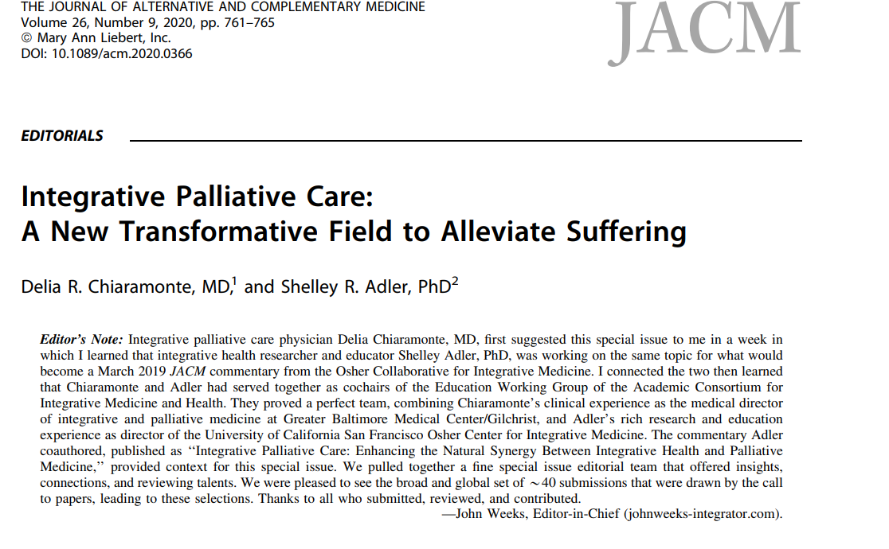

Slide 11
Healing
Our role as integrative health clinicians and palliative care specialists is to guide patients towards healing, which is very different than “curing” a disease. To heal is to “make whole or sound” as defined by the Merriam-Webster Dictionary.
Even when there is the inability to “cure” a cancer, patients still have the capacity to heal emotionally and/or spiritually which can allow them to find a place of peace with the situation.
Notes:
It is ultimately an internal process that may involve tapping into the mind-body connection, as well as making lifestyle behavior changes such directed at nutrition, exercise, weight management, and at times the use of botanicals/dietary supplements that are known to be safe and while also accepting conventional treatments.

Slide 12
Patient/Oncologist Quote
“The medical profession does a disservice to patients when we pigeonhole them into statistics. Plenty of people have beaten the odds and gone on to become their own statistic. That being said, I was cognizant of the reality of my medical condition and willingly accepted all I needed to do to survive… There were plenty of medicines essential to my survival, tests I must have, and interventions I must undergo. But if that’s all I did, I would have abdicated the true power of the mind-body connection…I knew all too well that we can’t rely on a doctor for everything. As good as doctor’s can be, if they don’t try to motivate patients to access their own source of energy, they miss an important aspect of healing.”
Excerpt from the book, “Gone in a Heartbeat: A Physician’s Search for True Healing” (2015).
Notes:
Excerpt from Gone in a Heartbeat: A Physician’s Search for True Healing. A harrowing account of one physician’s challenge through years of a life-threatening cardiac condition. He speaks so eloquently how integrative/complementary practices helped him regain his sense of control and improved his vitality and quality of life for many years.

Slide 13
Cancer Survivors and CAM/CIM Use
Studies vary widely in reports of CIM use among cancer survivors. One study reported up to 91% used at least one modality during treatment. Another reported up to 75% among those who were post-treatment.
Some studies suggest that approximately 80% of patients don’t share their use of CAM with their providers.
Most studies have been among individuals with breast and prostate cancers.
Characteristics of individuals most frequently reporting use of CAM: females, younger vs. older adults, individuals with higher income and higher education.
Notes:
John et al. J Cancer Surviv. 2016 October ; 10(5): 850–864. Complementary and Alternative Medicine Use among US Cancer Survivors, Of the 34,525 adults sampled in the 2012 NHIS, 2,977 were cancer survivors and 30,551 were cancer-free adults. Among cancer survivors, 36.4% used at least one CAM modality other than vitamins and minerals in the past 12 months (“CAM user”), 38.9% used only vitamins and minerals in the past 12 months (“vitamin/mineral user”), and 27.4% reported no CAM use in the past 12 months (“non-users”). Among colorectal CA patients, 4 studies reviewed and the most common CAM practice was use of dietary supplements, herbs, vits/minerals, medicinal teas, homeopathic products (57%), followed by mind-body and spiritual strategies (15%), and then relaxation techniques (13%). Study by Jones, Cohen et at. ( 2018 ) focused on minority and underserved populations with cancer and their interest in CAM use (28% Hispanic/over 40% AA) that with a high % of those with household incomes < 10,000/yr in an urban Texas cancer center showed Percentages of patients who reported ever having used CAM were highest for prayer (88%), relaxation (58%), massage (46%), special diet (36%), aromatherapy (31%), meditation (27%), and yoga (21%). Integrative Cancer Therapies 2018, Vol. 17(2) 371–379.
2019 survey study in JAMA oncology suggested that about 3o% didn’t info about CAM use. Another small study published in 2019 revealed that in over 500 recording of patient/provider cancer visits only 12% mentioned anything about integrative therapies. PROBLEM!
Charact. – higher educ/income likely due to the high cost of CAM practices that are often not reimbursable. However, this appears to be regional and for example, among those living in Hawaii there is a higher use among those with lower income/education (traditional practices of native Hawaiians). Also studies often underrepresent minority groups that may have higher rates of CAM due to traditional practices.

Slide 14
Common Reasons for CAM use among Cancer Survivors
To improve general well-being
To treat side effects of the cancer or cancer treatments
Prevent recurrence or spread of cancer
Increase the body’s ability to fight cancer
Prevent other non-cancer diseases

Slide 15
Integrative Medicine Survey Trends (N=839) Arring et al., (2021). Trends in integrative medicine and health consults: differences between cancer survivors and patients without cancer. Supportive Care in Cancer, 29, 3103-3112.
Notes:
Study of over 800 individuals referred for an IM visit at a SW academic medical center where the see both cancer (majority were post-tx – 56%) and non-cancer patients. A wide range of cancer dx, although breast and GI represented the highest % of DX. 37% and 11% respectively. Prior number of therapies used before IM consult was 1.74 compared to 1.5 in the non-cancer pts. The only statistical differences between the populations was with the use of Turmeric and Mindfulness which were higher in cancer patients. Top IM recommendations for Cancer survivors, were exercise (66%), mindfulness (49%), yoga (47%), Acupuncture (28%), massage (22%) and with regard to supplements (Turmeric 45%). Compared to recommendations in the non-cancer pop, the following were statistically less likely to be recommended, Turmeric, yoga, mindfulness, and massage. different compared to the non-cancer patients,

Slide 16
Elements of Evidence-informed Integrative Oncology
Mind-Body Practices
Natural Products
Lifestyle Changes
Clinical Expertise
Patient Beliefs, Values, & Preferences
Research Evidence
Notes:
David Sackett, in an editorial titled “Evidence-Based Medicine: What It Is and What It Isn’t” (27), argued that Evidence-based medicine is not ‘cookbook’ medicine. Because it requires a bottom up approach that integrates the best external evidence with individual clinical expertise and patients’ choice, it cannot result in slavish, cookbook approaches to individual patient care.... Similarly, any external guideline must be integrated with individual clinical expertise in deciding whether and how it matches the patient’s clinical state, predicament, and preferences, and thus, whether it should be applied. When honoring the patient’s beliefs and values we often have to provide some balance in what appears to be the best research evidence and what may be research-informed, but without causing potential harm as can occur with some herbs and botanicals.

Slide 17
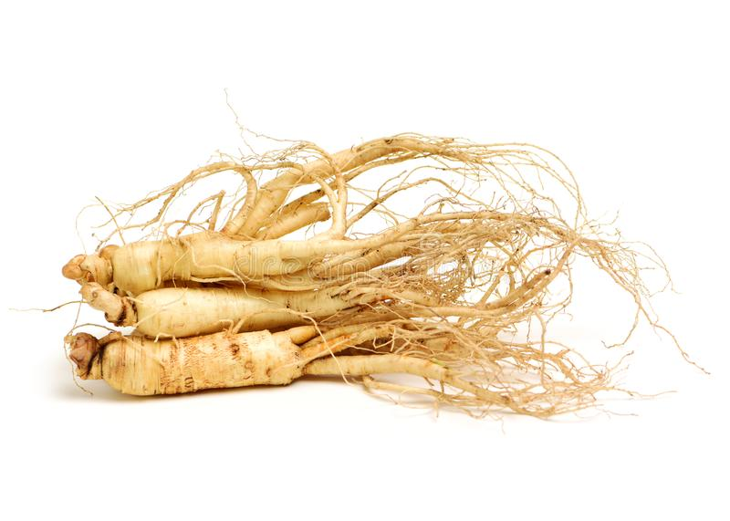
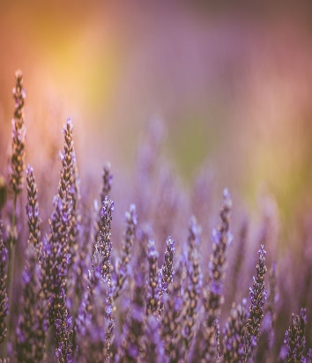
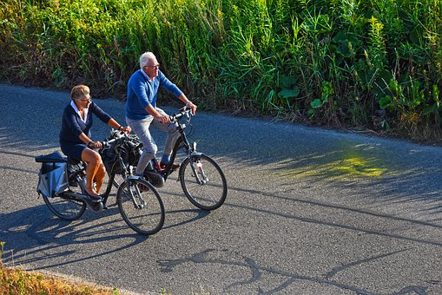
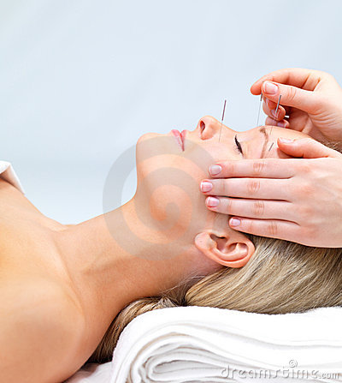
Integrative Oncology Emphasis Areas
Evidence-informed
Prevention, health promotion and well-being
Symptom and side effect management through non-pharmacologic strategies
Utilizes mind and body practices, natural products, and/or lifestyle modifications from different traditions alongside conventional cancer treatments

Slide 18
The Evidence Behind Three Integrative Medicine Modalities
Yoga
Acupuncture
Meditation/Mindfulness
Notes:
While I fully recognize there are other EB IM strategies, such as massage, Reiki, exercise, nutrition, use of botanical/supplements, etc. due to time constraints I did not add them in this presentation, but they are all important when it comes to healing. Anyone of the topics could take a whole conference to discuss so this is a very high level overview of just several modalities.

Slide 19
Exponential Increase of Studies on Acupuncture, Meditation and Yoga for Cancer –A Ten Year Look
Notes:
Overall results for acupuncture AND cancer in 2021 – 2,584 vs 88 in 2011, SR for 2021 are 224; mediation AND cancer was 798 vs 34 in 2011 SR for 2021 is 43; and yoga AND cancer 652 vs 29; 89 SR in 2021. Includes cohort studies, qualitative studies and other non research articles on the topics.

Slide 20
Evidence Grades for Clinical Recommendation Strength of evidence based on the number, quality, size of clinical trials, magnitude of effect, statistical significance, and consistency across trials.
GRADE Level | Definition | Suggestions for Practice
A | There is high certainty that the net benefit is substantial | Offer or provide this service
B | There is moderate certainty that the net benefit is moderate to substantial | Offer or provide this service
C | There is at least moderate certainty that the net benefit is small | Offer or provide this service for select patients depending on professional judgement and patient preferences
D | There is moderate or high certainty that the service has no benefit | Discourage use of this service based on demonstrated lack of efficacy
H | There is moderate or high certainty that the harms outweigh the benefits | Discourage use of this service due to potential harm
I | The current evidence is insufficient to assess the balance of benefits versus harms | If this service is offered, patients should understand the uncertainty regarding the balance of benefits and harms

Slide 21
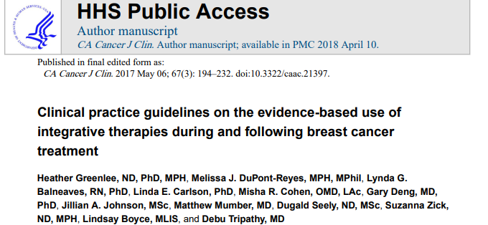
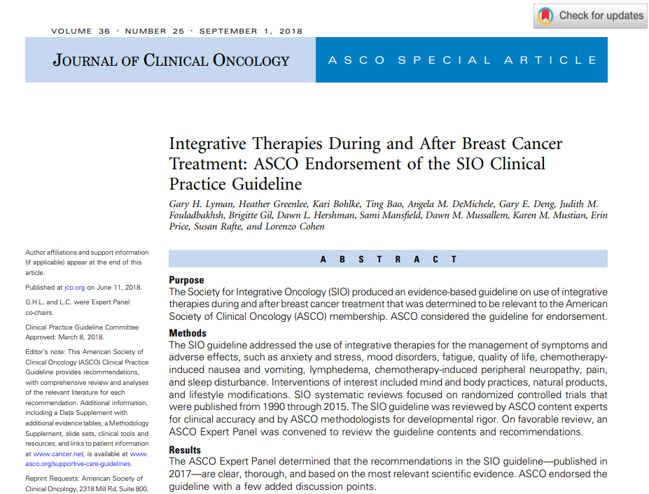
Breast Cancer Clinical Guidelines from the Society for Integrative Oncology (SIO) Endorsed by ASCO
Notes:
Many of the integrative medicine/complementary modalities recommended for the various symptom/side effects are also recommended as nonpharmacologic approaches within some of the NCCN supportive care guidelines (e.g., survivorship issues such as fatigue, sleep, anxiety/depression). For example, acupuncture for fatigue, sleep, hot flashes.

Slide 22
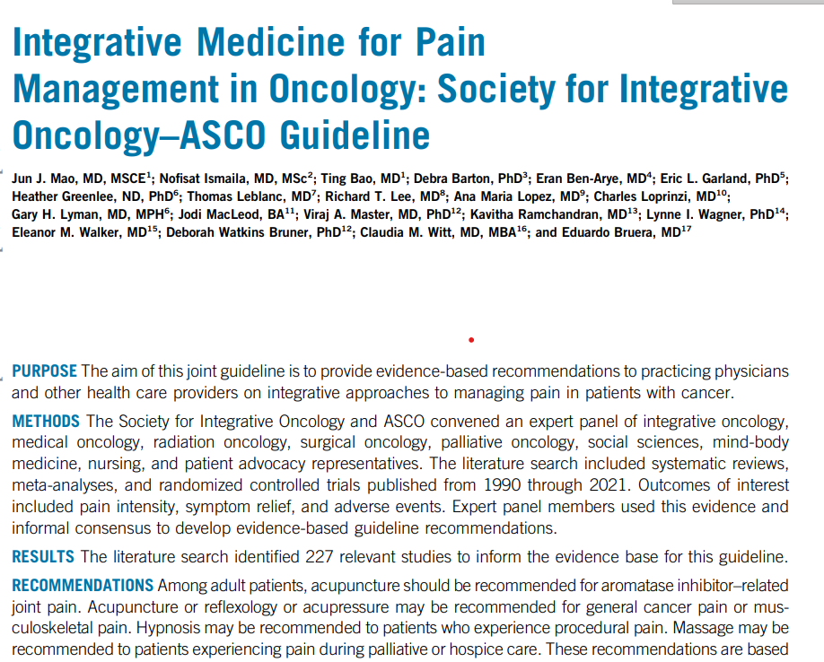
New Guideline for Cancer Pain Management
Mao, J.J., et al. (2022). Journal of Clinical Oncology. Additional information is available at https://integrativeonc.org/practice-guidelines/guidelines and www.asco.org/ survivorship-guidelines.
Notes:
More notes on results
Current work between ASCO and SIO is on the development of guidelines for anxiety and depression.

Slide 23
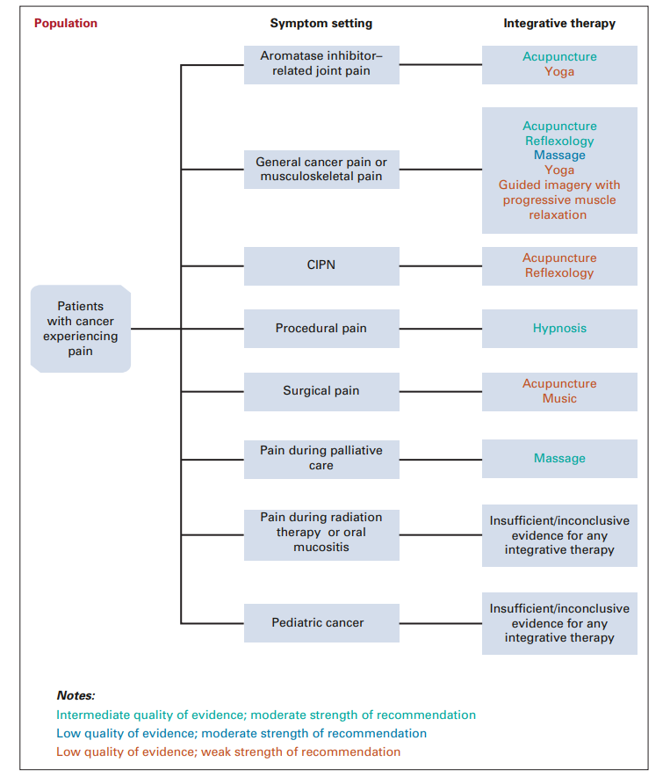
SIO/ASCO Pain Guideline (2022)
Clinical treatment algorithm

Slide 24
Acupuncture in Cancer Care
Statistically significant findings for reduced cancer-related pain, fatigue, as well as nausea and vomiting. Improvements also found for quality of life (Lau et al., 2015).
Therapeutic effects for cancer-related fatigue, nausea/vomiting and on leukopenia. Some evidence for hot flashes, quality of life, and hiccups (Wu et al., 2015).
Menopausal symptoms significantly decreased in breast cancer patients, but no reduction in hot flashes (Chien et al., 2017).
This Photo by Unknown Author is licensed under CC BY-SA-NC

Slide 25
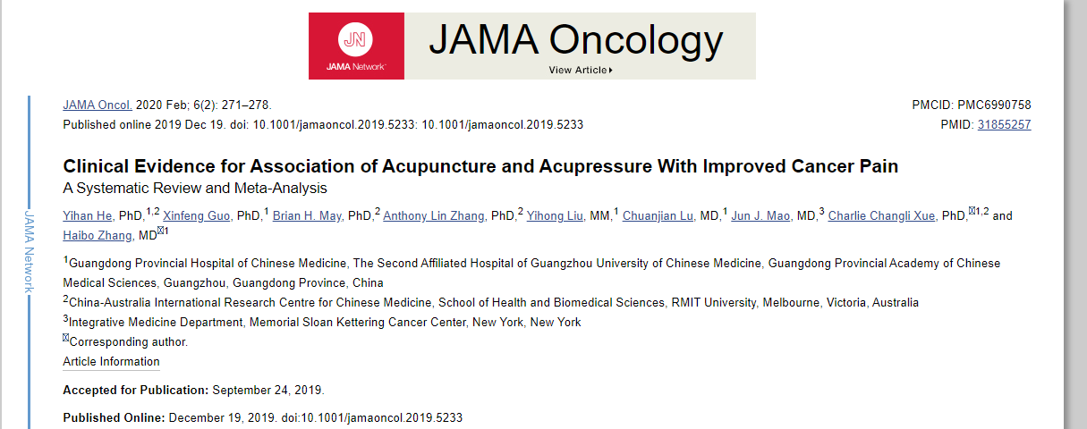
Notes:
This review showed Conclusions and Relevance
This systematic review and meta-analysis found that acupuncture and/or acupressure was significantly associated with reduced cancer pain and decreased use of analgesics, although the evidence level was moderate. This finding suggests that more rigorous trials are needed to identify the association of acupuncture and acupressure with specific types of cancer pain and to integrate such evidence into clinical care to reduce opioid use.

Slide 26
Evidence-based Acupuncture/Acupressure Recommendations
from the SIO Guideline for Breast Cancer
Nausea/Vomiting Level B
Anxiety Level C
Depressive Symptoms Level C
Fatigue Level C
Quality of Life Level C
Pain (due to AIs) Level C
Vasomotor/Hot Flashes Level C
Notes:
Acupuncture may be helpful for musculaskeletal pain due to aromatase inhibitors.
Emerging evidence that it may be helpful for peripheral neuropathy as well.

Slide 27
Mind-Body Therapies (Meditation/MBSR)
Following a cancer diagnosis, which is a time that often leads to high emotional distress.
Coping with and reduction of treatment-related side effects.
Aid in the stimulation of immunity and other healing responses.
Reduction of cancer-related pain.
Notes:
Namely meditation/MBSR – online course through the UNC IM program in the Department of Physical Medicine and Rehabilitation

Slide 28
Mindfulness-Based Stress Reduction (MBSR)
2019 meta-analysis of 14 studies in breast cancer patients - Results: reduced anxiety, depression, stress, fatigue and improved cognitive function.
2017 review of 6 studies of mixed cancer types – Results: MBSR may have some effect on biomarkers of improved immune function recovery (decreased IL-6 and tumor necrosis factor [TNF]).
2014 study in breast cancer patients - Results: increase in telomerase activity (marker of cellular aging and psychological stress) following a 6-week MBSR intervention.
Notes:
Breast CA meta-analysis - In all, 14 studies involving 1505 participants were included. Due to the effect of MBSR, statistically significant results were found on physiological function (SMD = 0.28, 95% CI [0.07, 0.049], P = 0.008), cognitive function (SMD = 1.48, 95% CI [0.34, 2.61], P = 0.01), fatigue (SMD = - 0.66, 95% CI [- 1.11, - 0.20], P = 0.004), emotional wellbeing (SMD = 1.01, 95% CI [0.35, 1.67], P = 0.003), anxiety (SMD = - 0.54, 95% CI [- 1.01, - 0.07], P = 0.02), depression (SMD = - 0.61, 95% CI [- 1.11, - 0.11], P = 0.02), stress (SMD = - 0.48, 95% CI [- 0.81, - 0.15], P = 0.004), distress (SMD = - 0.56, 95% CI [- 0.85, - 0.26], P = 0.0002) and mindfulness (SMD = 0.94, 95% CI [0.10, 1.79], P = 0.03). Although the effects on pain, sleep quality, and global QoL were in the expected direction, they were not statistically significant (P > 0.05) based on insufficient evidence.
2017 meta-analysis – proinflammatory markers – IL6, TNF, and IFN-gamma decreases in most ca studies.
Estimating the effect on QoL, a total of n = 248 patients out of 6 studies was included and the overall effect size was 0.29 (95% confidence interval (CI) 0.17–0.40; p ≤ 0.00005). Calculating the effect on mood, a total of n = 411 patients out of ten studies were included, and the overall effect size was 0.42 (95% CI 0.26–0.58; p < 0.0001). Reduction in distress revealed an overall effect size of 0.58 (95% CI 0.45–0.72; p < 0.0001; n = 587 patients out of 15 studies). MBSR programmes can improve QoL and mood, and reduce distress in cancer patients.
Carlson study (2007) Results. Fifty-nine, 51, 47 and 41 patients were assessed pre- and post-intervention and at 6- and 12-month follow-up, respectively, although not all participants provided data on all outcomes at each time point. Linear mixed modeling showed significant improvements in overall symptoms of stress which were maintained over the follow-up period. Cortisol levels decreased systematically over the course of the follow-up. Immune patterns over the year supported a continued reduction in Th1 (pro-inflammatory) cytokines. Systolic blood pressure (SBP) decreased from pre- to post-intervention and HR was positively associated with self-reported symptoms of stress. Conclusions. MBSR program participation was associated with enhanced quality of life and decreased stress symptoms, altered cortisol and immune patterns consistent with less stress and mood disturbance, and decreased blood pressure. T
2014 reduced TA and TL are associated with disease and health risks. Telomerase activity involved with telomere maintenance through adding telomeric DNA.

Slide 29
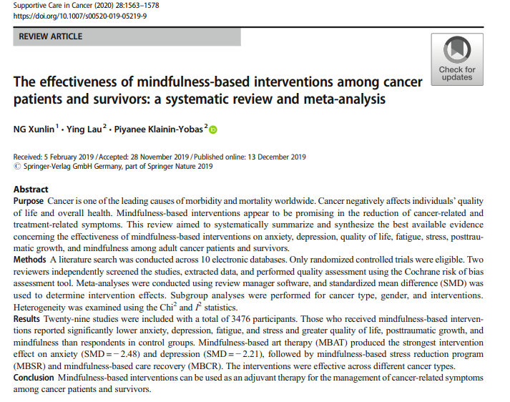

Slide 30
Evidence-based Meditation Recommendations
from the SIO Guideline for Breast Cancer
Anxiety/Stress Level A
Depressive Symptoms Level A
Quality of Life Level A

Slide 31
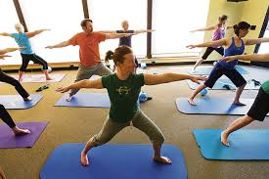
Yoga and Cancer
An ancient Eastern spiritual practice that includes physical postures, regulated breathing exercises and meditation with the goal of uniting mind, body and spirit for self-awareness and good health. Several different types exist.
Research on yoga and cancer suggests that yoga has psychological
and physical benefits, including:
Improving patients’ feelings of well-being and quality of life during and after treatment
Decreasing depression and anxiety
Decreasing fatigue and increasing energy
Decreasing nausea and pain
May enhance immune function.

Slide 32
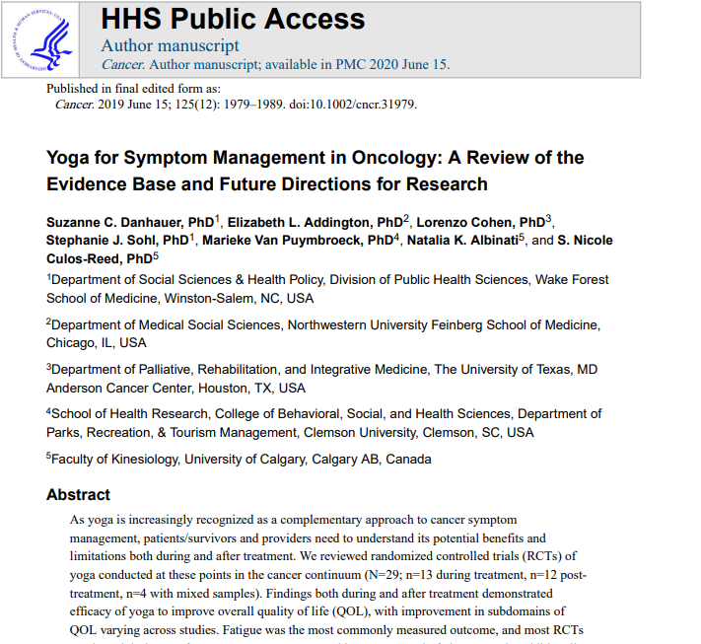
Significant findings demonstrated efficacy of yoga for overall QOL and fatigue, as well as trends suggesting
improvements for stress/distress, sleep and cognition.
Notes:
29 RCTs 13 during tx and 12 post tx. Findings demonstrated efficacy of yoga for overall QOL and fatigue. Suggest improvements for stress/distress, sleep and cognition. Studies included mixed cancers, but predominantly breast cancer.

Slide 33
Evidence-based Yoga Recommendations
from the SIO Guidelines for Breast Cancer
Anxiety/Distress Level B
Depressive Symptoms Level B
Quality of Life Level B
Fatigue Level C
Sleep Level C
Notes:
Results: Seven trials involving 693 breast cancer patients met inclusion criteria. Meta-analysis indicated a short-term improvement in fatigue [standard mean difference (SMD), −0.62; 95% confidence interval (CI), −1.17 to −0.07], sleep disturbance (SMD, −0.34; 95% CI, −0.55 to −0.12), depression (SMD, −0.50; 95% CI, −0.70 to −0.31) anxiety (SMD, −0.50; 95% CI, −0.70 to −0.31), and health-related quality of life (QoL) (SMD, 0.72; 95% CI, −0.12 to 1.56) in the yoga group; however beneficial medium- and long-term effects in fatigue, sleep disturbance were not identified. Moreover, qualitative analyses suggested that yoga was not associated with decreased adverse events (AEs) compared with control groups. Conclusions: Yoga may benefit to reduce fatigue, depression and anxiety, improve sleep disturbance, and improve QoL in breast cancer patients receiving chemotherapy in the short-term; however, medium- and long-term effects should be further established owing to limitations.

Slide 34
Integrative and Lifestyle Medicine Consultations at N.C. Basnight Cancer Hospital
The Integrative and Lifestyle Medicine consult service helps individuals affected by cancer understand how complementary therapies, such as mind-body practices, dietary and natural supplements, and lifestyle changes may decrease side effects of conventional cancer treatments, as well as enhance quality of life and overall well-being during and beyond cancer treatments.
Notes:
Shifting gears

Slide 35
“I am fighting mentally with the fear of side effects from radiation treatments.”
“My fatigue is a “6” most days.”
“I want to get physically fit and start eating the right foods.”
P.A. – 66 y.o. female with early-stage
breast cancer post-tx. Survivorship.
J.J. – 27 y.o. female with recurrent melanoma to the bone and lungs started on targeted immunotherapy.
J.C. – 75 y.o. male with newly diagnosed
head & neck cancer about to start XRT
“I want to do whatever I can to improve my immune function.”
“I have constant, sharp pain in my neck and shoulders, and I want to know if there is anything other than medications to try.”
“I don’t want to leave any stones unturned.”
T.S. – 82 y.o. female with early
stage endometrial cancer s/p
total hysterectomy.
M.P. – 35 y.o. female with metastatic
breast cancer to the cervical spine on
active treatment.
S.D. – 59 y.o. female with recent metastatic
breast cancer starting a new treatment.
Notes:
From my practice here are several patient quotes indicating their desire/reason for seeking out an IO consultation. Note the variation of ages, dxs., stages – possible prevention of recurrence through lifestyle behavior change, enhance overall health and QOL while living with cancer and pain & other symptom management.

Slide 36
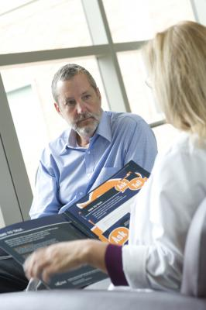
Consultation visits are available for anyone affected by cancer (i.e., prior to treatments, during active treatments and/or following treatments).
Visits are available four days/week with both in-person and telemedicine options.
Visits are typically one hour and are covered by insurance as a medical visit.

Slide 37
Referral Process
Clinical teams can place a referral through EPIC using the ambulatory referral order: Ambulatory referral to Integrative Medicine; Dept. Specialty Psychiatry; Dept. - UNC Comprehensive Cancer Support Center. Patients and clinical team members may also place the referral by calling the CCSP scheduling phone line 919-966-3494.

Slide 38
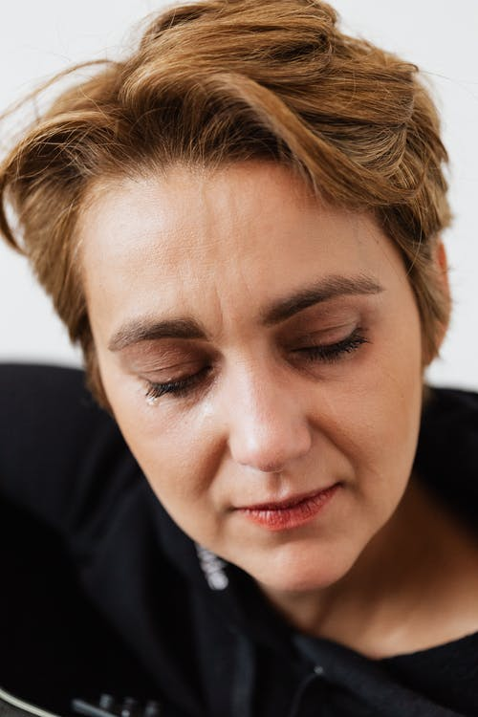
Case Study – KM 45 year-old Diagnosed with Early-stage Breast Cancer
KM underwent bilateral mastectomy, radiation therapy and combination chemotherapy. Was in the process of having reconstructive surgery and was taking hormonal therapy (i.e., Tamoxifen) when we met.
Additional medical history includes anxiety, depression, migraines and overweight. Her BMI was 26.6 kg/m2.
Married, husband with Stage IV cancer; Two children 12 and 15 years of age; financial and marital stress.
Requested IO referral for symptom management and overall health and wellness.
Presented with several symptoms, such as fatigue, bone and joint pain, hot flashes, insomnia, weight gain, depression, cognitive changes, constipation, neuropathy, etc.

Slide 39
Integrative Oncology Recommendations:
A predominantly plant-based, whole foods diet, such as the Mediterranean-style diet, with the addition of 1-2 tablespoons of ground flax/day for constipation. Supplementation with Vitamin D for low serum blood level.
In addition to a healthy diet encouraged regular exercise. Referral to Get REAL and HEEL
exercise program at UNC.
Recommended yoga program through CCSP for stress management/mood/sleep, etc. Also recommended the use of aromatherapy with lavender essential oil for relaxation.
Referral for acupuncture for neuropathy.
Acupuncture for sleep, as well as stress reducing herbal teas and Melatonin.
Continued counseling through CCSP for depression. Recommended counseling for family as
well. Consider an in-person or online breast cancer support group. Additional suggestions
were guided imagery, etc. For spiritual health – journaling, especially a gratitude journal,
meditation and prayer.
Notes:
One BC study in post-menopausal women showed a 40% reduction in risk with a Med diet.
Flaxseed is a good source of fiber and Omega 3 FA (anti-inflammatory) small study has shown that following 1 month of regular consumption lowered cell proliferation rates and increased apoptosis (programmed cell death) prior to BC surgery. Other studies have shown that flaxseed can enhance Tamoxifen’s inhibitory effects of hormone sensitive BC cells in mice.
Vitamin D and breast cancer. Culinary mushrooms (maitake, shiitake, reishi, and turkey tail (Beta glucans and polysaccharides, etc) have been found to augment immune function and downregulate estrogen response. Clinical trials have shown mixed results for disease-free survival when PSK constituent has been added to chemo and endocrine therapy.
Green tea (polyphenols) some limited data showing a lowered risk of BC with green tea consumption.
To include whole food based soy such as tofu, tempeh, edamame, etc. Avoid soy supplements.
Along with diet, should help with weight loss (goal is weight loss). Overweight and
obesity known to increase risk for BC by 20-40%. Possible connections are increased
inflammation, excessive estrogen production, insulin resistance, depressed immune function.
Social Support:
A 2017 study found that women with a history of BC who had a higher number of social
connections were less likely to have a recurrence or die from the disease. Associated
with lower levels of stress hormones and other blood markers of inflammation such as
IL-6.

Slide 40
The Essence of Integrative Medicine from the Patient Perspective
“The health of my body, mind, and spirit are related…
…and whomever cares for my health should take that into account.”
Astin J. A. (1998). Why patients use alternative medicine: Results of a national study. JAMA, 279, 1548-1553.
Notes:
I am now going to pivot to provide a glimpse of my personal experiences recently with the blending of IM and PC utilizing some additional non-pharmacologi strategies not previously discussed, mostly with expressive art therapy.

Slide 41
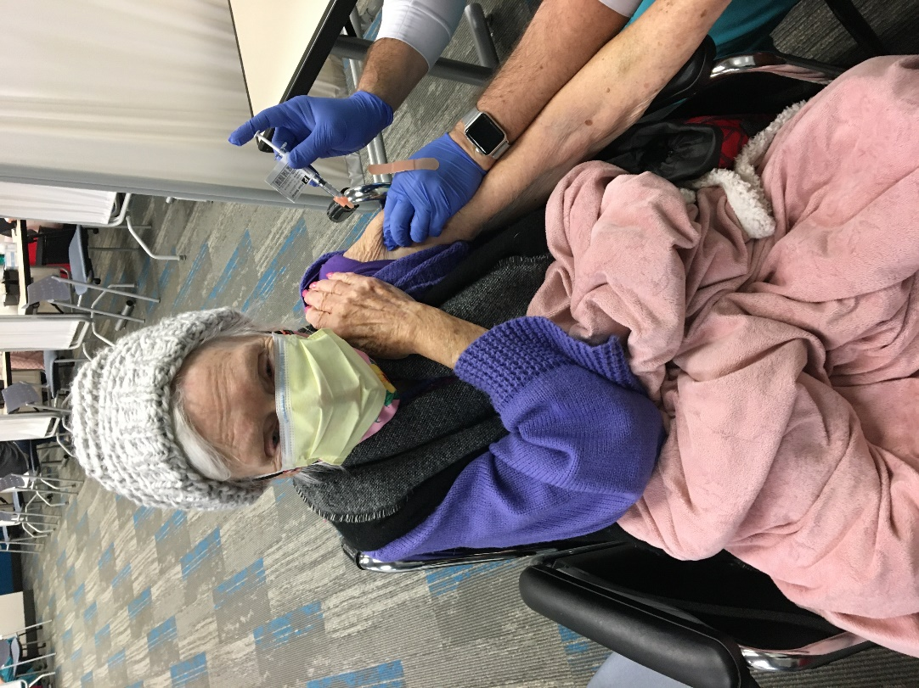
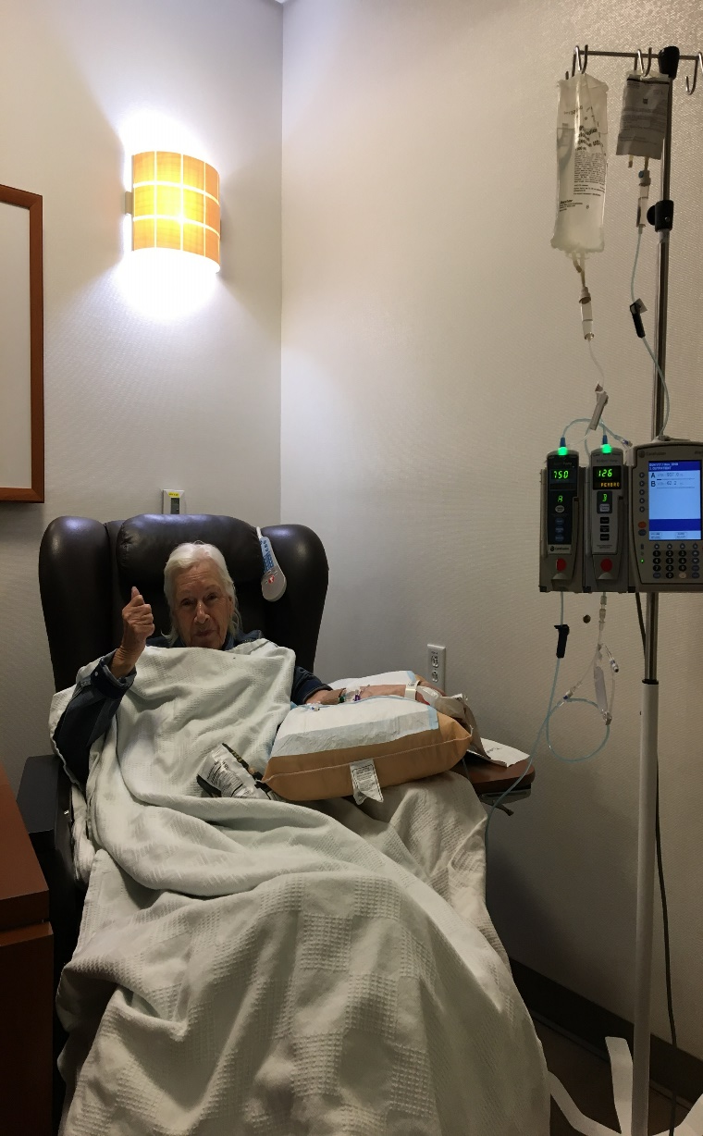
Living with Uncertainty
Notes:
MP in 2020 receiving Keytruda and getting her COVID vaccine

Slide 42
Relieving Stress and Finding Purpose through Art as Therapy
Notes:
Birthday gift of an easel to start painting at age 92. Finished piece gracing the wall. Just finished painting a bird house and ready to move onto a new art project. Studies of expressive art therapies in cancer care have shown significant

Slide 43
Summary: Expressive Art Therapies for Cancer
Number of studies reviewed: N=8 clinical trials
Total number of participants: 222
Participants: breast and pediatric cancers
Intervention/Control:
4-12 sessions, 30-90 minutes each
Individual or group based
Led by an art therapist or mental health provider
Significant improvements on stressful feelings, anxiety, depression,
and social enjoyment.
Decrease in anxiety ranged from 28-61%
Decrease in depression ranged from 28-61%

Slide 44
Grappling with Existential Plight
Notes:
Grandson holding the frail hand of his grandmother while providing comforting and loving words to her know of her importance in this life and beyond. Soothing music, aromatherapy with lavender, back and feet massages were integrated in for a calming, healing environment. Utilized inhalation aromatherapy with a room diffuser – scent molecules are absorbed through the nasal membranes stimulating the olfactory nerve and once nerve impulses reach the limbic system it exerts relaxation response. In fact, a recent systematic review on the effects of aromatherapy on cancer symptoms in 2019 found that aromatherapy with lavender significantly reduced anxiety, pain perception and improved sleep. This review also found that peppermint and ginger aromatherapy was effective in reducing nausea and vomiting.
My mom was able to pass peacefully at home with me in May 2021, one month after her 93 birthday.

Slide 45
Systematic Review Results: Aromatherapy and Cancer
Number of studies reviewed: N=43 (RCTs – 31)
Number of participants: 3239 in 13 countries
Participants: included those with multiple cancer types
Most commonly used aromas: lavender (n=18),
Chamomile (n=6), and ginger (n=5)
Most common duration of inhalation therapy: 10 mins
repeated daily
Main findings:
Lavender reduced anxiety and pain, improved sleep and
quality of life
Peppermint and ginger reduced nausea and vomiting
Farahani, Afsargharehbagh, Marandi et al. (2019).

Slide 46
The Best of both Conventional and Integrative and Lifestyle Medicine
Awaiting heart transplant 2009
Post heart transplant 2014
Notes:
Pretransplant – 48 hours before living-saving heart transplant 7/2009 Victory sign – For 16 years Neil lived with heart failure and an EF of 10% - continued to exercise, ate a healthy med style diet, a few supplements such as Co-Q10, Mg, MVI, meditated/MBSR course, and had Reiki therapy regularly for energy healing, healthy diet, regular aerobic and strength training exercise. These approaches are in part what helped him do so well for 16 years prior to the need for a heart transplant. Neil continued these practices following his transplant, although stress management became harder due to academic demands, family illnesses, etc.
First half-marathon post-transplant 2014 Again the victory sign

Slide 47
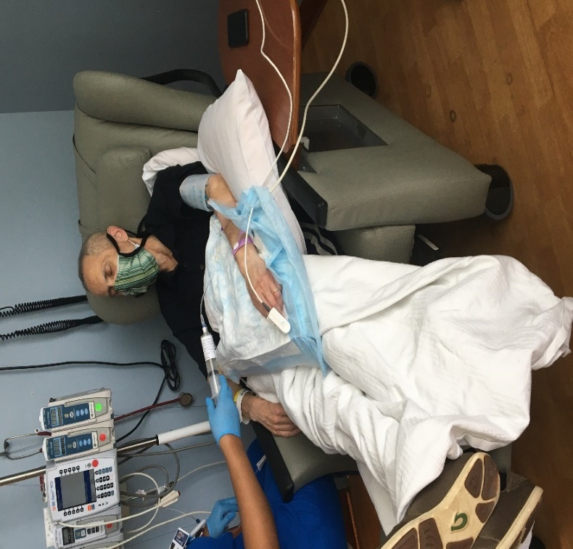
Thriving to Surviving – Benefits of IM in Both Scenarios
Fall 2019 healthy and thriving at
A Lyme Disease event
May 2020 receiving investigative T-cell therapy - barely surviving
Notes:
First photo is in 2019 a Lyme Gala NS was speaking at and the 2nd photo is May 2020, when receiving the first EBV targeted T-Cell therapy. This was about 2 weeks before he passed from this earthly plain. Ironic that the symbolic ribbon for both NHL and Lyme Disease are practically the same – Lime green.
For pain used opioids as well as meditation and acupuncture and music for distraction. For nausea used peppermint, ginger aromatherapy and ginger/chamomile teas. Finding continued purpose included doing an interview 2 weeks prior to his last hospitalization on a podcast called, Own Your Truth, where he shared his most raw and vulnerable experiences and inspirational insights. Neil was experiencing a high level of pain that day and the podcast host suggested they postpone the talk, but Neil persevered through the talk, called True Healing.

Slide 48
Music as Therapy for Emotional Strength
Notes:
Note the headphones - Healing Rain by Michael Smith
Source of strength through his transplant ordeal and again when dealing with PTLD/Lymphoma. Music as we know is a great distraction, especially around procedures. It is well known to have relaxation effects and can reduce anxietyUnfortunately, my beloved passed in June 2020.

Slide 49
Findings from studies on listening to music before or during cancer treatments revealed that it can significantly reduce anxiety by up to 56% (Chen et al., 2012; Ferrer, 2007). Additional studies have found that music therapy can also improve mood and pain.
Music as Therapy

Slide 50
The Journey Beyond
Summoning courage from the depths of our very being,
We struggle to come to grips with life’s ultimate transition.
Fueled by fears of the unknown,
Primal survival instincts surface,
Vestiges of days long since forgotten,
When unbridled energy coursed through our ancestral veins.
We truly want to believe,
That life exists eternally.
The voice from within questions.
“What will become of me?”
“What does non-existence feel like?”
“Without the beating of the heart,
How am I to define my presence?”
There is no need to fear,
For beyond the opaque vail exists the purest of white light.
Brilliant in its hue,
Comforting to all that accept its warm embrace.
Reminding us of the universal truth,
Life is a continuum-eternity.
Oh to be home in the presence of only beauty and goodness,
A respite from the pain and suffering that manifest all too frequently in this reality,
For here there are no malignancies of the body or spirit.
In this realm,
Only the soul shines.
The personification of who we truly are,
Rather than merely a medical condition from which our mortal bodies succumb.
From this ethereal vantage point,
We can understand that the body has no true meaning.
Serving instead as an instrument,
Enabling the soul to fully experience its incarnation.
How wonderful to be liberated from the confines of flesh and bone.
Light and free of the burdens and worries of the physical existence.
In the end,
We reawaken to the fact that there is no end.
There are no good-byes.
Only new beginnings.
For our lives are not constrained by units of time, purely man-made.
Purpose of being is continuous,
As are relationships with kindred souls,
Though at levels unimaginable on this physical plane.
Paths will surely cross again,
Just as the night begets the day.
We struggle in life to find meaning and purpose.
In death, the true essence of our being is fully revealed.
To enter into the light with total love and assurance.
Reconnect to the universal energy,
That sustains each of us.
Continue to guide us in our quest,
For the advancement of the common good.
Until we meet again.
Neil Spector, MD
Notes:
Another expressive arts form is writing through either journaling or the creation of poems. Through early health struggles poetry became a form of therapeutic catharsis. This Prophetic poem was written years before my beloved husband’s passing during the time he was dealing with life-threatening heart failure with an EF of 10%, which was prior to his transplant. As the Sufi mystic and poet Rumi stated, The cure for pain is in the pain. Delving into

Slide 51
Resources
American Cancer Society – Stay Healthy
https://www.cancer.org/healthy.html
American Institute for Cancer Research (AICR)
http://www.aicr.org
Memorial Sloan Kettering Cancer Center: Herbs & Botanicals
https://www.mskcc.org/cancer-care/diagnosis-treatment/symptom-management/integrative-medicine/herbs
National Center for Complementary and Integrative Health
https://www.nccih.nih.gov/
Natural Medicines Database – subscription required
https://naturalmedicines.therapeuticresearch.com/
Society for Integrative Oncology – membership required
https://integrativeonc.org/

Slide 52
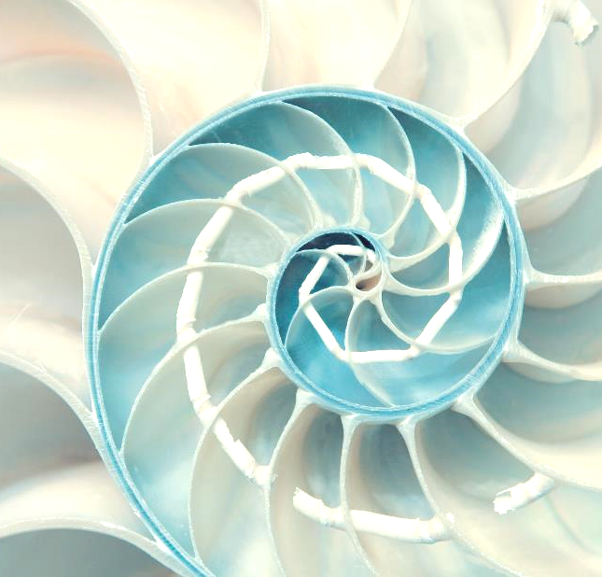
Thank you for your attention and a very special thank you to the UNC CCSP and Hospice teams!
Questions/Comments
Contact: denise.spector@unchealth.unc.edu

Slide 53
References
Chen L.. C., Wang, T. F., Shih, Y. N. , & Wu, L. J. (2012). Fifteen-minute music intervention reduces pre-radiotherapy anxiety in oncology patients. European Journal of Oncology Nursing, 17, 436-441.
Chien, T., Hsu, C., Liu, C., et al. (2017). Effect of acupuncture on hot flush and menopause symptoms in breast cancer: A systematic review and meta-analysis. PloS One, 12, doi:10.1371/journal.pone.0180918
Farahani, M. A., Afsargharehbagh, R., Marandi, F., et al. (2019). Effect of aromatherapy on cancer complications: A systematic review. Complementary Therapies in Medicine, 47, https://doi.org/10.1016/j.ctim.2019.08.003
Ferrer A. J. (2007). The effect of live music on decreasing anxiety in patients undergoing chemotherapy treatment. Journal of Music Therapy, 44, 242-255.
Hall, D. L., Luberto, C. M., Philpotts, L. L., Song, R., Park, E. R., & Yeh, G. Y. (2018). Mind-body interventions for fear of cancer recurrence: A systematic review and meta-analysis. Psychooncology, 27(11), 2546–2558. doi:10.1002/pon.4757
Lengacher, C. A., Reich, R. R., Kip, K. E. (2014). Influence of mindfulness-based stress reduction (MBSR) on telomerase activity in women with breast cancer (BC). Biological Research for Nursing, 16, 438-447. doi:10.1177/1099800413519495
Lau, C. H. Y., Wu, X., Chung, V. C. H., et al. (2015). Acupuncture and related therapies for symptom management in palliative cancer care: Systematic review and meta-analysis. Medicine, 95, 2901.
Sanada, K., Diez M. A., Valero, M. S., et al. (2017). Effects of mindfulness-based interventions on biomarkers in health and cancer populations: A systematic review. BMC Complementary and Alternative Medicine, 17, 125. doi:10.1186/s12906-017-1638-y
Wu, X., Chung, V. C., Hui, E. P., et al. (2015). Effectiveness of acupuncture and related therapies for palliative care of cancer: Overview of systematic reviews. Scientific Reports, 5, doi: 10.1038/srep16776.
Yi, L., Tian, X., Jin, Y., et al. (2021). Effects of yoga on health-related quality, physical health and psychological health in women with breast cancer receiving chemotherapy: A systematic review and meta-analysis. Annals of Palliative Medicine, 10(2), 1961-1975. http://dx.doi.org/10.21037/apm-20-1484
Zhang, Q., Zhao, H., & Zheng, Y. (2019). Effectiveness of mindfulness-based stress reduction (MBSR) on symptom variables and health-related quality of life in breast cancer patients: A systematic review and meta-analysis. Supportive Care in Cancer, 27(3), 771-781. doi:10.1007/s00520-018-4570-x

