Slide 1
After Death Communication
Scott Janssen, MA, MSW, LCSW

Slide 2
What is in a name?

Slide 3
Guggenheim and Guggenheim’s Definition of After Death Communication (ADC)
A spiritual experience that occurs when someone is contacted directly and spontaneously by a family member or friend who has died.

Slide 4
Okay, Okay. Try This One Then
Spontaneous phenomenon during which a living person reports a felt sense or perception of contact with a deceased person.

Slide 5
Why Get Personal?
Impact of explanatory narratives
Impact over time
Gauging our response as healthcare professionals

Slide 6
It Was a Dark and Not So Stormy Night

Slide 7
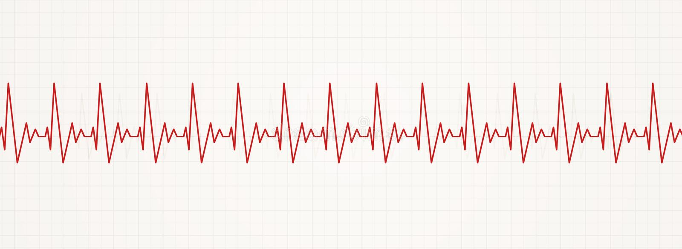
What The Hell Was That!?

Slide 9
After Death Communication (ADC)
ADCs are common (meta-analysis by Straight-Horn estimates 30-35% lifetime prevalence; approximately 75% occur within one year of surviving a loved one’s death)
Most find them comforting, encouraging and/or reassuring
For some, an ADC can cause distress
Occur across culture, race, age, socio-economic status, educational level, gender, and religious belief
Occur more frequently but not exclusively in those who have had a recent loss
May be veridical

Slide 10
After Death Communication (ADC)
Sensing
Sensing a presence
Hearing
Hearing a voice (Stop!)
Feeling
Feeling a touch
Smelling
Smelling a fragrance (e.g. perfume, cigar, flowers)

Slide 11
After Death Communication (ADC)
Visual experiences which range from an ephemeral appearance to more solid form
Visions in which the deceased has a lifelike, full-body appearance which appears solid and real (Mommy’s not dead. I just saw her)
Twilight experiences occur during altered states of consciousness such as falling asleep, awakening from sleep, praying or meditating
Dreams perceived as significant in that they are reported to be more intense and/or hyper-real compared to ordinary dreams (Mary Mohin McCartney)

Slide 12
After Death Communication (ADC)
Out-of-body ADCs (described as a visitation with the deceased in an alternate, typically their “new”, environment)
Physical phenomena (e.g. lights going off and on, objects falling from a shelf, appliances turning on or items being moved around)
Telephone calls (It lit up the room)
Symbolic ADCs (e.g. perceived meaning in things like feathers, coins, butterflies, birds, flowers, or natural phenomena like rainbows)

Slide 13
Potential Barriers to Disclosure
Fear of stigma, ridicule or psychiatric labelling
Risk of having something meaningful/profound dismissed, rejected or explained away
Uncertainty about with whom it is safe to talk
Learned fear stemming from initial attempts to tell the story and being shut down
Conflicts with world view or spiritual beliefs

Slide 14
Potential Clinical Implications and Therapeutic Benefits
Decreased death fear in those who are dying
Psychological and/or emotional benefits for those who are grieving
Enhanced relational closeness and support
Opportunities to name and process these experiences can enhance well-being, reduce experience-related distress and mitigate the risk of “disclosure regret”

Slide 15
What Can We Do?
Increase knowledge and awareness
Be prepared to share information/provide education when indicated
Be prepared to discuss in a supportive, affirming and nonjudgmental manner
Know your biases
Learn to ask directly or indirectly
Listen for indirect or suggestive clues that a person may want to talk

Slide 16
What Can We Do?
Affirm the experience as common and well-recognized
Affirm the experience as real or potentially real
Avoid psychiatric labels
Encourage conversation
Let people decide the meaning for themselves
Normalize
Use positive or neutral framing

Slide 17
It Was a Not So Dark and Very Stormy Night

Slide 19
References:
Abel, J., & Kellehear, A. (2018). Palliative curriculum re-imagined: A critical evaluation of the UK palliative medicine syllabus. Palliative Care Research and Treatment. 11:1-7.
Blake, J. (2021). They lost their loved ones to Covid. Then they heard from them again. CNN online. June.
Elsaesser, E., Roe, C., Cooper, C., & Lorimer, D. (2020). Investigation of the phenomenology and impact of spontaneous and direct after-death communications (ADCs): Research findings. https://www.evelyn-elsaesser.com/wp-content/uploads/2020/02/Booklet_Web_English_Research.pdf
Fenwick, P., & Fenwick, E. (2008). The art of dying: A journey to elsewhere. New York: Continuum International Publishing.
Foster, R., & Holden, J. (2014). External connection: An exploratory study of the effects of learning about near-death experiences on adult grief. Journal of Loss and Trauma.19: 40-55.
Foster, R., Maxwell, L., & Butler, W.(2020). Coping with cancer: Case studies on the effects of learning about near-death experiences. Journal of Near-Death Studies. 38(2): 87-100.
Greyson, B. (2021). After: A doctor explores what near-death experiences reveal about life and beyond. Saint Martin’s.

Slide 20
References:
Holden, J. M., Kinsey, L., & Moore, T. (2014). Disclosing near-death experiences to professional healthcare providers and non-professionals. Spirituality in Clinical Practice. 1(4), 278-287.
Janssen, S. (2021). It’s time we started talking openly about near-death experiences and after death communication. Geripal. February.
Janssen, S. (2021). Combat-related near-death experiences: Veterans who report them deserve better support. Combat Stress Magazine. 10(2): 34-41.
Janssen, S. (2021) Letter to the editor: Brief dispatch from the hospice field: Transpersonal end-of-life experiences in the COVID-19 era. Journal of Near-Death Studies.39:2. 137-139.
Janssen, S. (2015). Letting patients and families interpret deathbed phenomena for themselves. American Journal of Nursing. 115(9): 11.
Janssen, S. (2015). Deathbed phenomena in hospice care: The social work response. Social Work Today, 15(6), 26-31.
Keen, C. et al. (2012). Sensing the presence of the deceased: A narrative review. Mental Health, Religion & Culture. 16 (4), 384–402.

Slide 21
References:
Kerr C. (2020). Death is but a dream: Finding hope and meaning at life’s end. New York: Avery.
Samoilo, l., & Corcoran, D. (2020). Closing the medical gap of care for patients who have had a near-death experience. Narrative Inquiry in Bioethics. 10(1): 37-42.
Streit-Horn, J. (2011). A systematic review of research on after-death communication (ADC) (doctoral dissertation). University of North Texas: Denton, Texas.
Vincent, K. (2021). Evidential after-death communications. DeNumine. 70, pp. 4–6.

Slide 22
Thank you

