Slide 1

Medication Management for
Older Adults
Anthony J. Caprio, MD, CMD
Medical Director, Division of Aging
Department of Family Medicine

Slide 2
Objectives
Identify the physiologic changes associated with normal aging that influence pharmacokinetics and pharmacodynamics
Avoid potentially harmful medications for older adults
Recognize Adverse Drug Events (ADEs) when an older adult presents with a new condition or complaint
Utilize strategies for evaluating starting and stopping medications

Slide 3
Challenges of Prescribing for Older Adults
Multiple medical conditions
Multiple medications
Multiple prescribers
Different metabolisms and responses
Adherence and cost
Supplements, herbals, and OTC drugs
Lancet. 1995;346(8966):32–36.
Notes:
You probably appreciate the many challenges of prescribing medications for older adults They may have multiple medications and multiple medications. Often there are multiple prescribers, especially if the patient is seeing several specialists. It may be difficult for those multiple health care providers to keep track of all of these medications or to fully account for other medications on the patient's medication list.
An additional challenge is that older patients may have different metabolisms and responses to medications compared to younger patients. Reduced dosing or avoiding certain medications are important for older patients.
You can also appreciate that it must be difficult to adhere to a prescribed regiment when the list of medications is so long. Not to mention the high cost associated with all of these medications. Even with Medicare part D coverage, the expenses associated with prescription drugs can be quite significant for older adults.
Finally, remember that older patients may be taking non-prescription medications, such as supplements, herbals, or other over-the-counter drugs. These products still can carry significant risks of drug-drug interactions or adverse effects.

Slide 4
Lots of Medications and Little Evidence
2/3 of older adults are on regular medications
Adults age >65 account for 1/3 of all prescriptions, but only represent 15% of the US population
Older adults are frequently not included in clinical trials, which makes it difficult to predict drug metabolism or drug effects
Health Care Financ Rev. 1990;11:1-41.
Notes:
Older adults (those over the age of 65) have disproportionate use of prescribed medications.
Unfortunately, there is a general lack of good evidence for using these medications for older adults. Older adults are often excluded from drug trials either because they are on other medications or have exclusion criteria like co-morbid diseases or an inability to provide consent for participation in clinical drug trials.

Slide 5
Adverse Drug Events (ADEs)
Adverse symptoms
Adverse clinical outcomes
  Doctor visits or hospitalizations
  Falls
  Functional decline
  Changes in cognition (delirium)
  Death
Poor adherence, poor quality of life
Increased cost
Notes:
The major focus of this presentation is the concept of Adverse Drug Events, or ADEs. At the most basic level, ADEs include the adverse symptoms or "side effects" of medications like nausea, vomiting, diarrhea, dizziness, or headache. But more broadly speaking, ADEs include a variety of adverse clinical outcomes like precipitating a doctor visit or hospitalization, falls, functional decline, changes in cognition (such as delirium), or even death. The adverse effects on adherence and quality of life and cost are also worth mentioning as adverse effects of drugs.

Slide 6

Physiologic Changes with Normal Aging
Less Water
More Fat
Less muscle mass
Slowed hepatic metabolism
Decreased renal excretion
Decreased responsiveness and sensitivity of the baroreceptor reflex
Notes:
Jack LaLanne died at 96

Slide 7
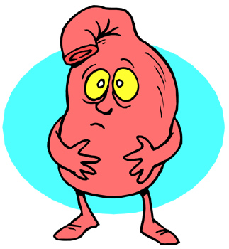
Absorption
Not affected by the normal aging process
Can be altered by drug interactions
  Antacids
  Iron
Can be affected by disease
  Lack of intrinsic factor (B12 absorption)
  Delayed gastric emptying

Slide 8

Distribution
Less water = ↓ volume of distribution
Higher concentration of water soluble drugs
More fat = ↑ volume of distribution
Prolonged action of fat-soluble drugs (increased half-life)
Lower serum proteins (like albumin) increases the concentration of unbound (free or active) form of drugs

Slide 9
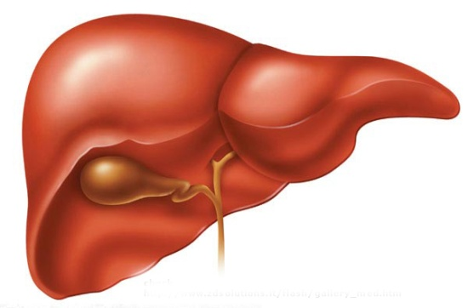
Metabolism
Slowed Phase I, cytochrome P450, reactions
  Oxidation, reduction, dealkylation
  Warfarin and phenytoin levels may be higher because of altered metabolism
Phase II reactions are essentially unchanged
  Conjugation, acetylation, methylation
Drug-drug interactions
  Increased risk with increased number of drugs

Slide 10
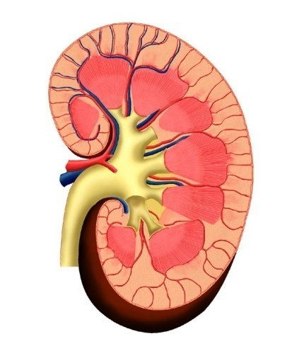
Excretion
Hepatic
Renal
  Renal clearance may be reduced
  Serum creatinine may not be an accurate reflection of renal clearance in elderly patients.
  (decreased lean body mass)
Active drug metabolites may accumulate
  Prolonged therapeutic action
  Adverse effects

Slide 11
Physiologic Changes
Associated with Disease States
Cardiac Disease
  Impaired cardiac output (decreased absorption, metabolism, clearance)
  Greater susceptibility to cardiac adverse effects
Kidney and Liver Disease
  Decreased drug clearance and altered metabolism
Neurological Diseases
  Diminished neurotransmitter levels
  Greater susceptibility to neurological effects

Slide 12
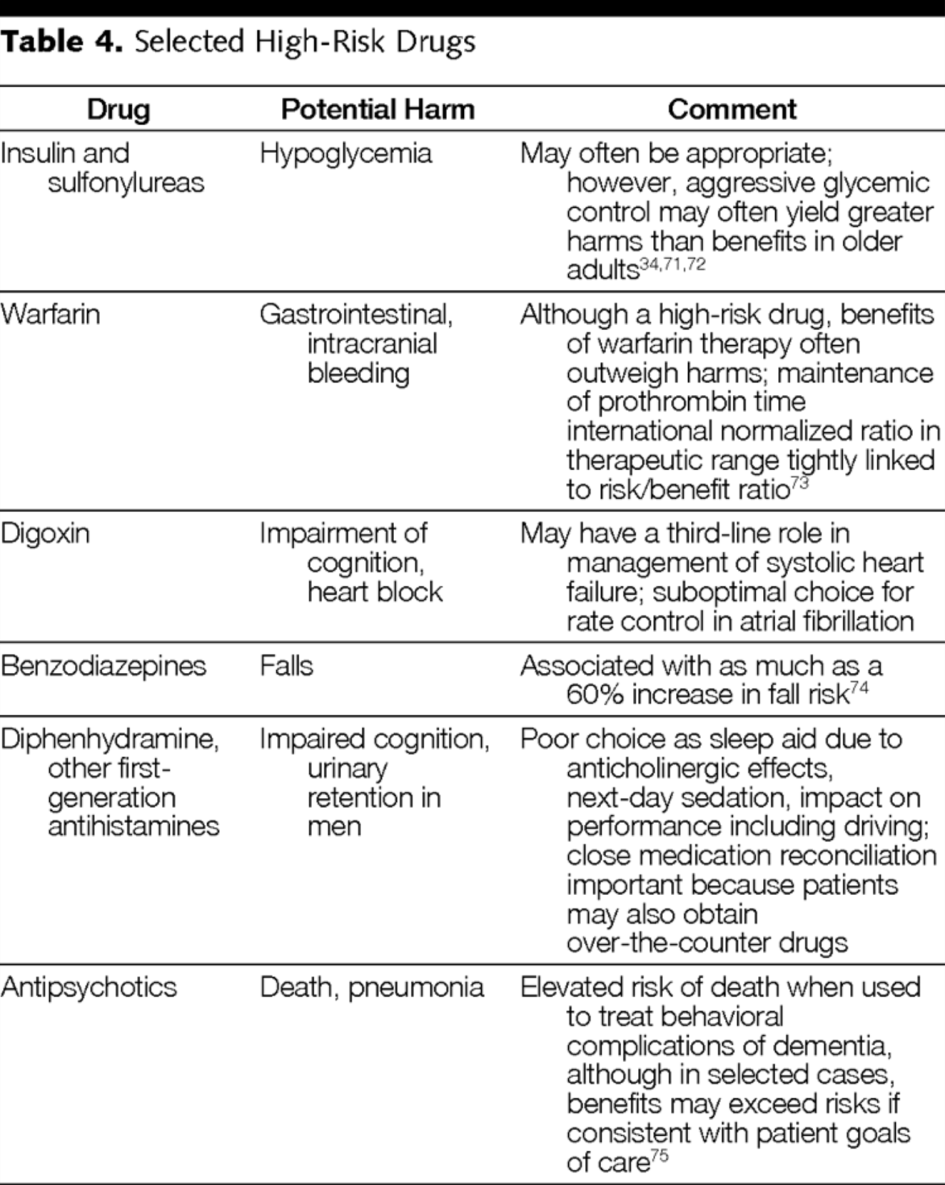
Account for 1/3 of ED visits for ADE
JAMA. 2010;304(14):1592-1601. Ann Intern Med. 2007;147:755-765.
Notes:
warfarin, insulin, and digoxin accounted for more than one third of visits to ED for ADEs (Ann Intern Med. 2007;147:755-765.)

Slide 13
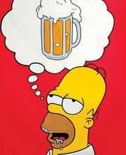
Beers Criteria
Potentially inappropriate medications for older adults.
Originally conceived by Dr. Mark Beers
Published in 1991, revised in 1997, 2002, and 2012.
Consensus-based, but statistical association with adverse drug events
Adopted for nursing home regulation.
Does not account for the complexity of a patient’s entire medication regimen.
J Am Geriatr Soc 60:616–631, 2012.

Slide 14
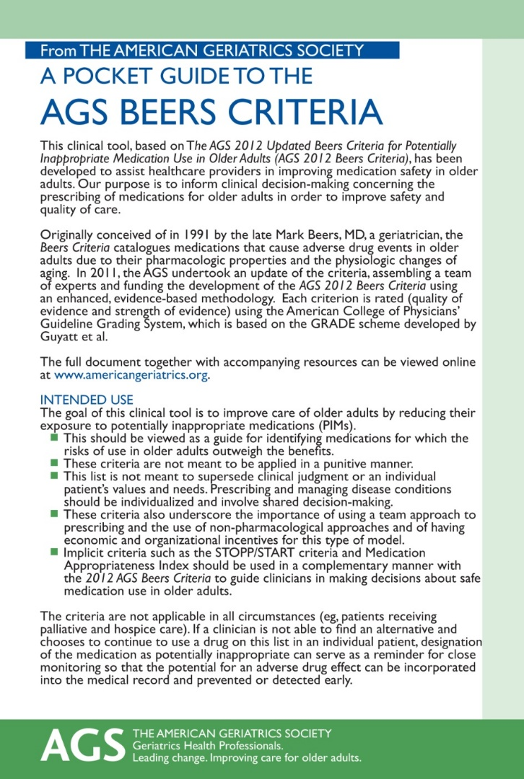

AGS Beers Criteria Resources
http://www.americangeriatrics.org/health_care_professionals/clinical_practice/clinical_guidelines_recommendations/2012

Slide 15
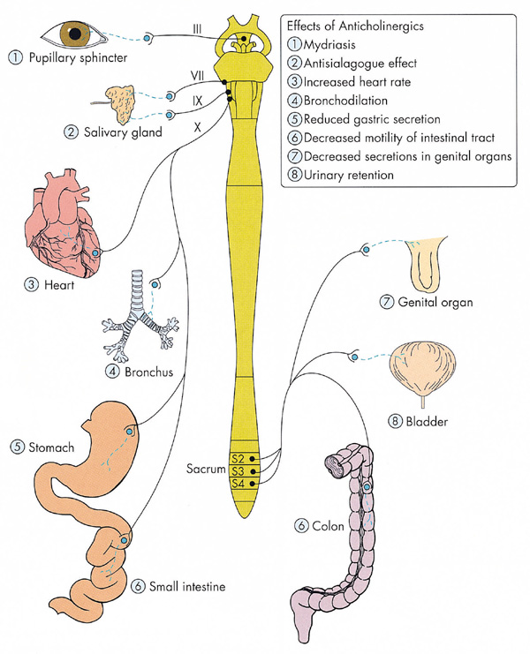
Beers Criteria: Anticholinergic Medications
Antihistamines (1st generation)
  Diphenhydramine (Benadryl, Unisom, Tylenol PM, Advil PM)
  Hydroxyzine (Atarax, Vistaril)
  Promethazine (Phenergan)
Antispasmodics
  Dicyclomine (Bentyl)
  Hyoscyamine (Levsin)
  Scopolamine (Transderm Scop)
Skeletal Muscle Relaxants
  Carisoprodol (Soma)
  Cyclobenzaprine (Flexeril)
  Methocarbamol (Robaxin)
Tricyclic Antidepressants
  Amitriptyline (Elavil)
  Doxepin (Sinequan)
J Am Geriatr Soc 60:616–631, 2012. See Table 2.
Notes:
These drugs cause many side effects in older adults, including confusion, drowsiness, blurred vision, difficulty urinating, dry mouth and constipation

Slide 16
Beers Criteria: Benzodiazepines
Increased sensitivity for older adults
  Slowed metabolism, especially long-acting agents
  Similar neurocognitive effects to alcohol
  May cause a paradoxical reaction (increased agitation)
Increased risk of adverse clinical events
  Falls and fractures
  Cognitive impairment
  Delirium
Avoid if possible
  Appropriate if being used for seizures, alcohol withdrawal, severe anxiety, or periprocedural anesthesia
  If necessary, use lowest dose possible
J Am Geriatr Soc 60:616–631, 2012. See Table 2.

Slide 17
Beers Criteria: Sedative-Hypnotics
Nonbenzodiazepine Hypnotics
  Eszopiclone (Lunesta)
  Zolpidem (Ambien)
  Zaleplon (Sonata)
Benzodiazepine-receptor agonists
Adverse events similar to those of benzodiazepines
Increased risk for delirium, falls fractures
J Am Geriatr Soc 60:616–631, 2012. See Table 2.

Slide 18
Beers Criteria: Antipsychotic Medications
FDA “Black Box” warning: increased risk of death, mostly due to cardiovascular events (eg. heart failure, sudden death) and infections (eg. pneumonia)
Avoid using for behavioral problems associated with dementia
  Try non-pharmacologic interventions
  Reserve for threat to self or others
Typical (First Generation, Conventional)
  Haloperidol (Haldol)
  Prochlorperazine (Compazine)
Atypical (Second Generation)
  Risperdone (Risperdal)
  Quetiapine (Seroquel)
  Olanzepine (Zyprexa)
  Ziprasidone (Geodon)
  Aripiprazole (Abilify)
Adverse Effects
  Arrhythmias (QT prolongation)
  Abnormal Movements (Parkinsonism, tardive dyskinesia)
J Am Geriatr Soc 60:616–631, 2012. See Table 2.

Slide 19
Beers Criteria: Pain Medications
Non–COX-selective NSAIDs
  GI bleeding and peptic ulcer disease
  Avoid chronic use
Indomethacin and Ketorolac (Toradol)
  Higher risk of GI, renal, and CNS effects
Meperidine (Demerol)
  Can cause neurotoxicity
  Safer alternatives available
J Am Geriatr Soc 60:616–631, 2012. See Table 2.

Slide 20
Before You Prescribe
Question the need for new medications
Stop medications, whenever possible
Prioritize treatments
Weigh risks and benefits
Avoid undertreating older patients
  Pain
  Systolic hypertension (stroke, renal failure, CHF)
  Anticoagulation and atrial fibrillation (stroke)
Drugs Aging 2003; 20: 23-57.
Lancet 2000; 355: 865–872.
Ann Intern Med 1999;131:492-501.
J Gen Intern Med 2005; 20:116–122.

Slide 21
“Start Low and Go Slow…”
Start one medication at a time.
Start with a low dose and increase gradually.
Once daily is usually best.
Monitor for response and adverse effects.
Assess adherence with regimen.

Slide 22
“…But, Go All The Way!”
Be conservative, but don’t miss the target!
What is your goal? Are you achieving it?
Can you keep increasing the dose or are you limited by side effects?
Are you observing a clinical benefit at lower doses?
Consider stopping if you can’t “go all the way” and the benefit is not clear.

Slide 23
“Deprescribing”
  “Systematic process of identifying and discontinuing drugs in instances in which existing or potential harms outweigh existing or potential benefits within the context of an individual patient’s care goals, current level of functioning, life expectancy, values, and preferences.”
JAMA Intern Med. 2015;175(5):827-834

Slide 24
“Deprescribing” Should Be Considered
New symptom or clinical syndrome suggestive of ADE
Advanced disease, terminal illness, extreme frailty
High-risk drugs or combinations
Preventive drugs for scenarios associated with no increased risk despite stopping drug
  Stopping alendronate after 5 years of treatment results
  Stopping statins for primary prevention
Patient/family willing to participate in shared decision
JAMA Intern Med. 2015;175(5):827-834

Slide 25
“Deprescribing”
Instruct patient to bring all medications to visit (prescription and non-prescription)
What Are Current Indications for Each Drug?
Is the Patient Actually Taking the Drug?
Does the Likely Benefit of the Drug Outweigh Its Potential for Harm?
  High-risk medications (see Beers Criteria)
  Time to benefit for preventive medications
JAMA Intern Med. 2015;175(5):827-834

Slide 26
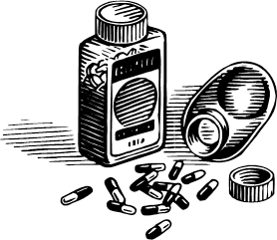
Cases

Slide 27
Case 1: Mr. Johnson
What physiologic change associated with normal aging may affect Mr. Johnson’s clinical response to medications?
b) Decreased responsiveness of the carotid baroreceptors

Slide 28
Case 1: Mr. Johnson
Which of the following is the best explanation for his overall clinical presentation?
b) Acute urinary retention due to anticholinergic effects of diphenyhydramine and orthostatic hypotension from the doxazosin
Urinary Retention
  Parasympathetic nervous system mediates detrusor muscle contraction
  Blocked by anticholinergic medications like diphenhydramine
Orthostatic Hypotension
  α -adrenergic agonists help to relax the urethral sphincter
  α-adrenergic agonists also decreases systemic vascular resistance and can cause hypotension

Slide 29
Case 2: Mr. Jones
What physiologic change associated with normal aging may affect Mr. Jones’ clinical response to medications?
c) Prolonged half-life of lipid-soluble drugs due to a higher relative composition of body fat compared to younger individuals

Slide 30
Case 2: Mr. Jones
Which of the following is the best explanation for his overall clinical presentation?
b) Anticholinergic effects of the promethazine precipitated delirium, and the lorazepam had a paradoxical effect.

Slide 31
Case 3: Mrs. Smith
After ruling-out an underlying urinary tract infection, you should
c) reduce or discontinue the donepezil (Aricpet)

Slide 32
Prescribing Cascade:
Pharmacologic Tug-of-War
Tolterodine (Detrol) →potent anticholinergic
  Relaxes detrusor muscle to treat urge incontinence
Donepezil (Aricept) →acetylcholinesterase inhibitor
  Raises acetylcholine levels to help improve cognition
  Can cause detrusor hyperactivity
Incontinence
  Dementia is a risk factor
  Possible ADE related to Donepezil
Arch Intern Med 2005; 165:808-813.
Notes:
Prescribing Cascade

Slide 33
Case 3: Mrs. Smith
If Mrs. Smith developed bradycardia after starting the donepezil (Aricept), what is the most likely mechanism?
c) Increased tone of the vagus nerve
Donepezil (Aricept) →acetylcholinesterase inhibitor
  Raises acetylcholine levels throughout nervous system
  Increases vagal tone
  Could cause symptomatic bradycardia

Slide 34
Case 4: Mrs. Green
Mrs. Green is at risk for which of the following adverse drug events (ADEs)?
d) All of the above
Hypotension: diuretics, antihypertensives
Hyperkalemia: ACE-I and spironolactone
Bleeding: ASA, clopidogrel, warfarin

Slide 35
Case 4: Mrs. Green
All of the following medications for Mrs. Green are listed in the 2012 Beers Criteria as potentially inappropriate medications for older adults EXCEPT:
c) Metoprolol tartrate (Lopressor) 25mg po BID

Slide 36
Beers Criteria (2012)
Digoxin (Lanoxin) > 0.125 mg/day
  Higher dosages associated with no additional benefit and may increase risk of toxicity
  Slow renal clearance may lead to risk of toxic effects
Dronedarone (Multaq)
  Worse outcomes reported in patients with permanent atrial fibrillation or heart failure
  In general, rate control is preferred over rhythm control
Spironolactone (Aldactone) >25mg/day
  Higher risk of hyperkalemia at higher doses (especially if taking NSAID, ACE-I, ARB, or K+ supplement)
  Avoid in patients CrCl < 30 mL/min

Slide 37
